Slide 1
Black & White
It’s more than removing colors
©Scotty Elmslie 2021

Slide 2
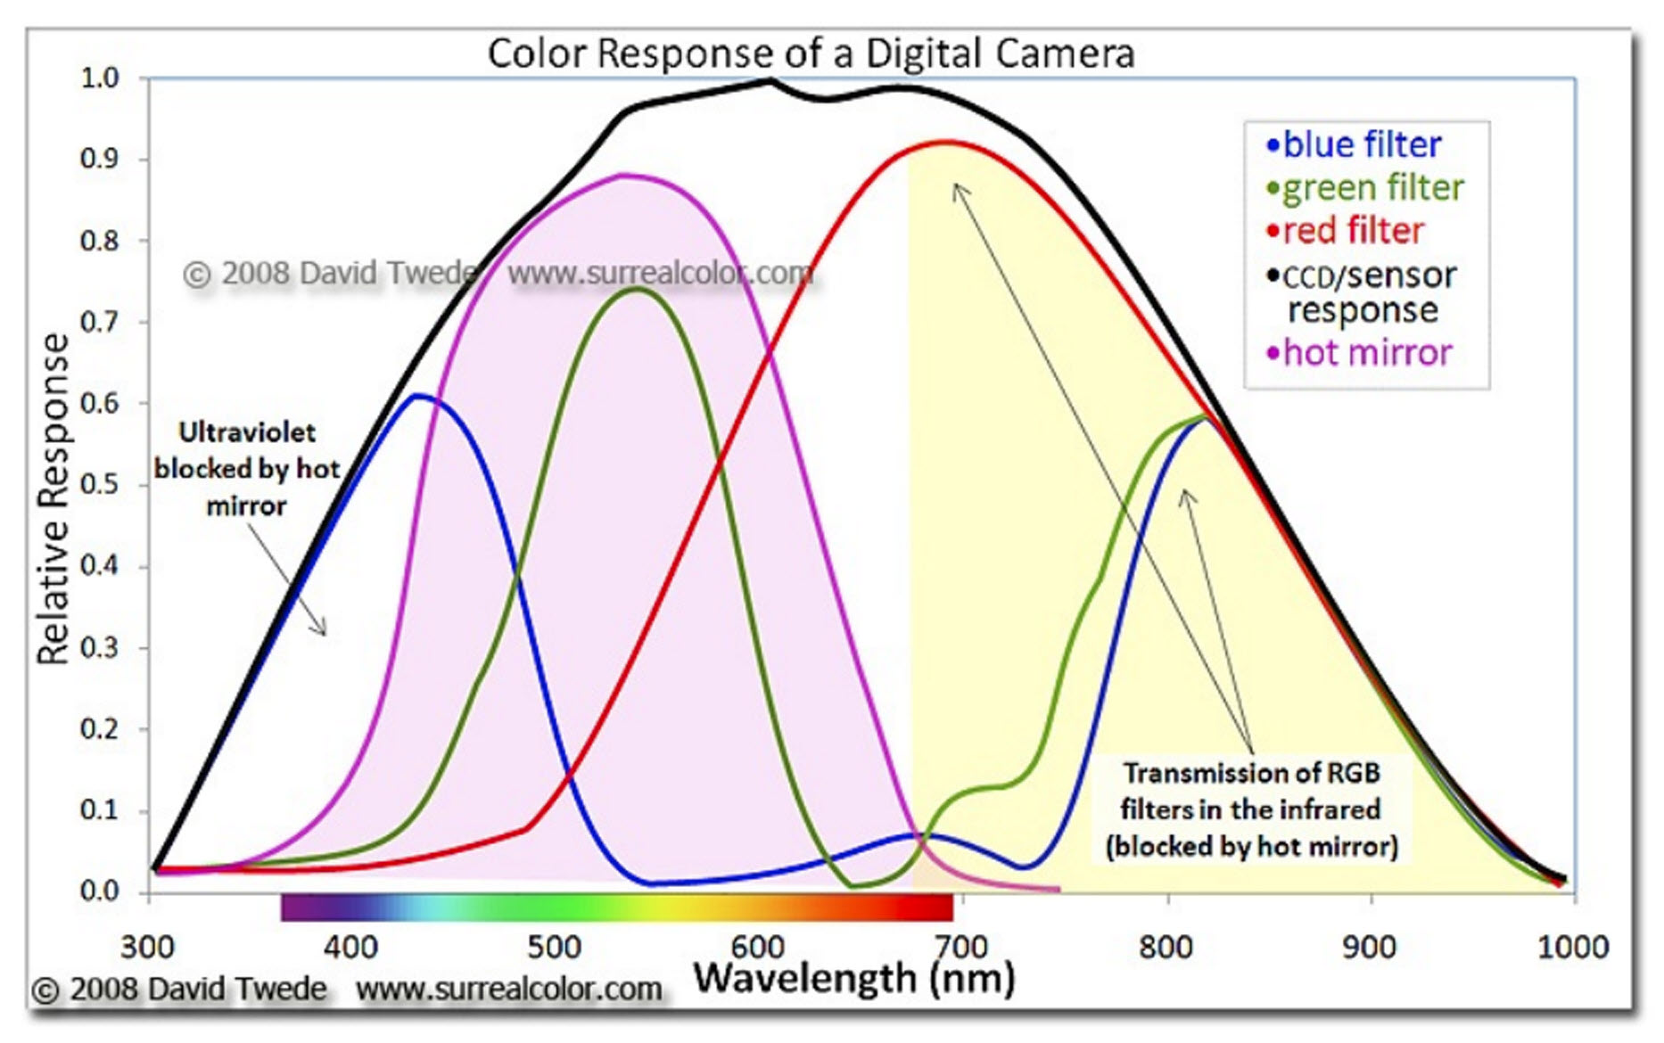
Digital Sensor Response
Light is visible to the sensor from ultraviolet (UV) through infrared (IR)
The human eye cannot see UV or IR so it is normally prevented from reaching the sensor by a hot mirror (cut filter)

Slide 3
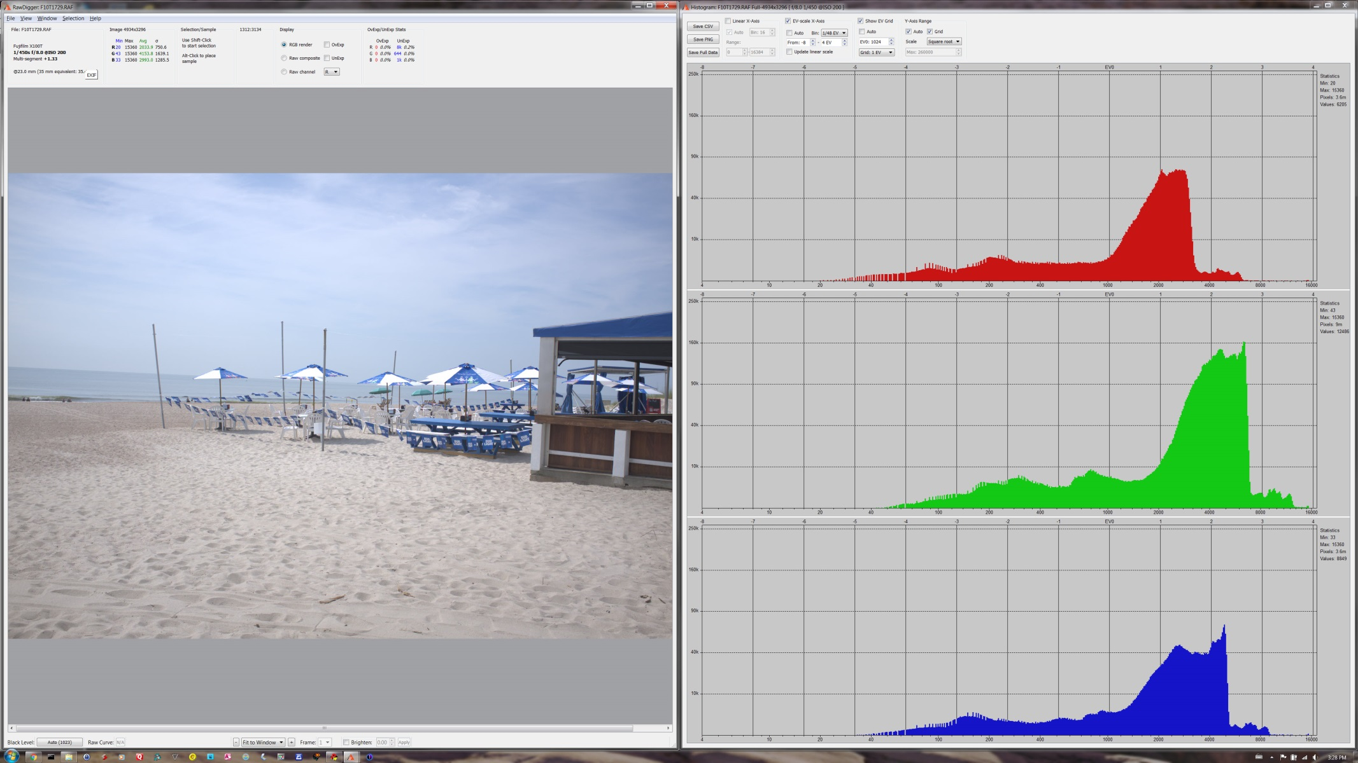
RawDigger display of raw histograms in a typical outdoor scene. The position of the green plot is slightly to the right of the blue and red plots.
Green is the predominant color used to determine luminance which are weighted about 72% green, 21% red and 7% blue.

Slide 4
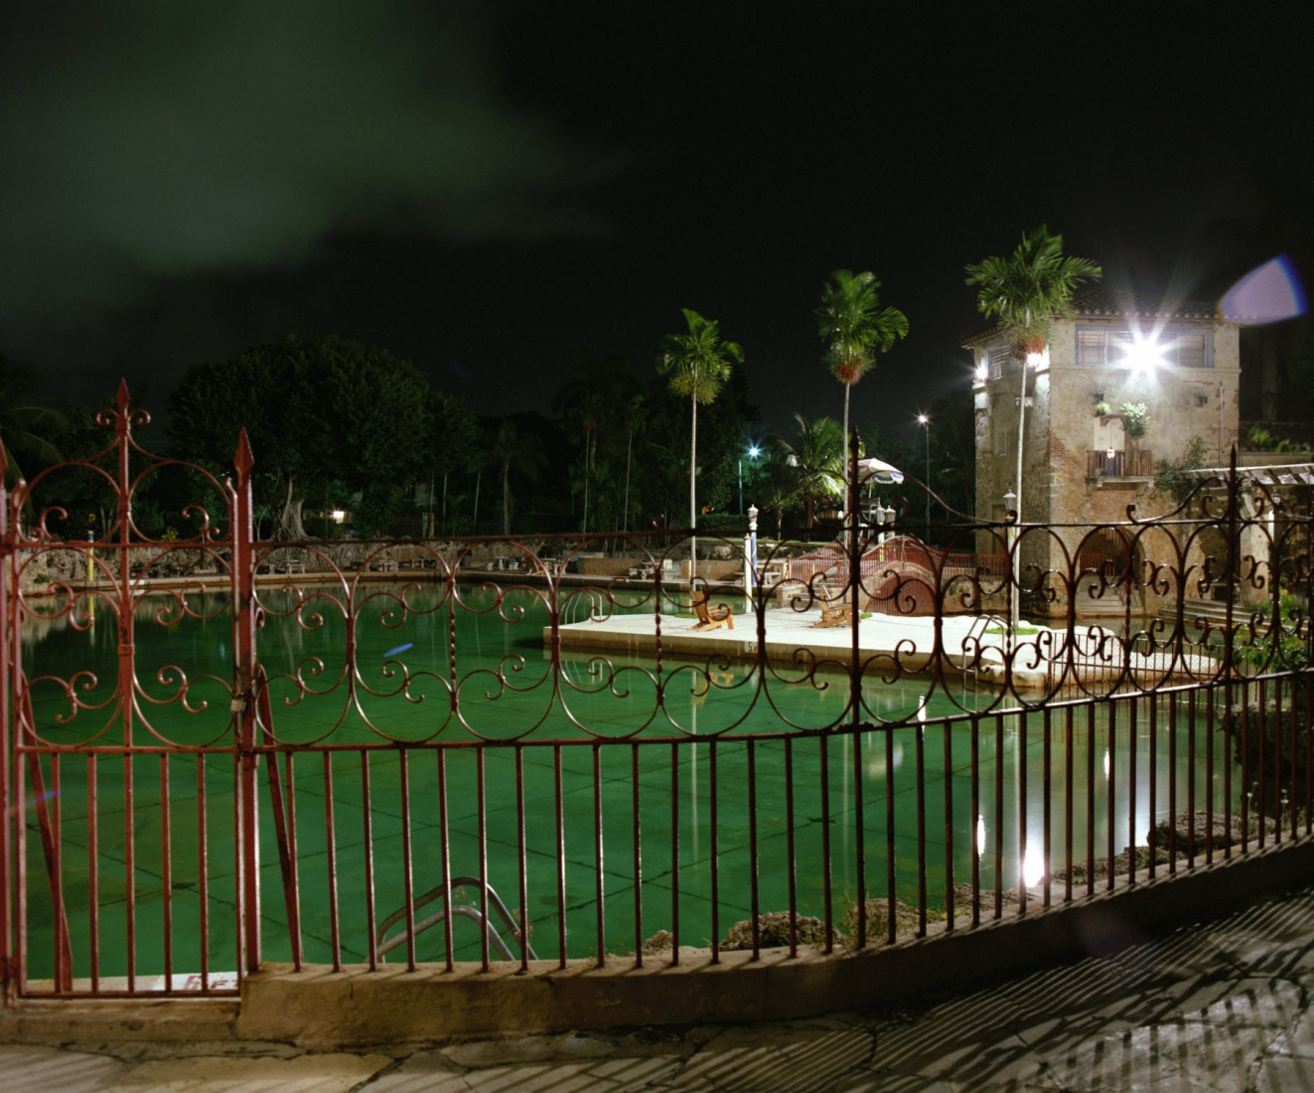
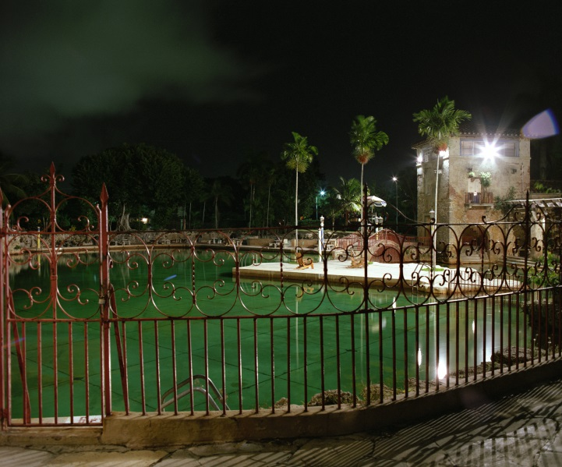
Colors can be saturated
Notes:
Venetian Pool, Coral Gables

Slide 5
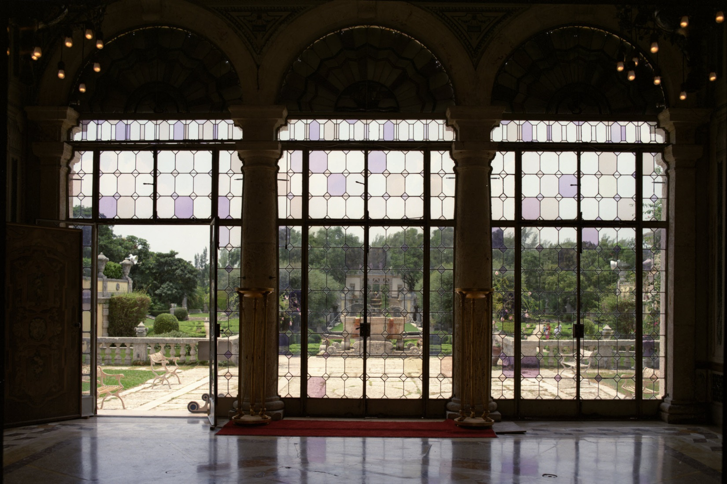
Or Subtle
Notes:
Viscaya, Miami

Slide 6
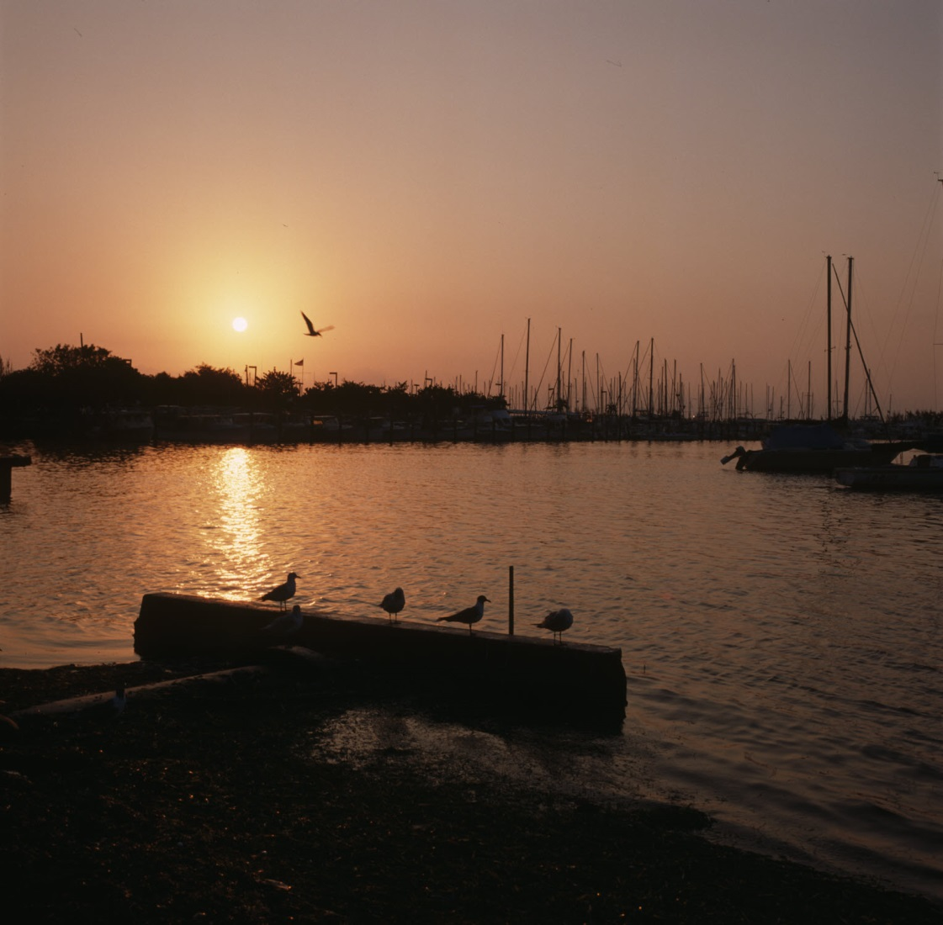
Color may be why we took the image
Notes:
Coconut Grove Marina

Slide 7
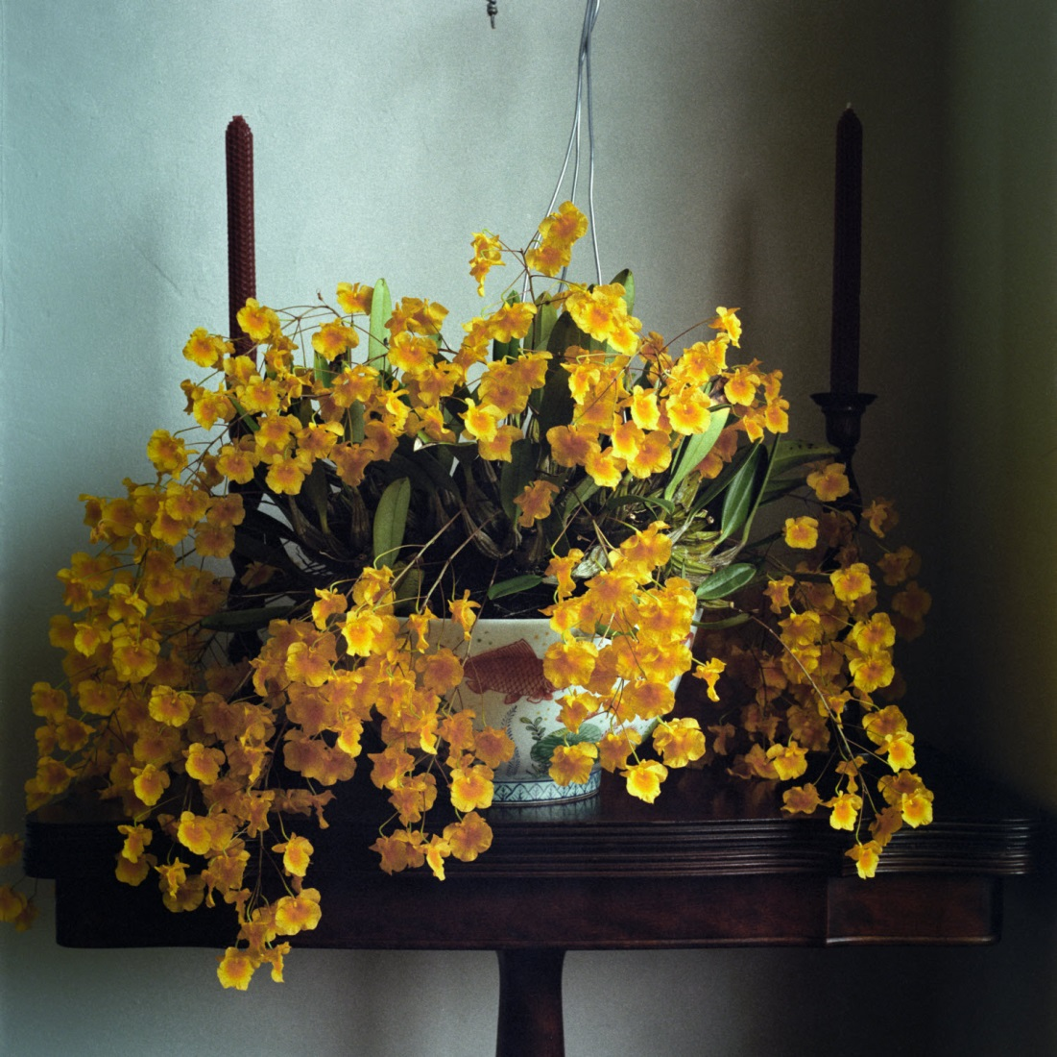

Slide 8
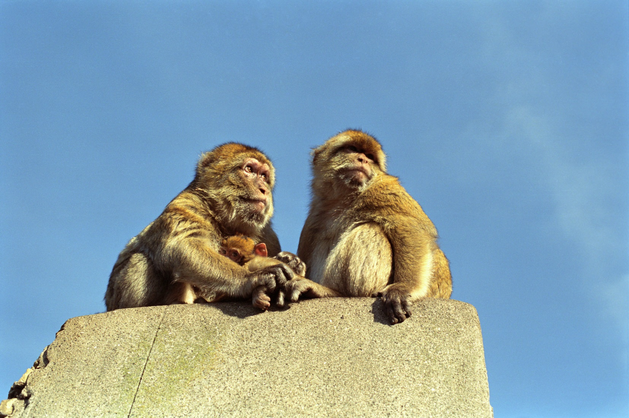
They make the image look real
Notes:
Gibraltar

Slide 9
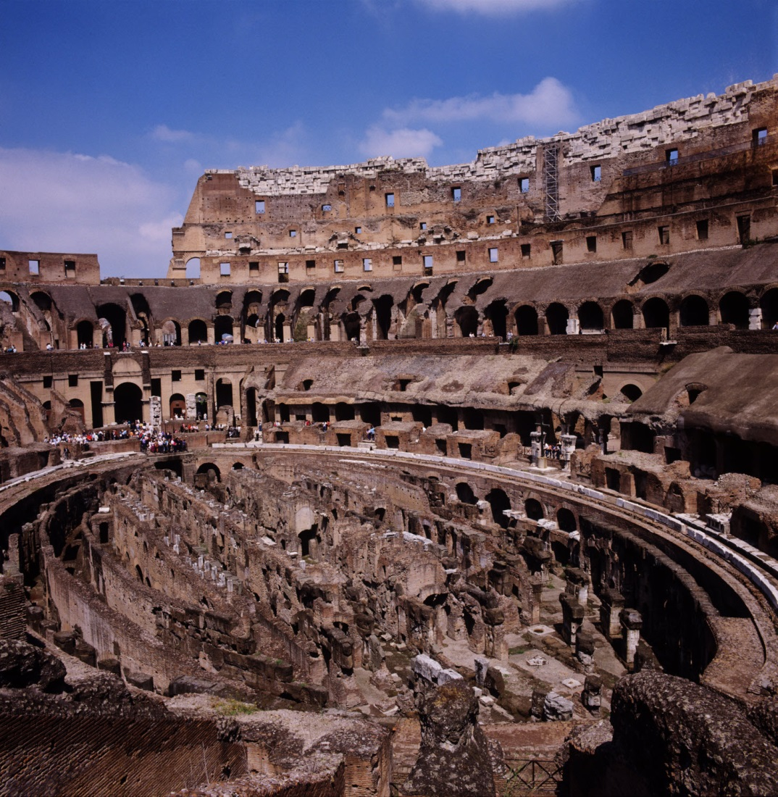
Notes:
Colosseum, Rome

Slide 10
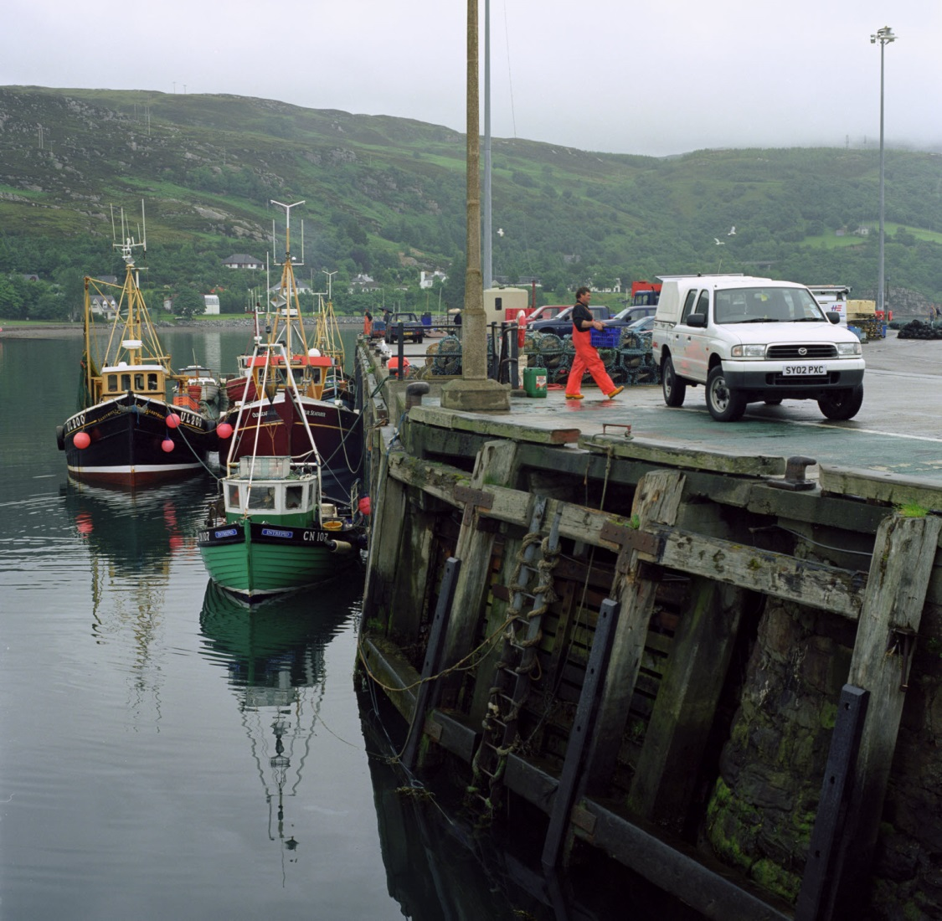
Notes:
Ullapool, Scotland

Slide 11
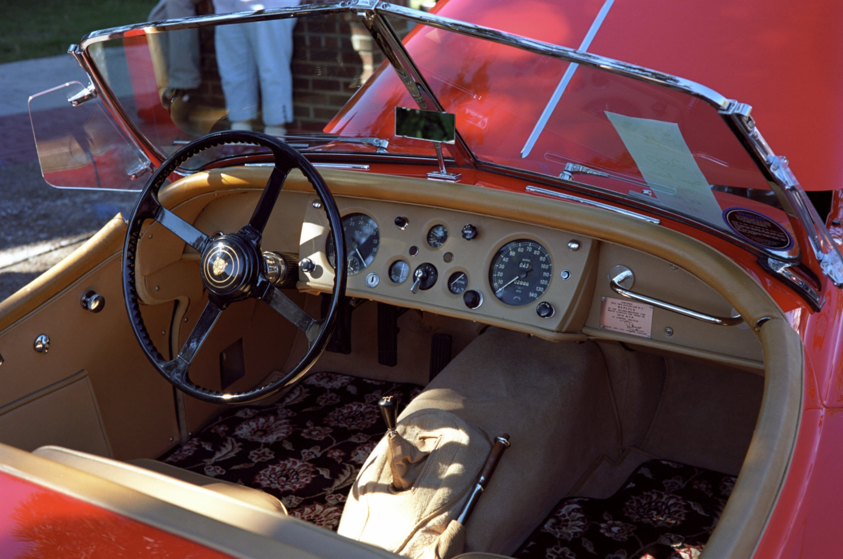
Notes:
2012 Fall car show

Slide 12
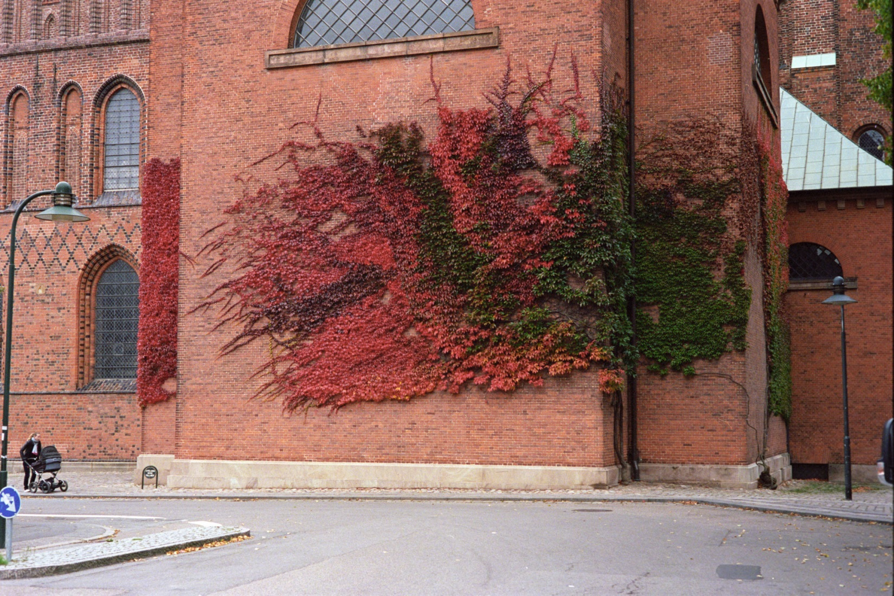
Notes:
Roskilde, Denmark

Slide 13
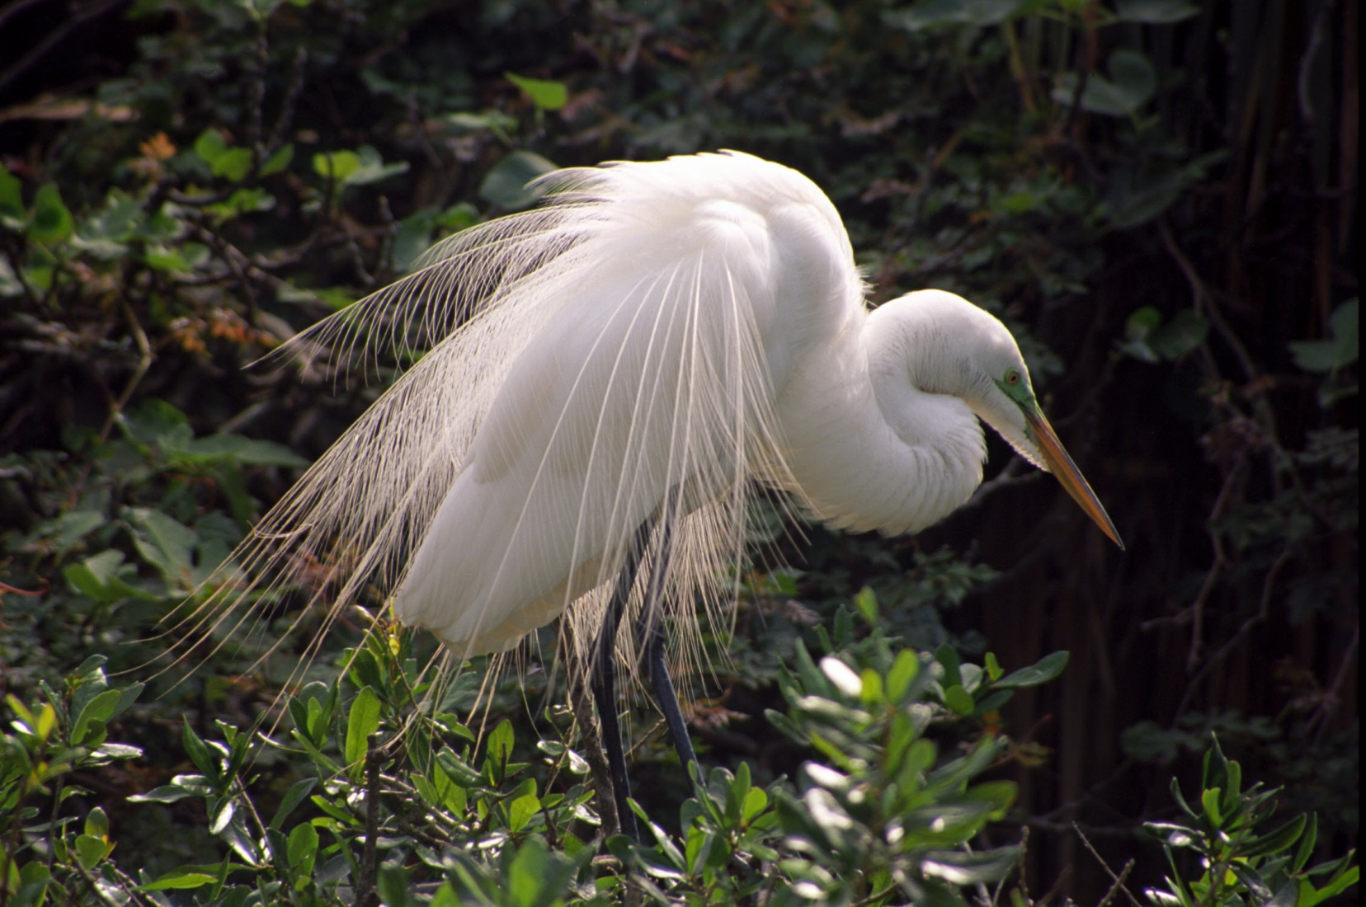
Notes:
2013 Alligator Farm Ektachrome 100

Slide 14
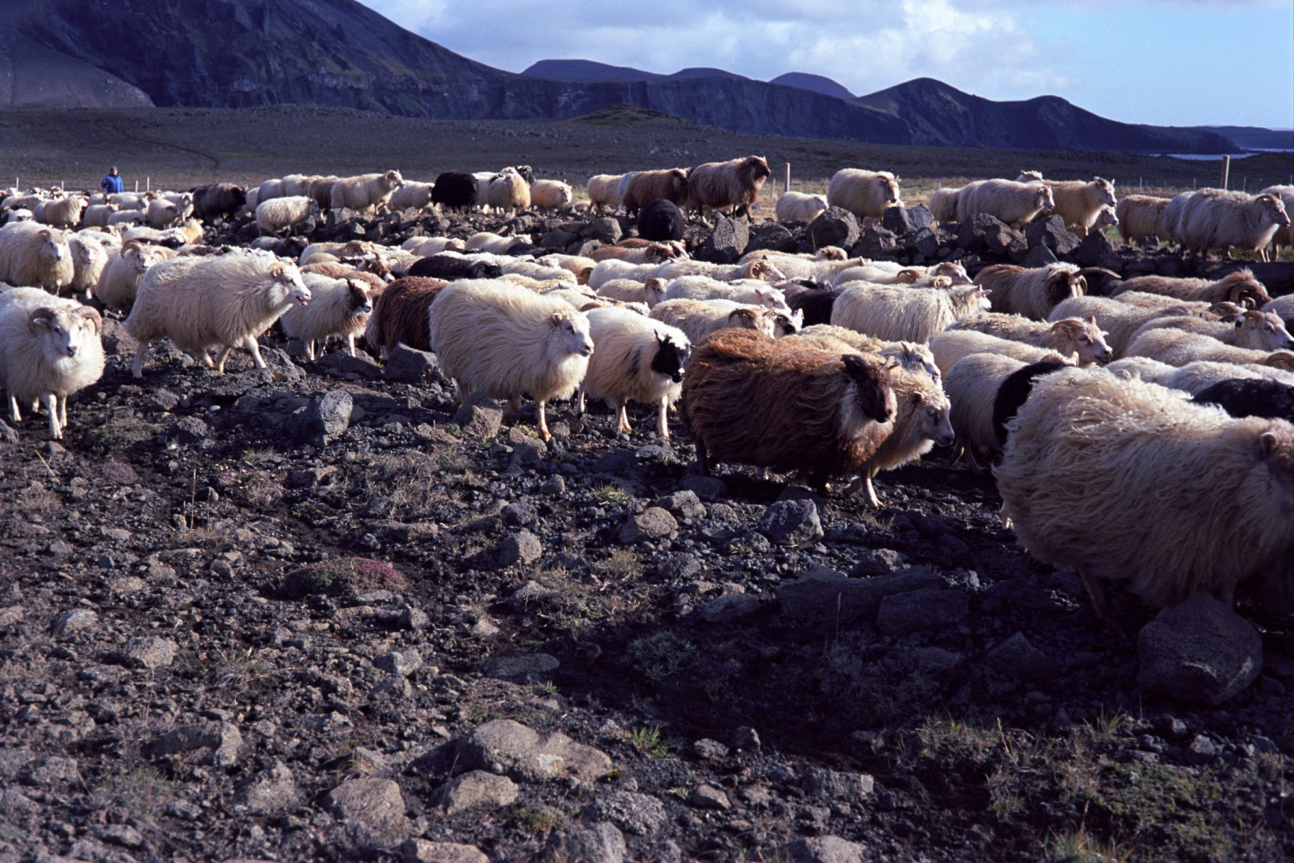
Notes:
2013 Iceland

Slide 15
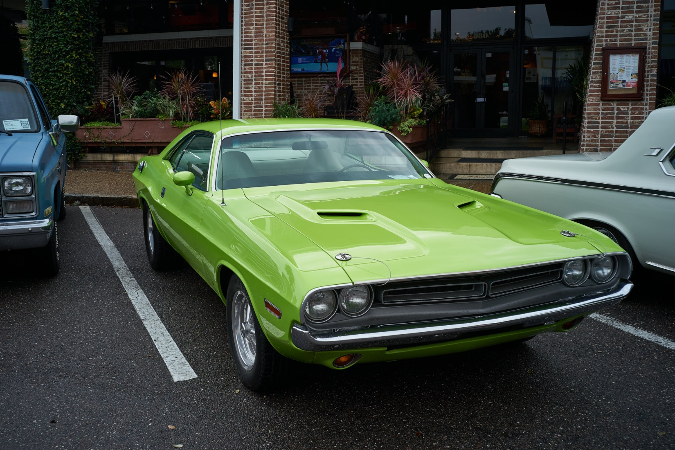
Notes:
2019 Fall car show Sony A7 II

Slide 16
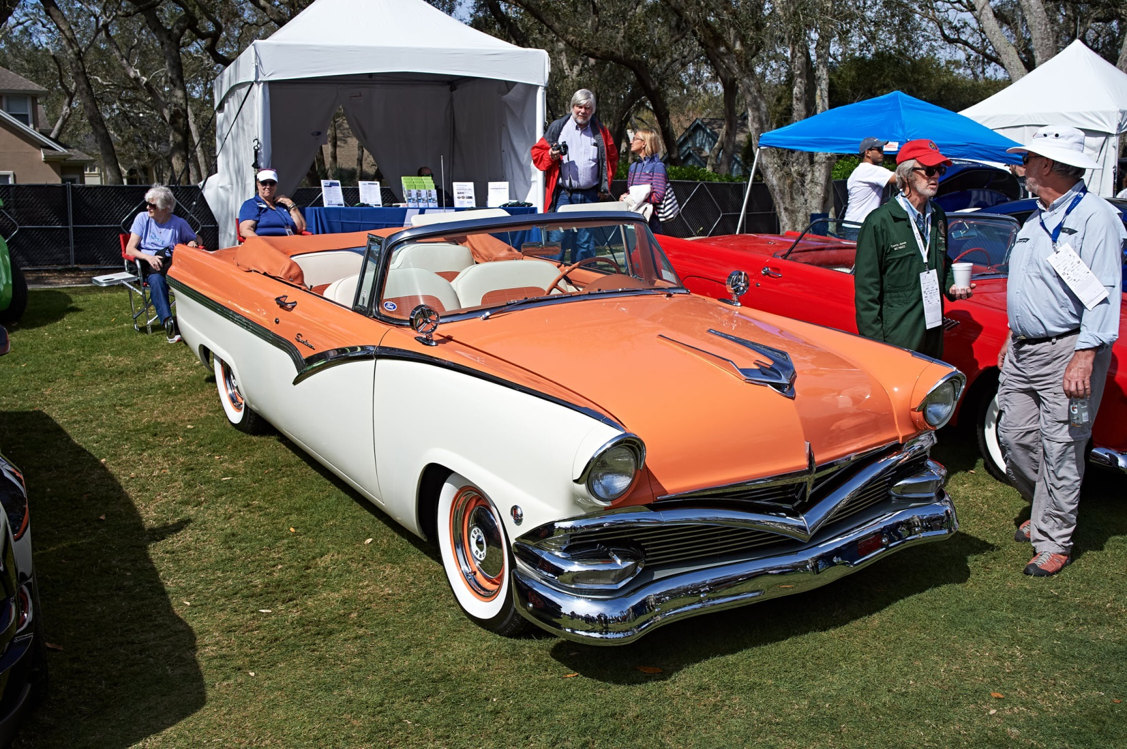
Notes:
2018 Concourse Nikon Df

Slide 17
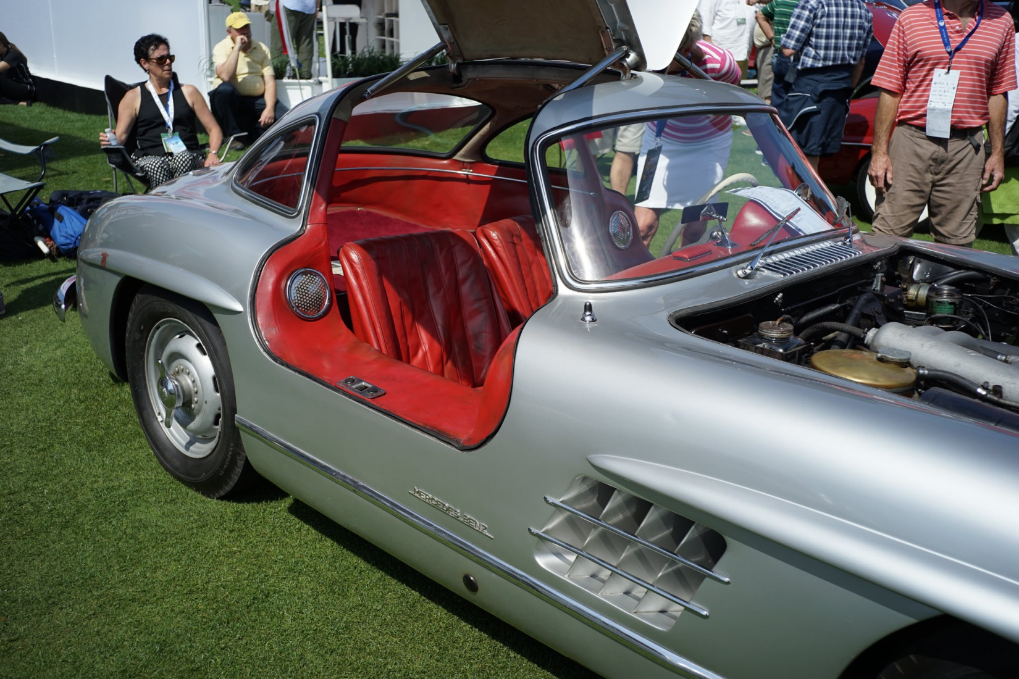
Notes:
2014 Concourse Sony A7 II

Slide 18
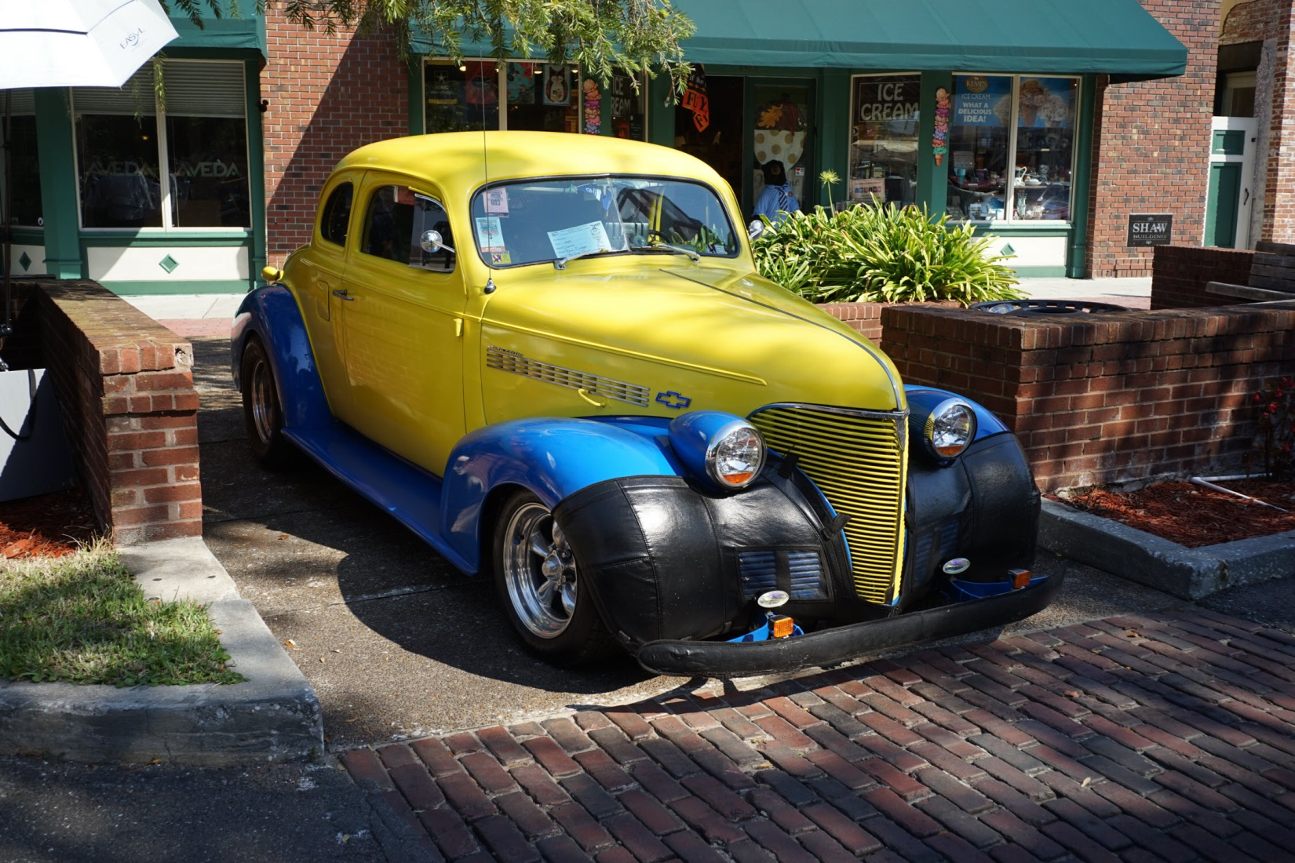
Notes:
2015 Fall car show Sony A7 II

Slide 19
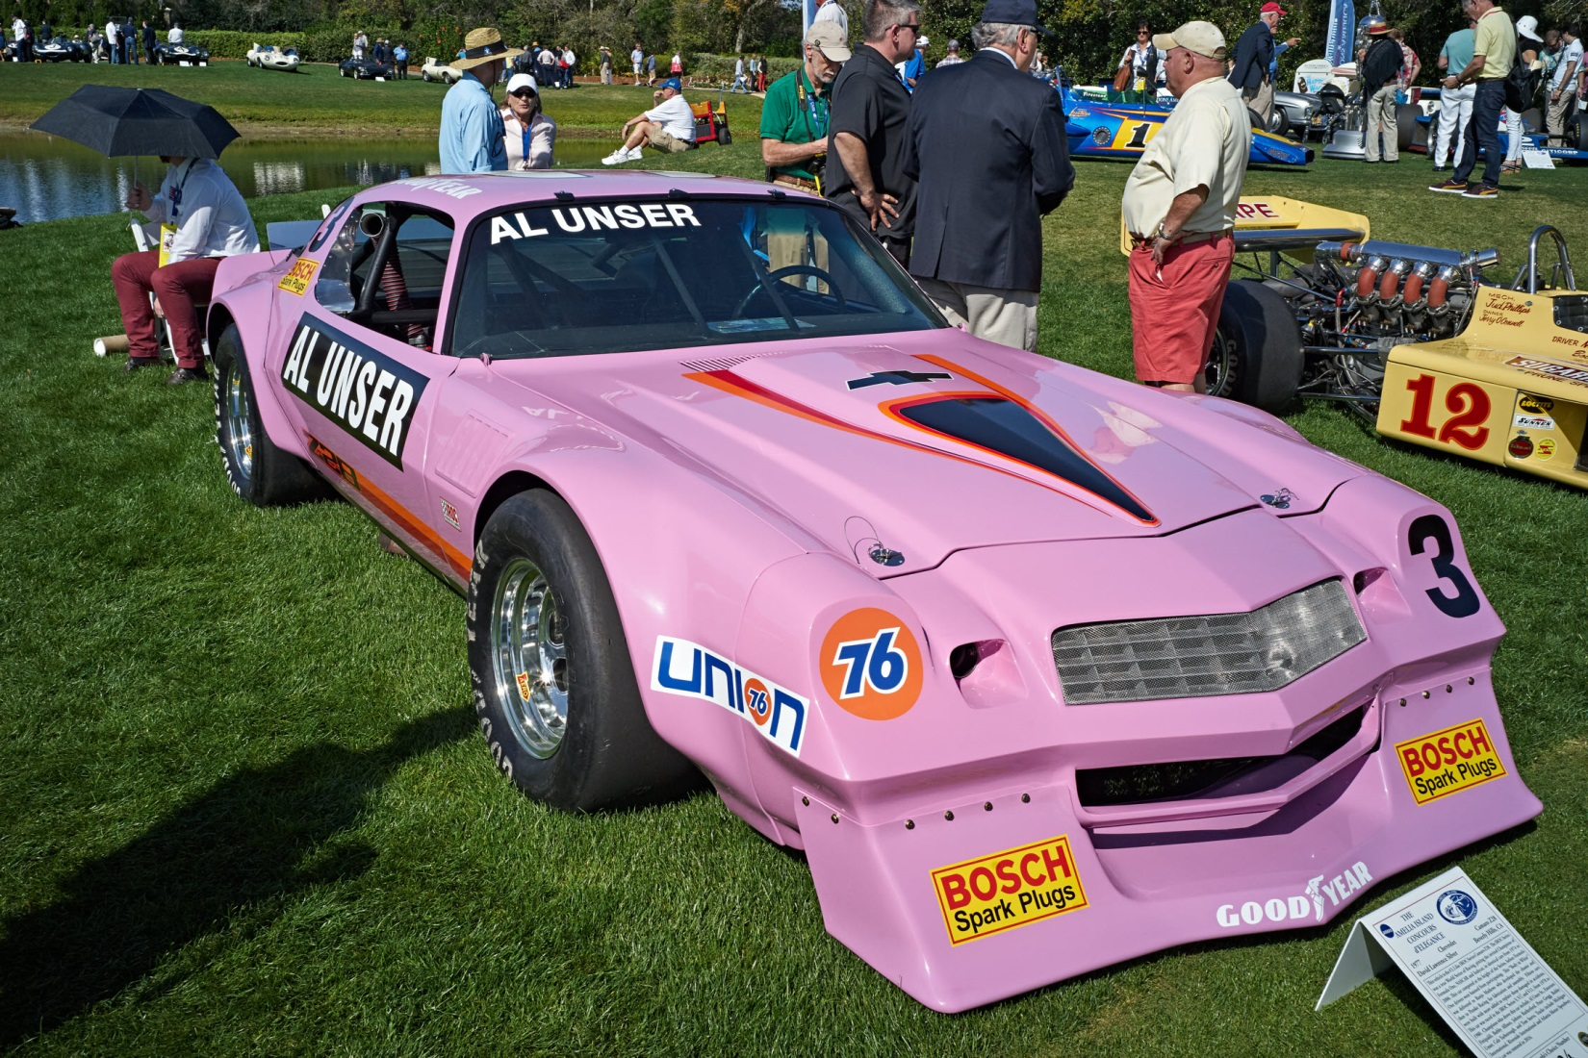
Notes:
2017 Concourse Sony A7 II

Slide 20
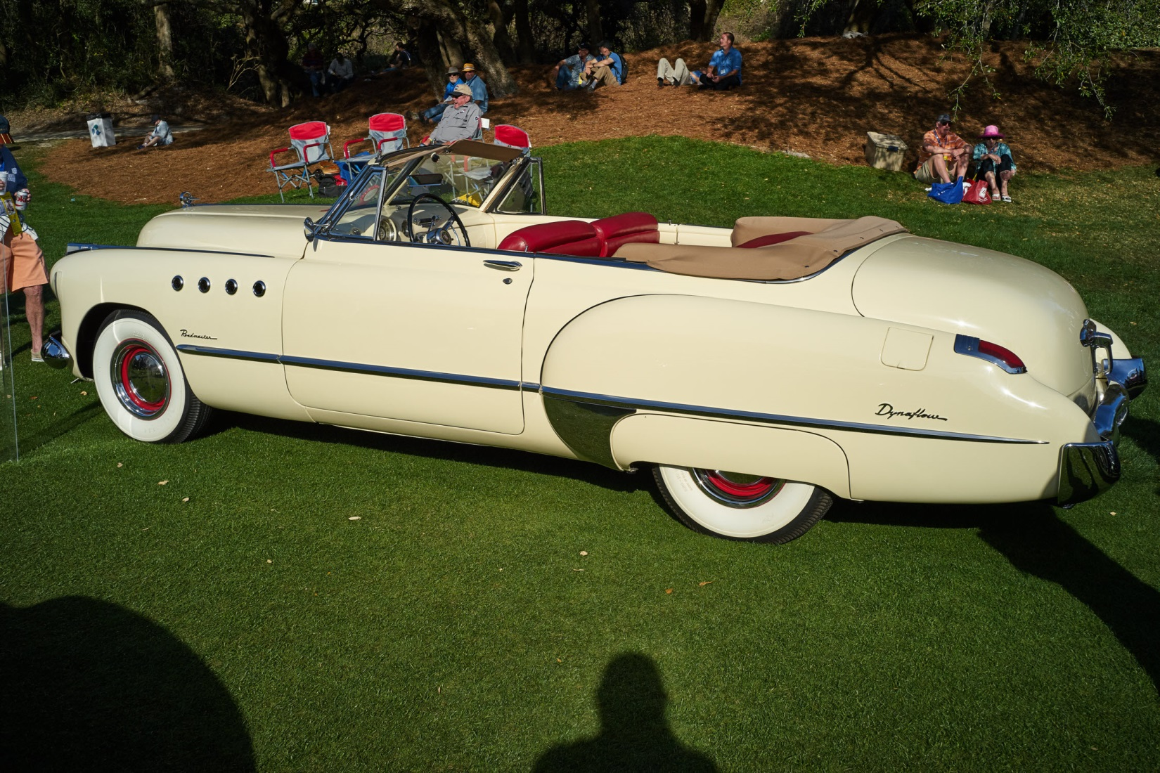
Notes:
2017 Concourse Sony A7 II

Slide 21
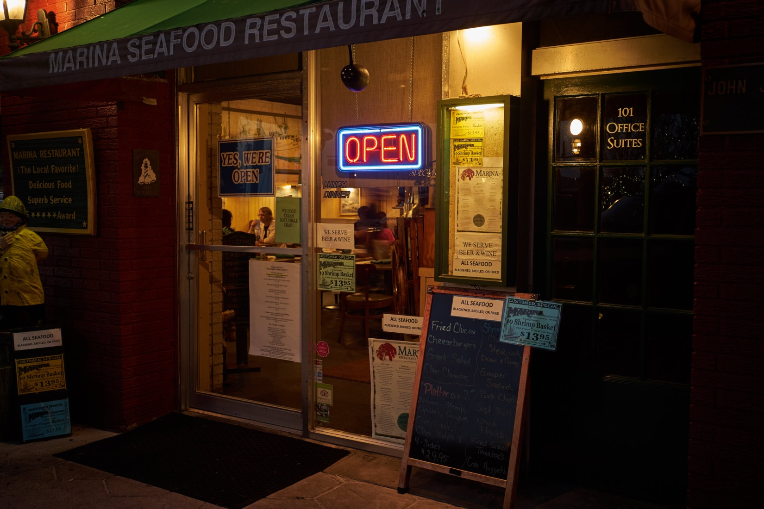
Notes:
2017 Downtown Sony A7 II

Slide 22
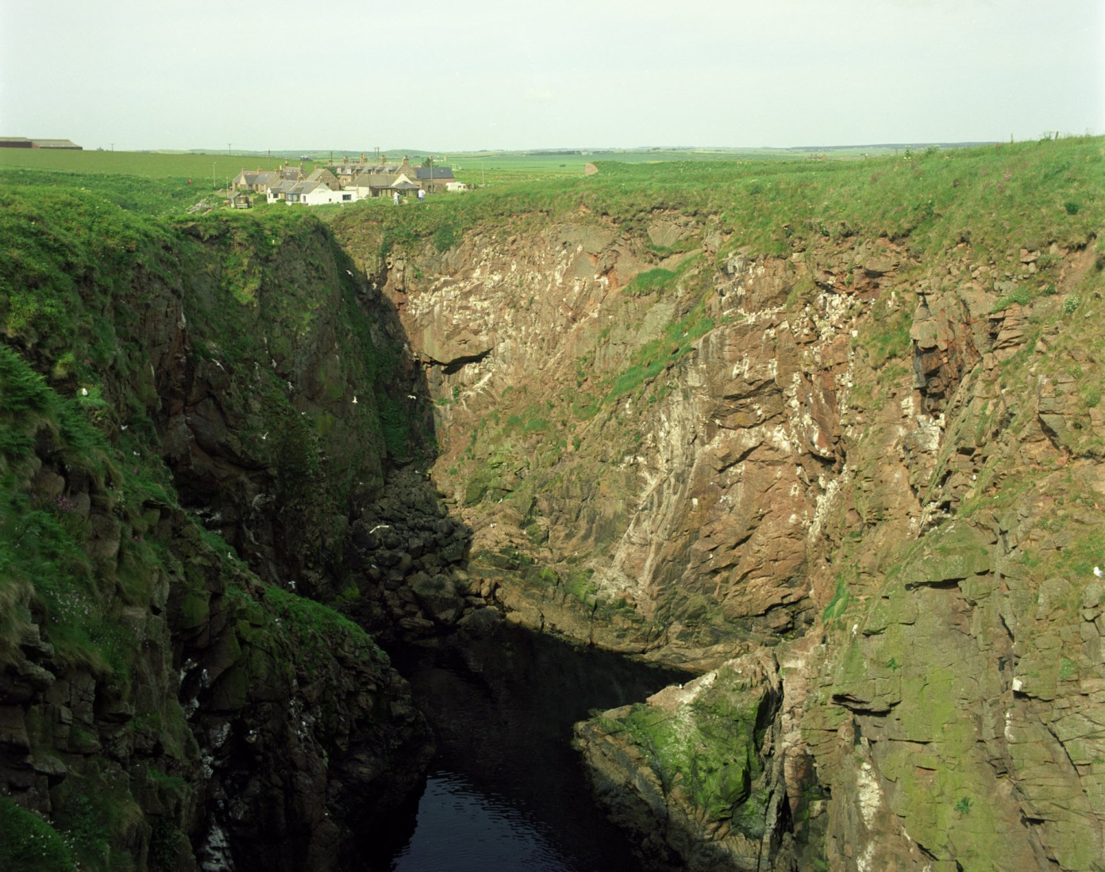

Sometimes we want something other than color (2013)
Notes:
2003 Bullers of Buchan, Aberdineshire, Scotland Hasselblad Kodak 160 NC

Slide 23
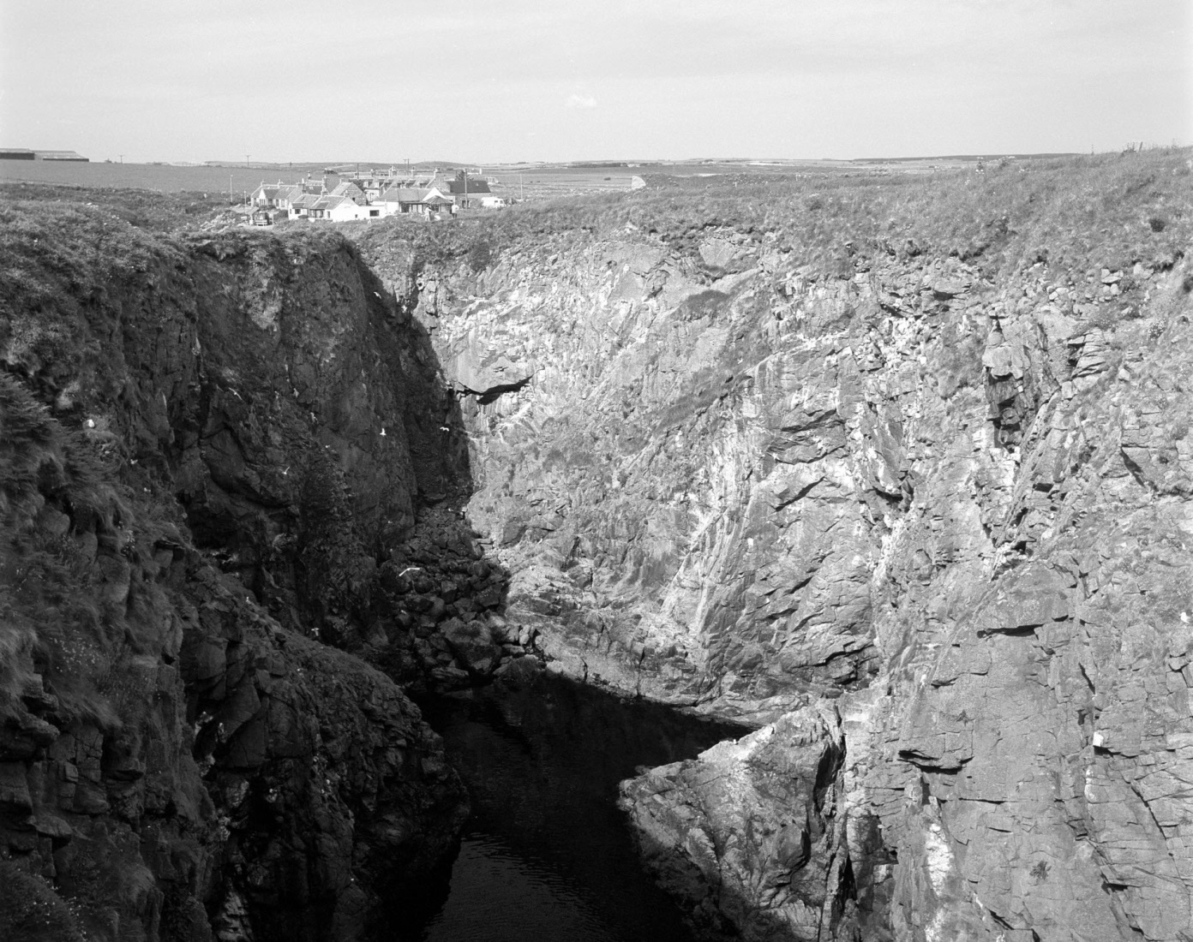
The green was not what I wanted

Slide 24
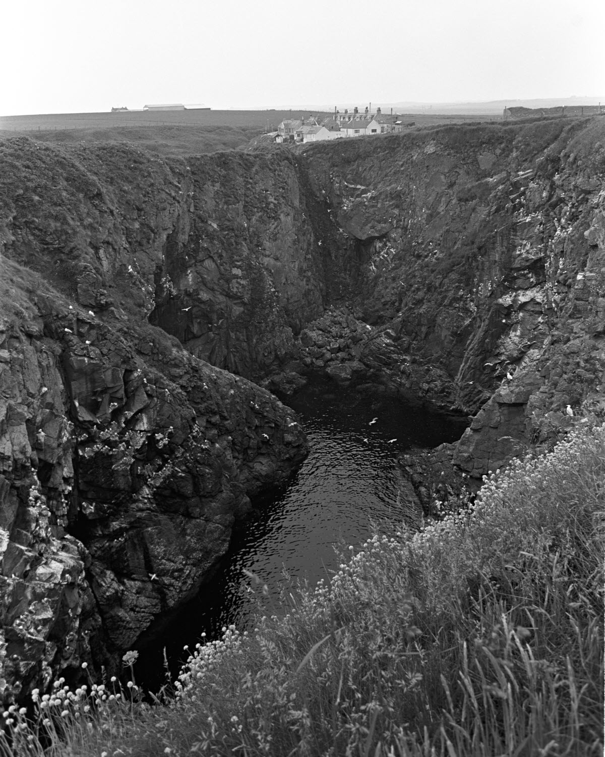
Same location 1983 on B&W film
Notes:
1983 Nikon F3, 24mm, Kodak Tech Pan

Slide 25
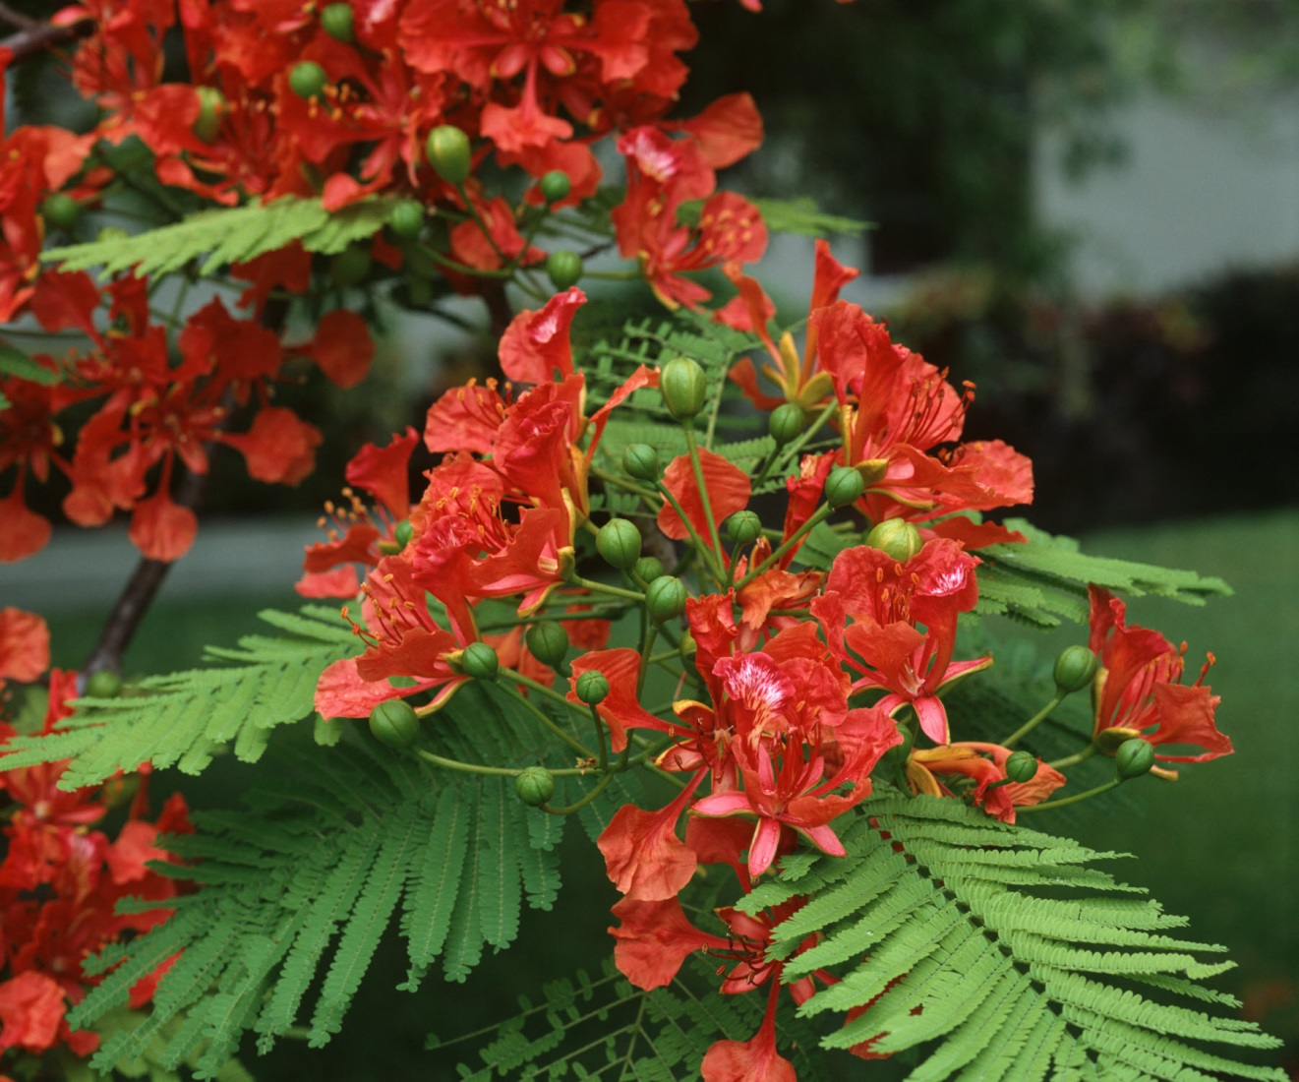
Colors facilitate different conversions
Notes:
1984 Ektachrome Plus

Slide 26
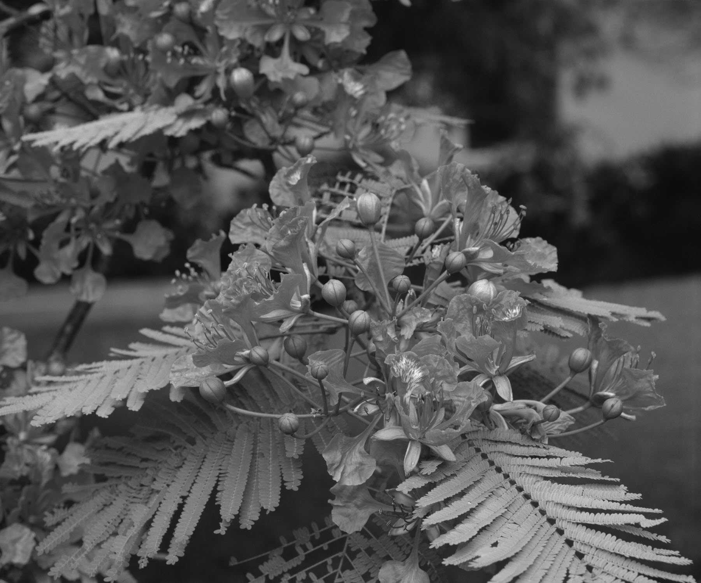
Basic conversion to B&W (desaturation)

Slide 27
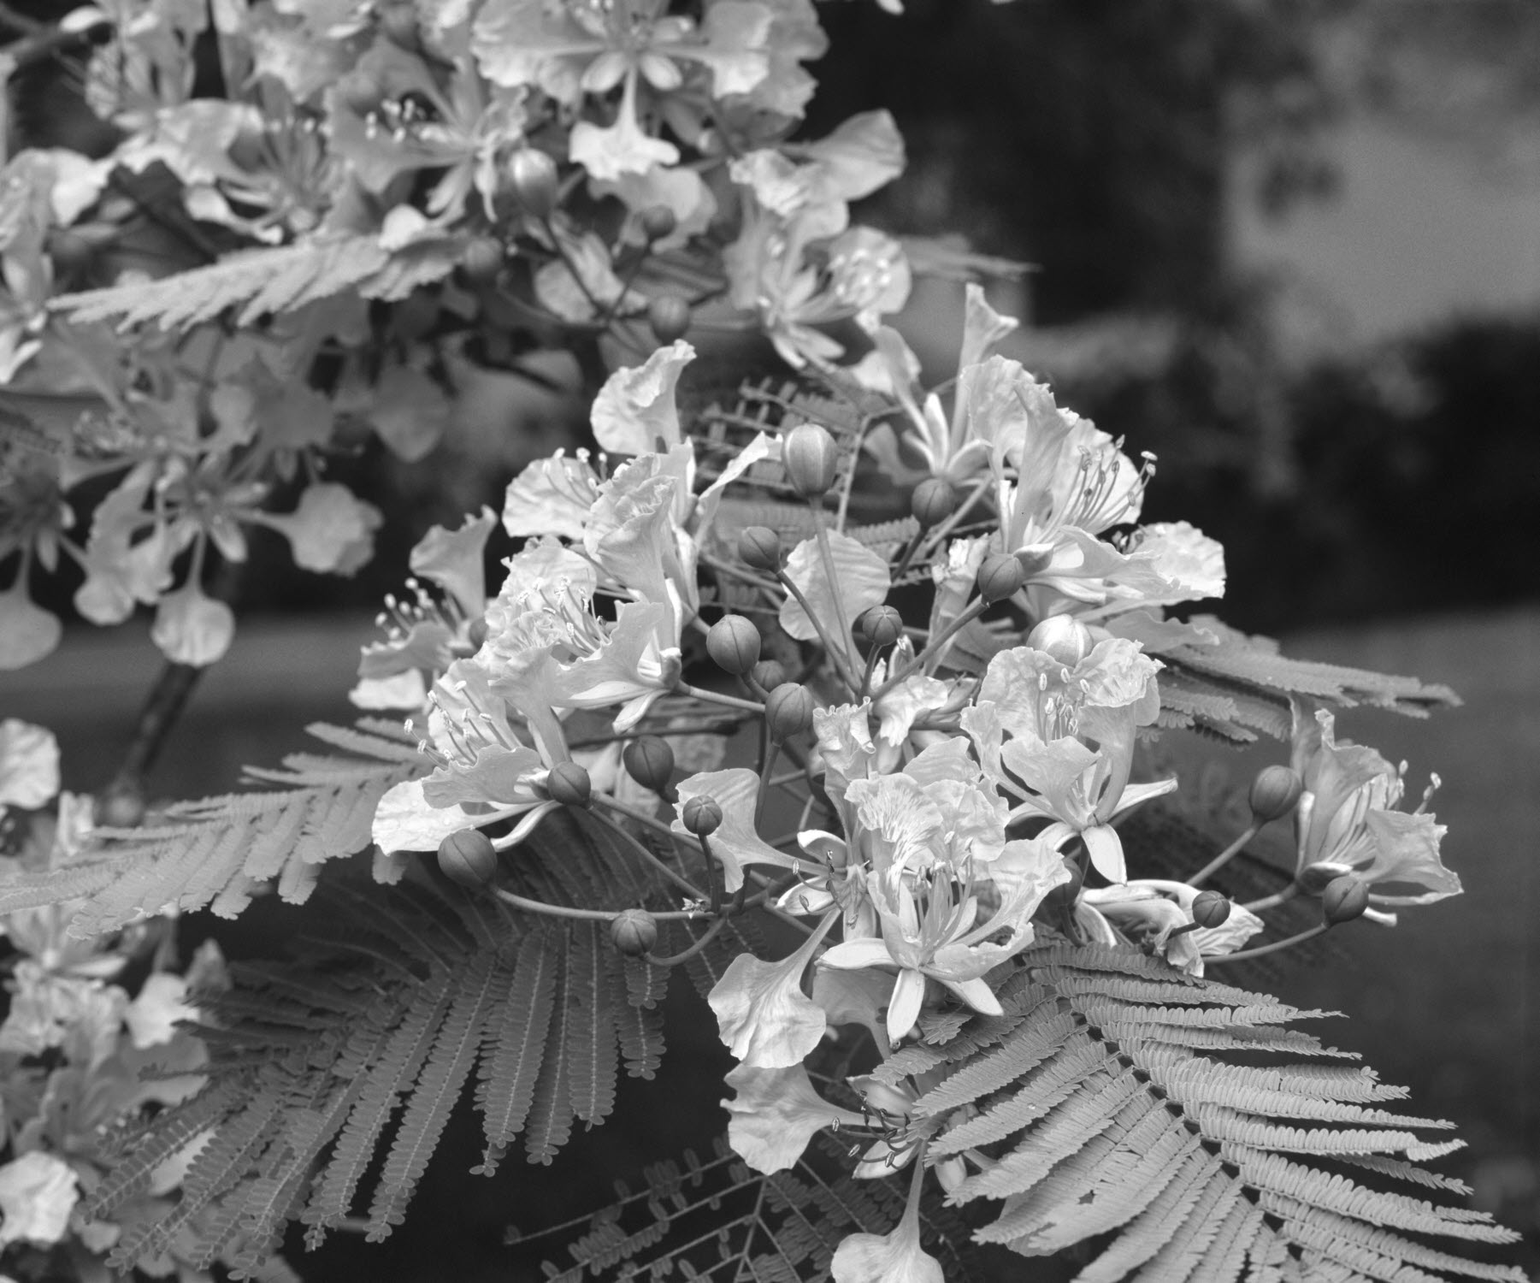
Red made brighter

Slide 28
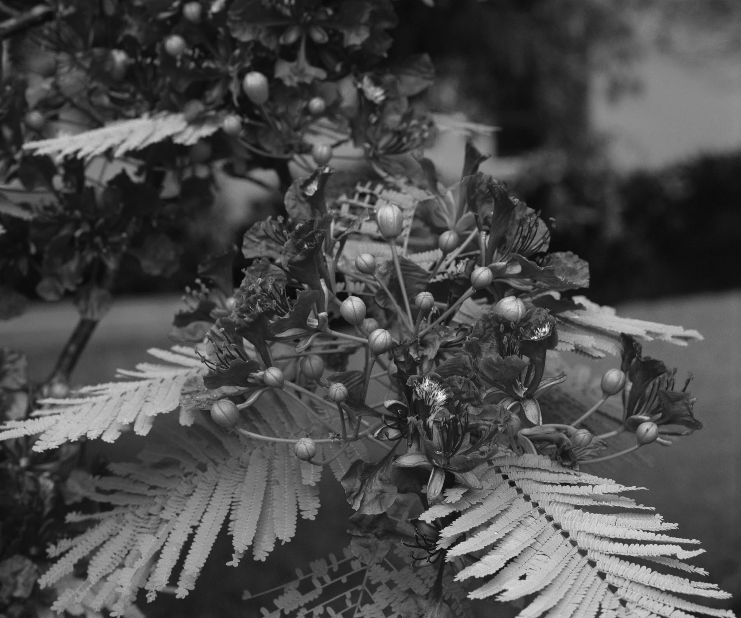
Red made darker

Slide 29
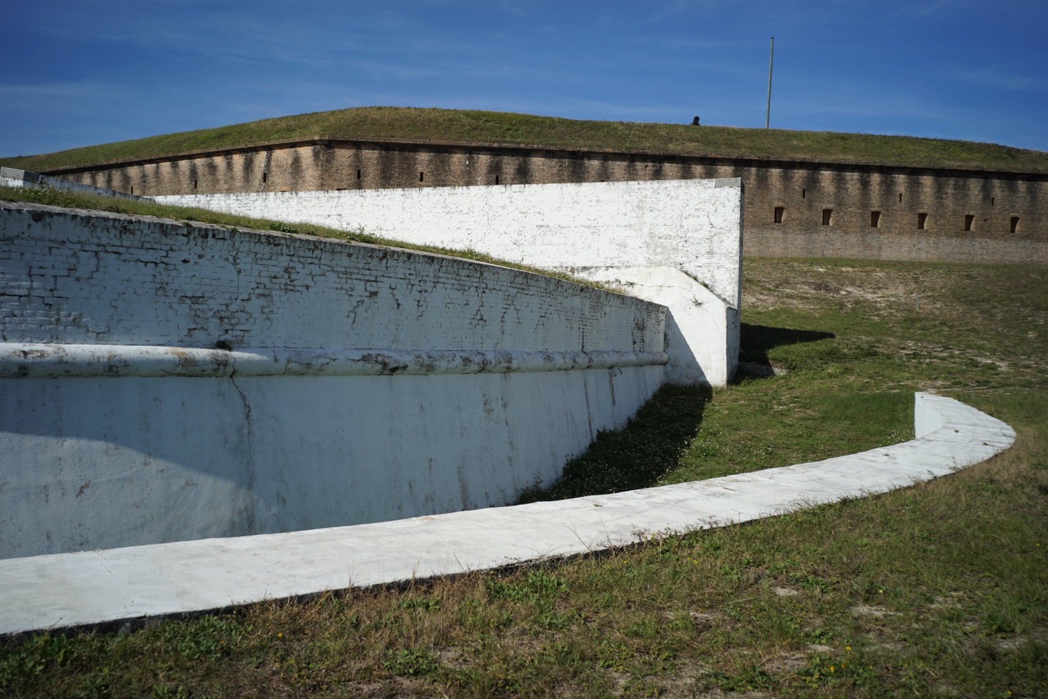
Fort Barrancas, Pensacola
Notes:
2015 Sony A7 II

Slide 30
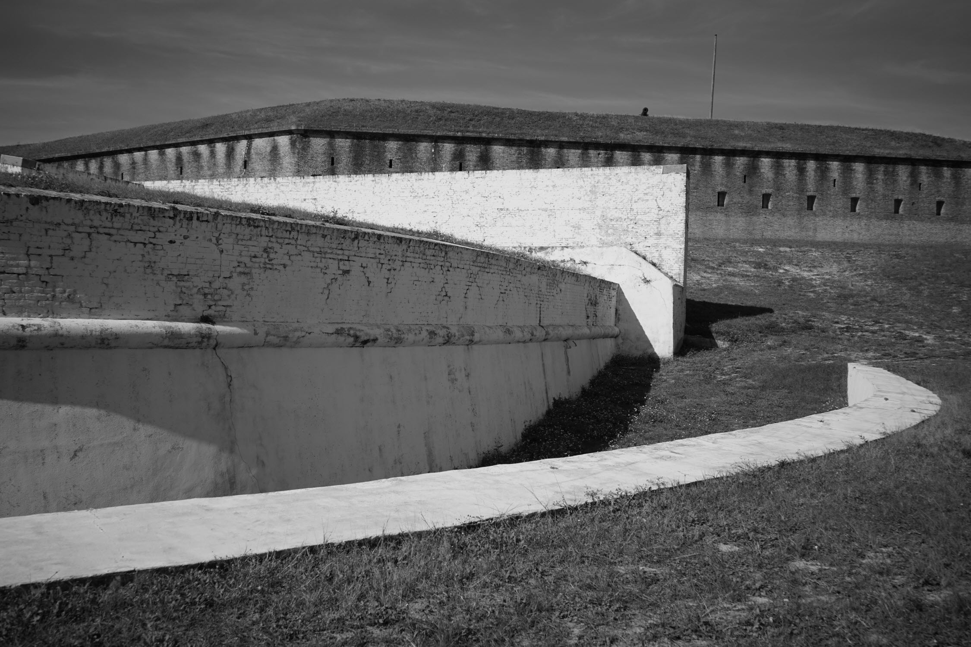
Basic conversion

Slide 31
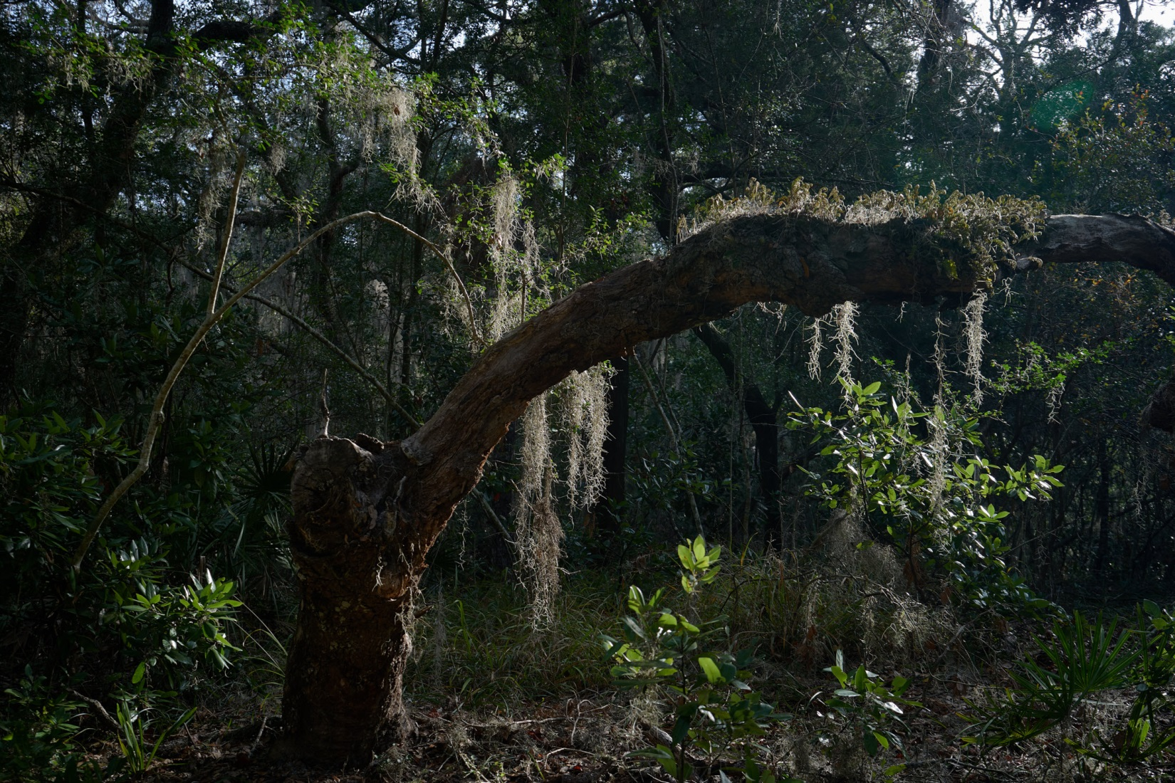
Fort Clinch Road
Notes:
2017 Fort Clinch Drive Sony A7 II

Slide 32
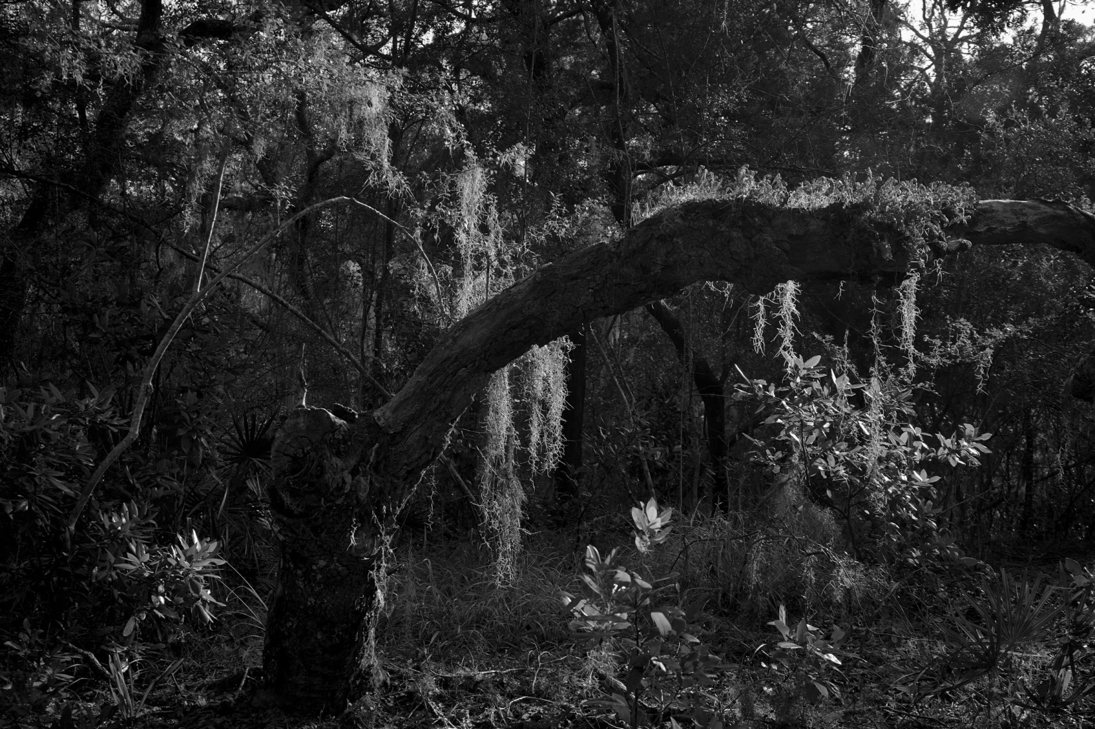
B&W separated the moss from the green foliage

Slide 33
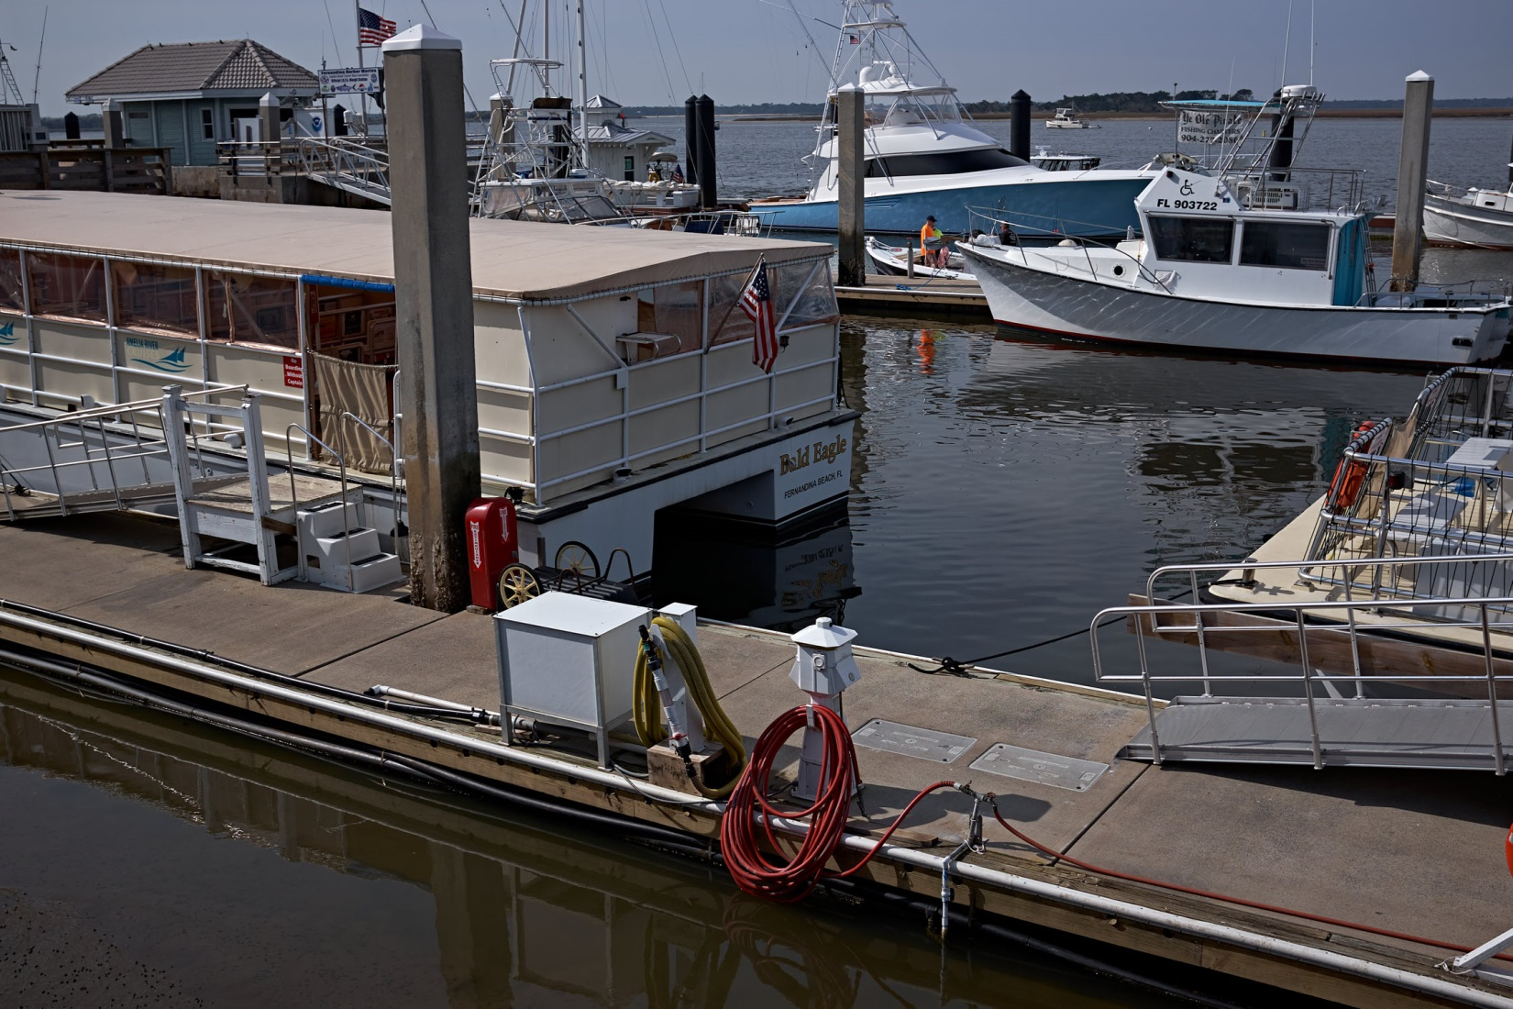
Marina floating docks colors might be distracting
Notes:
2021 Fuji X100T

Slide 34
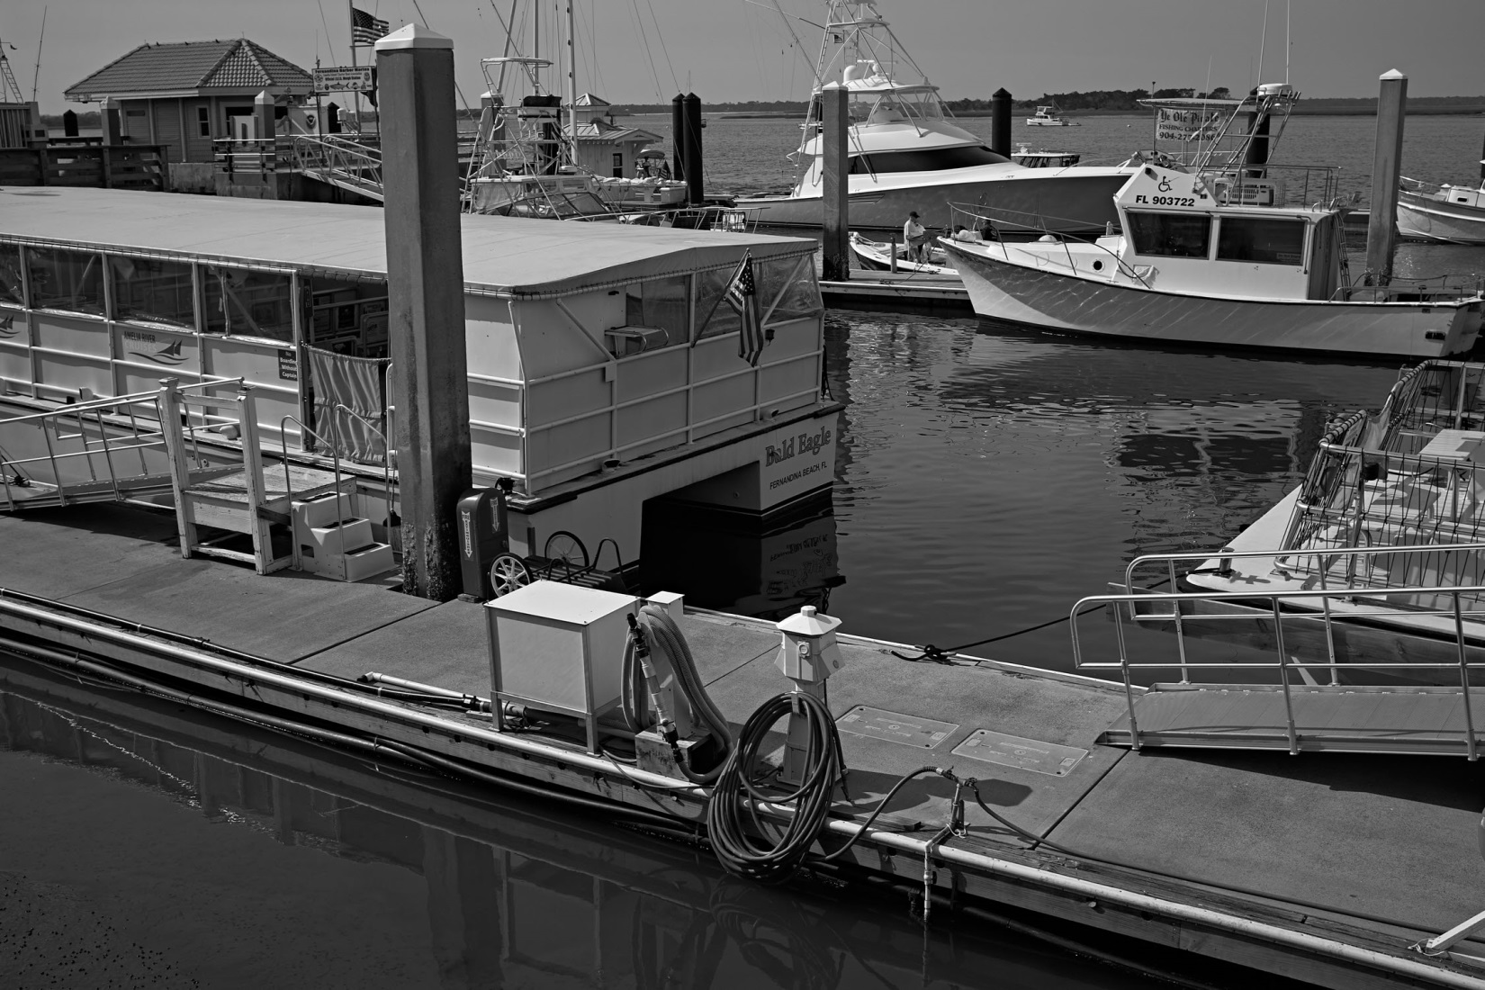
Distractions reduced

Slide 35
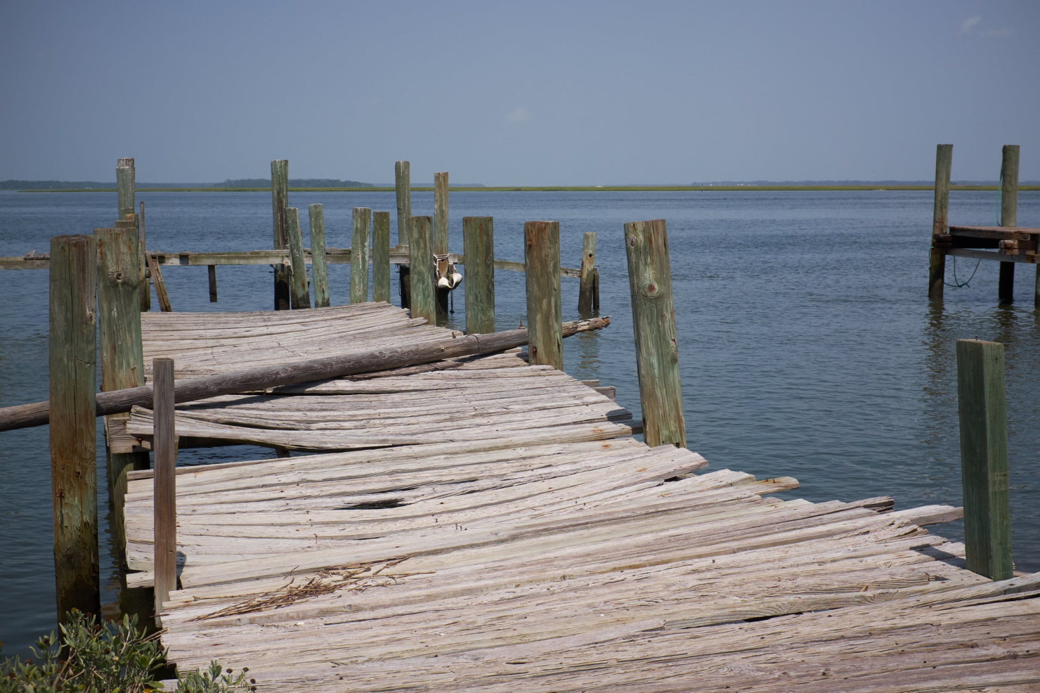
Dock – blue sky and water and green pilings compete for attention
Notes:
2019 Fuji X100T

Slide 36
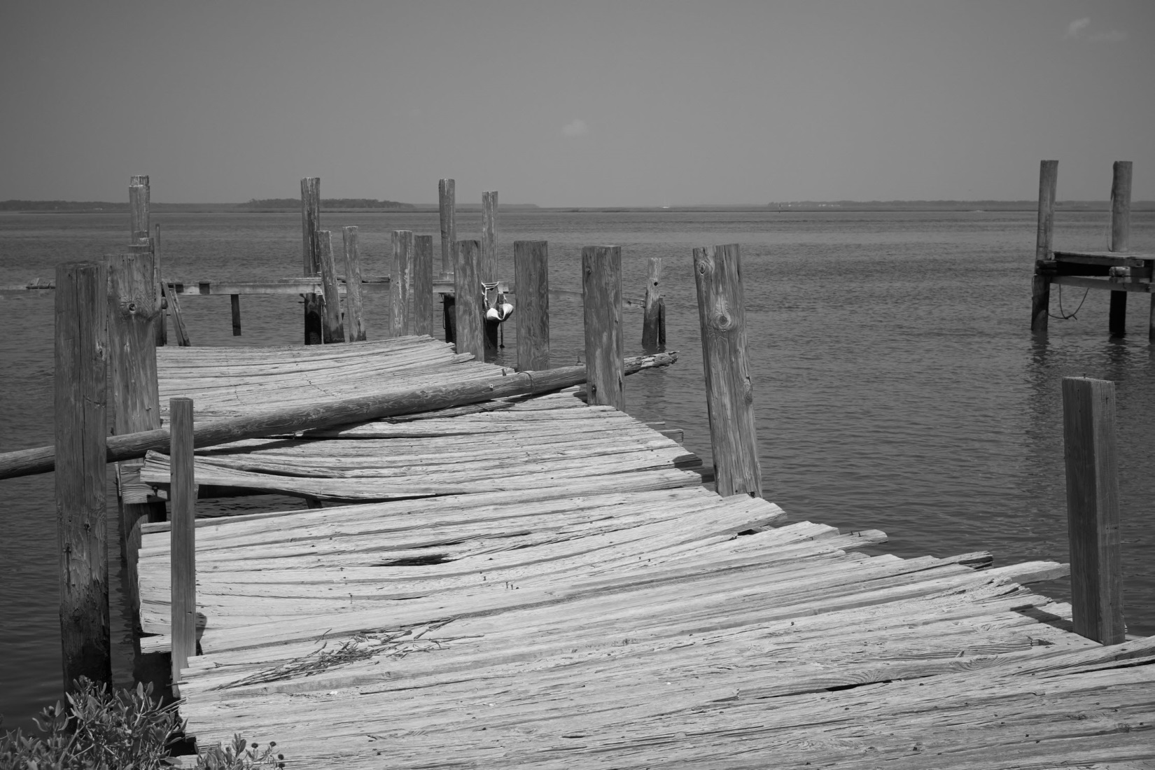
Removing the colors draws attention to the planks

Slide 37
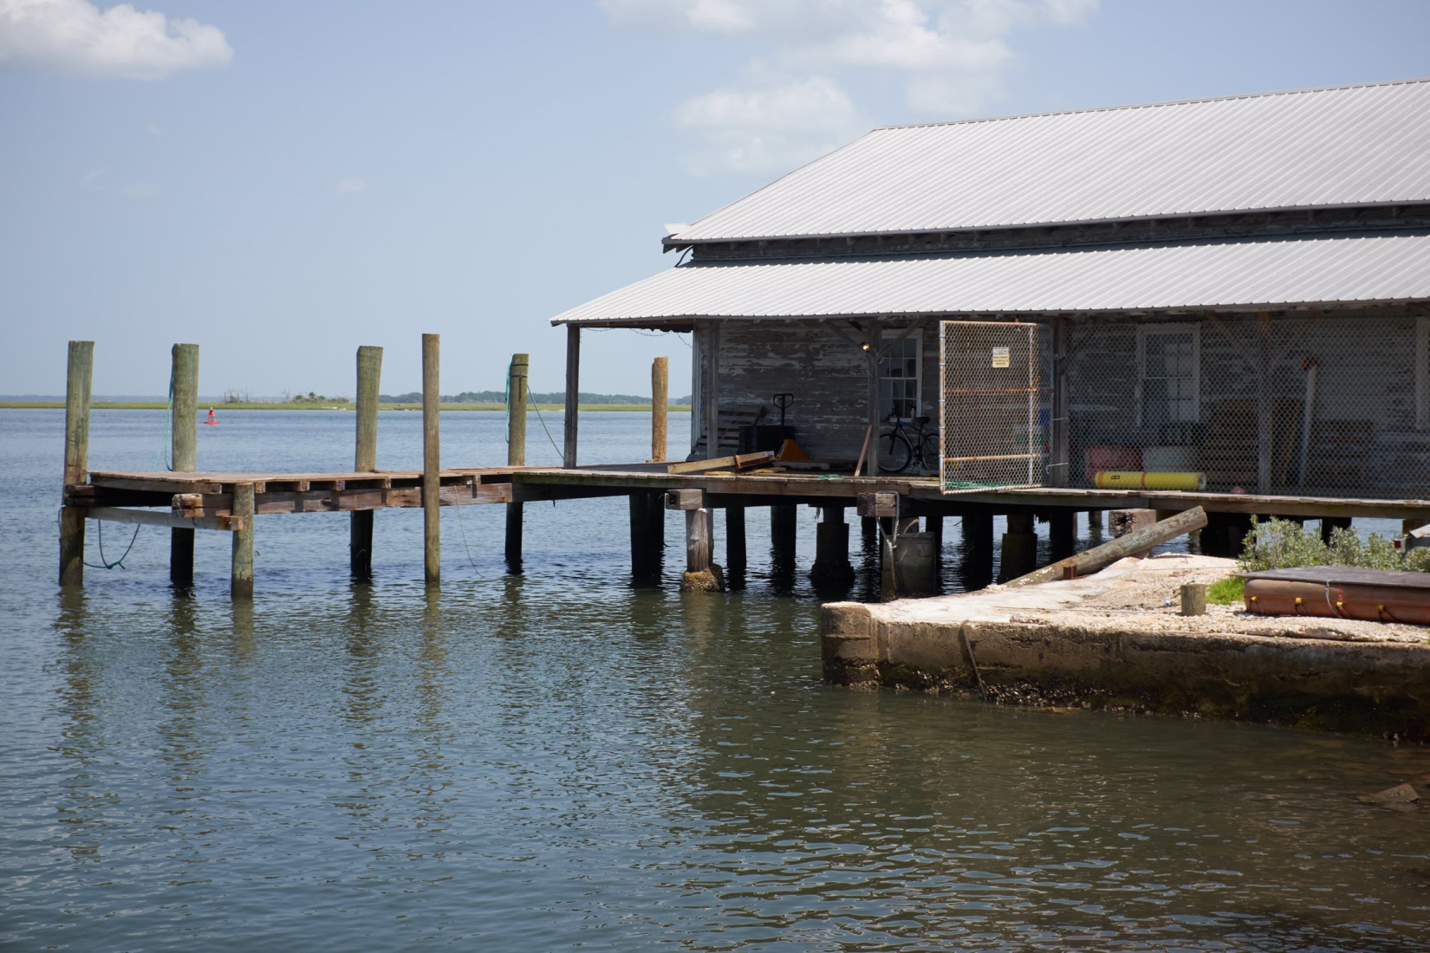
Colored objects draw the viewer’s attention
Notes:
2019 Fuji X100T

Slide 38
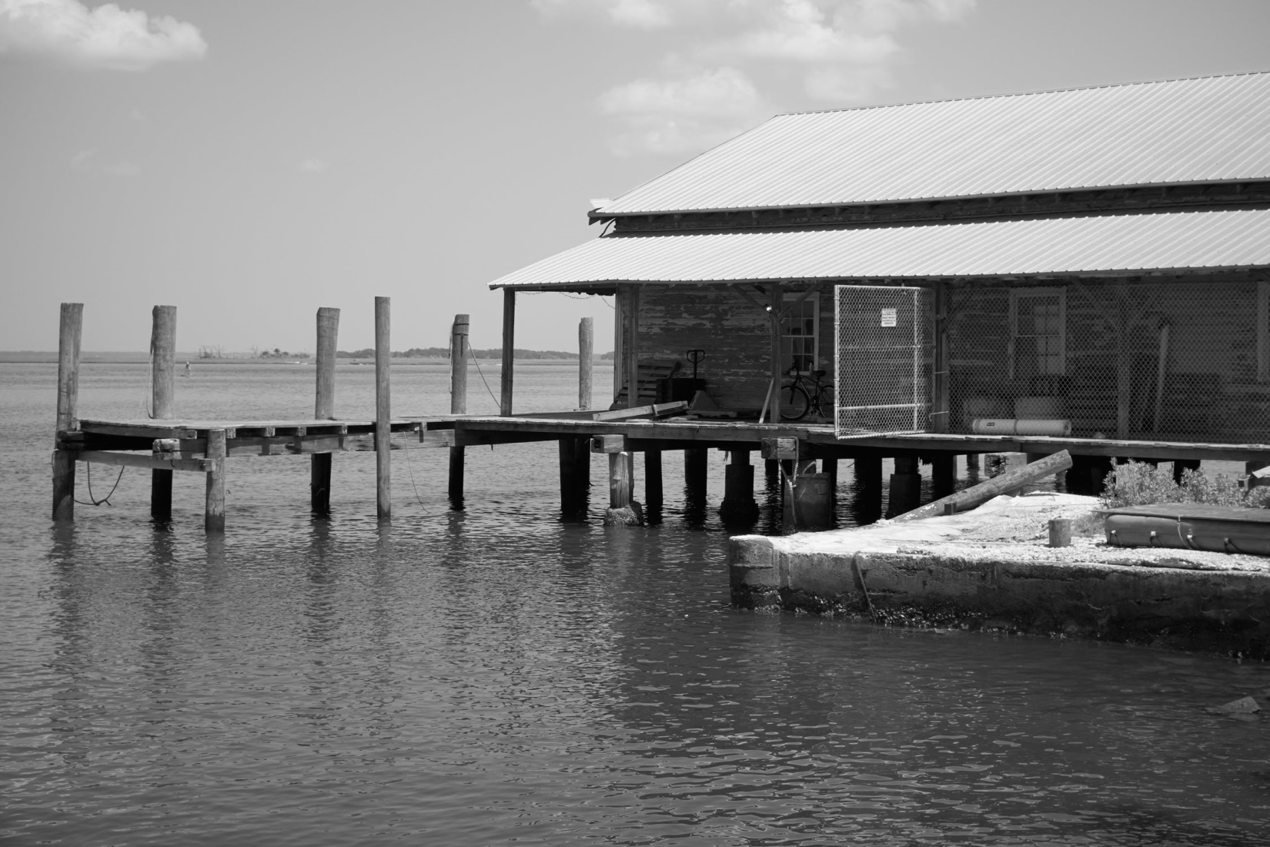
Now the entire structure is the subject

Slide 39
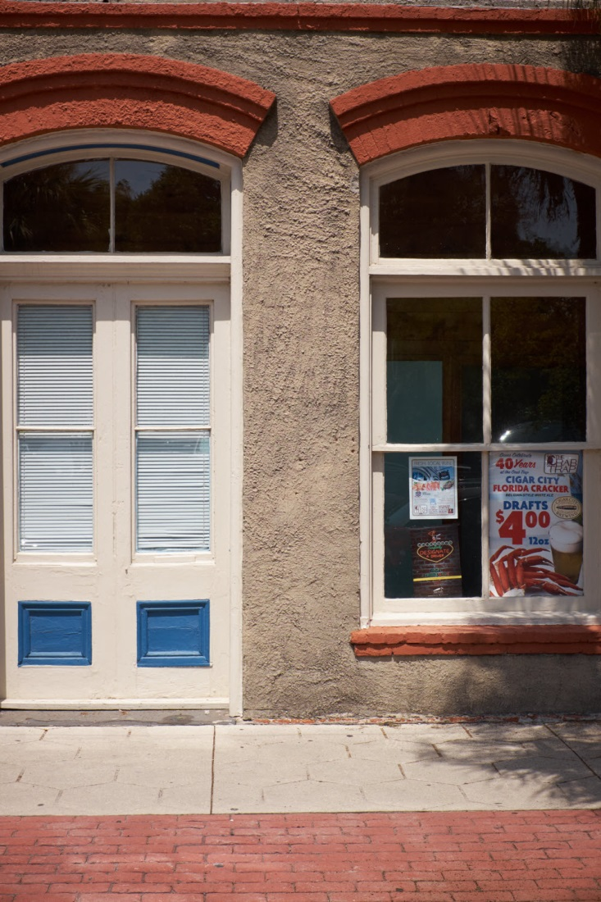
Colors draw attention away from the center
Notes:
2019 Fuji X100T

Slide 40
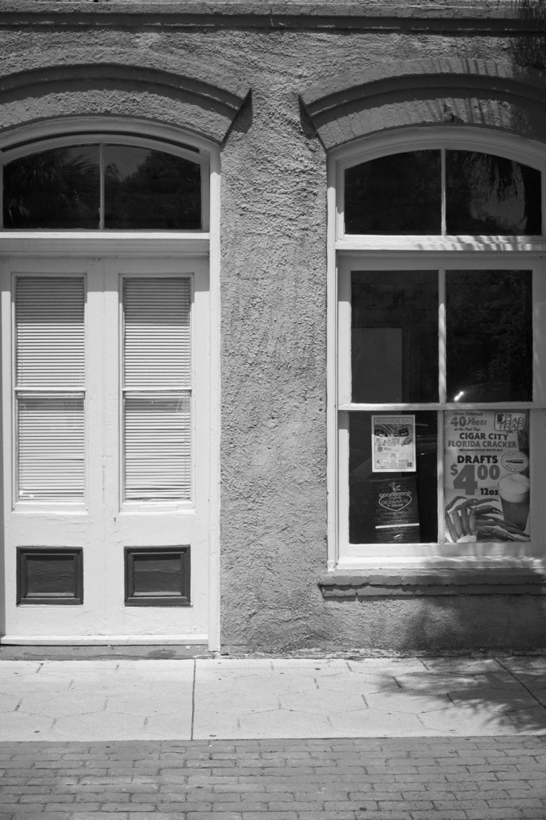
Without color there are no distractions

Slide 41
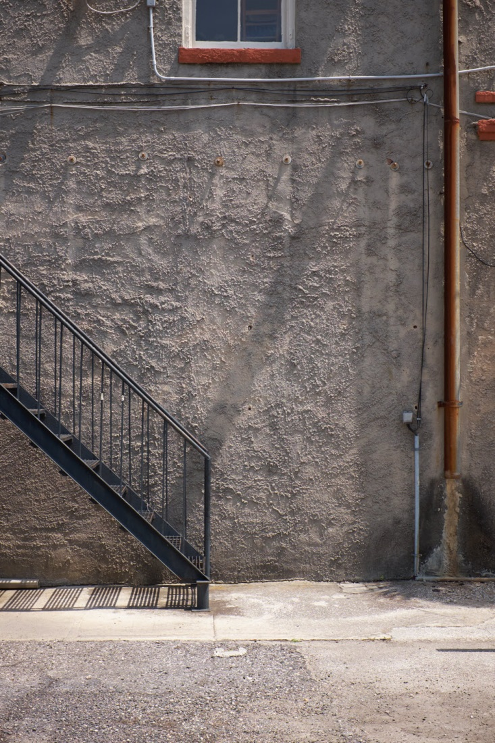
Colors draw attention toward the top and right edges
Notes:
2018 Fuji X100T

Slide 42
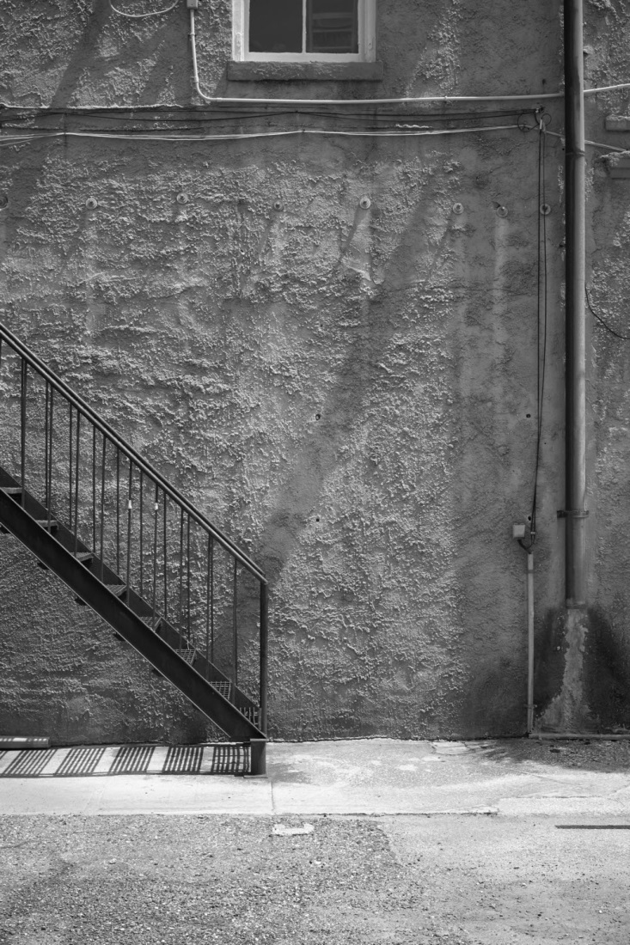
Without color the you see the entire image

Slide 43
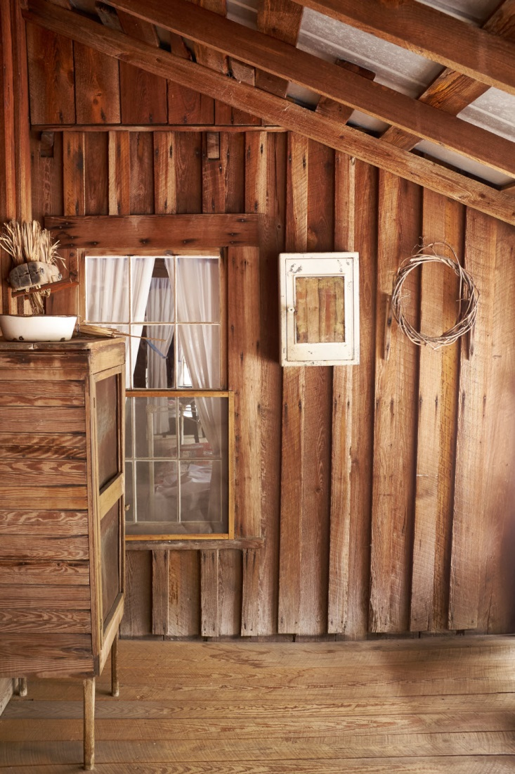
Chesser cabin Okefenokee Park looks new
Notes:
2019 Fuji X100T

Slide 44
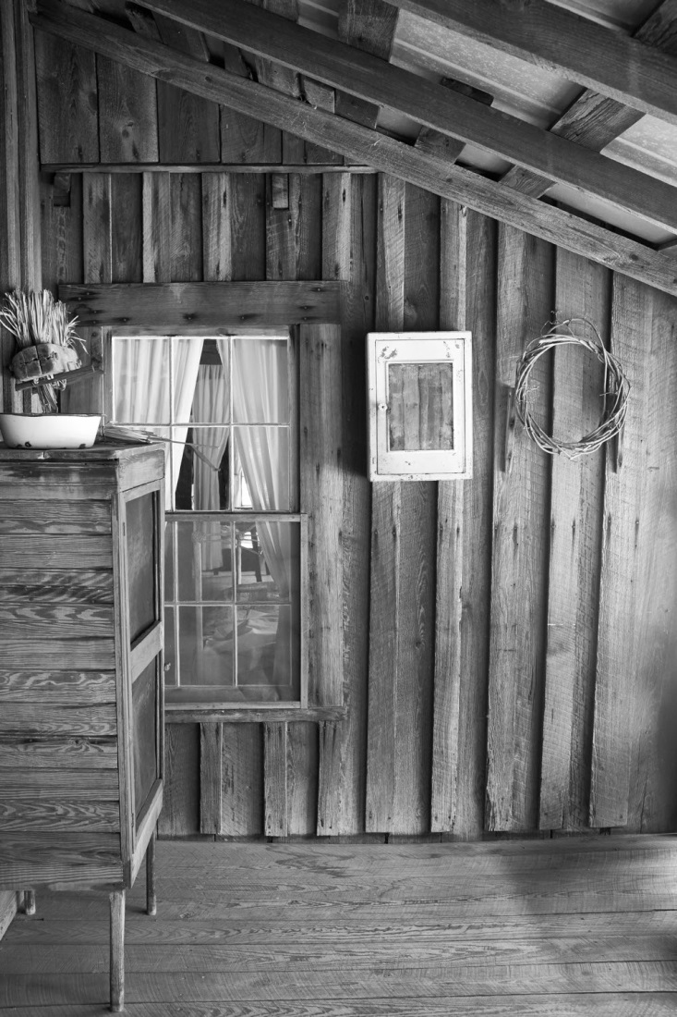
It looks more authentic without color

Slide 45
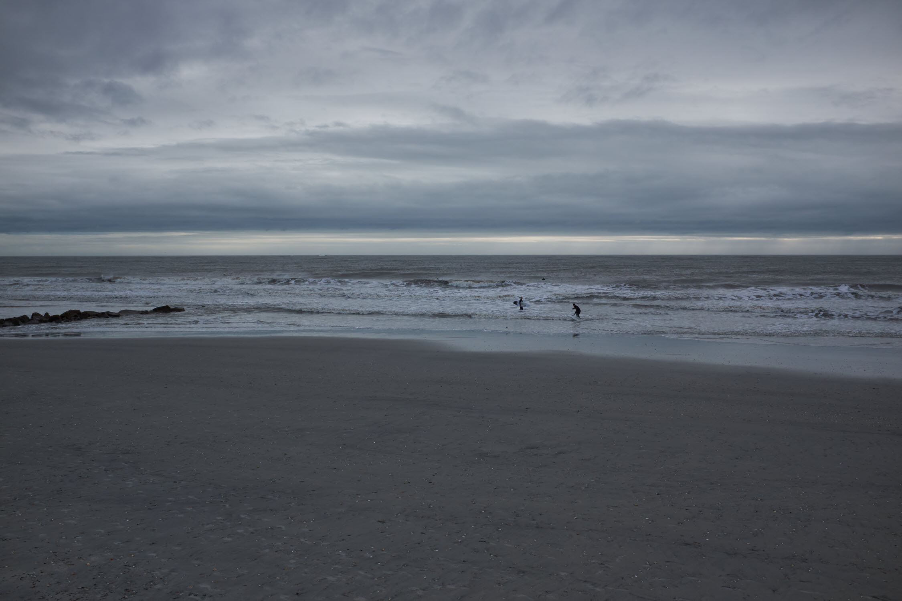
Folly Beach, SC on a cold and colorless December morning
Notes:
2019 Fuji X100T

Slide 46
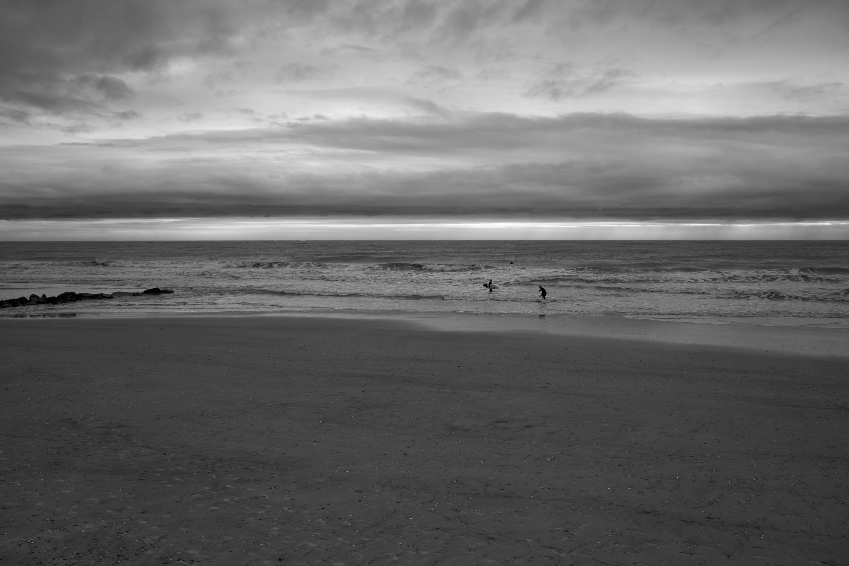
The dull colors removed and the made brighter

Slide 47
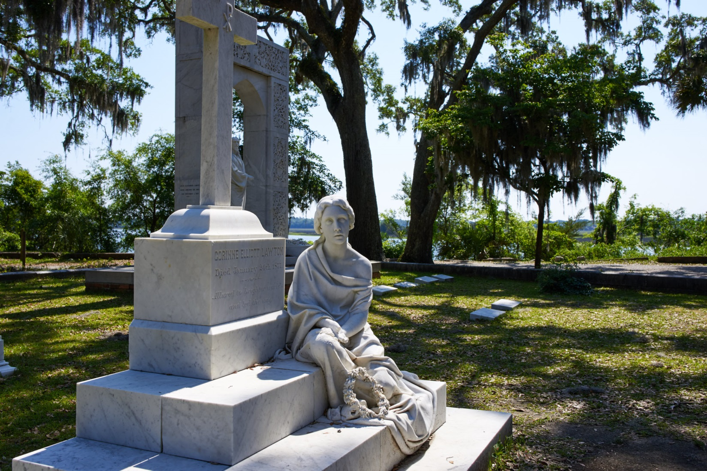
Bonaventure Cemetery Savannah, GA – the vegetation competes with the sculpture
Notes:
2016 Nikon D610

Slide 48
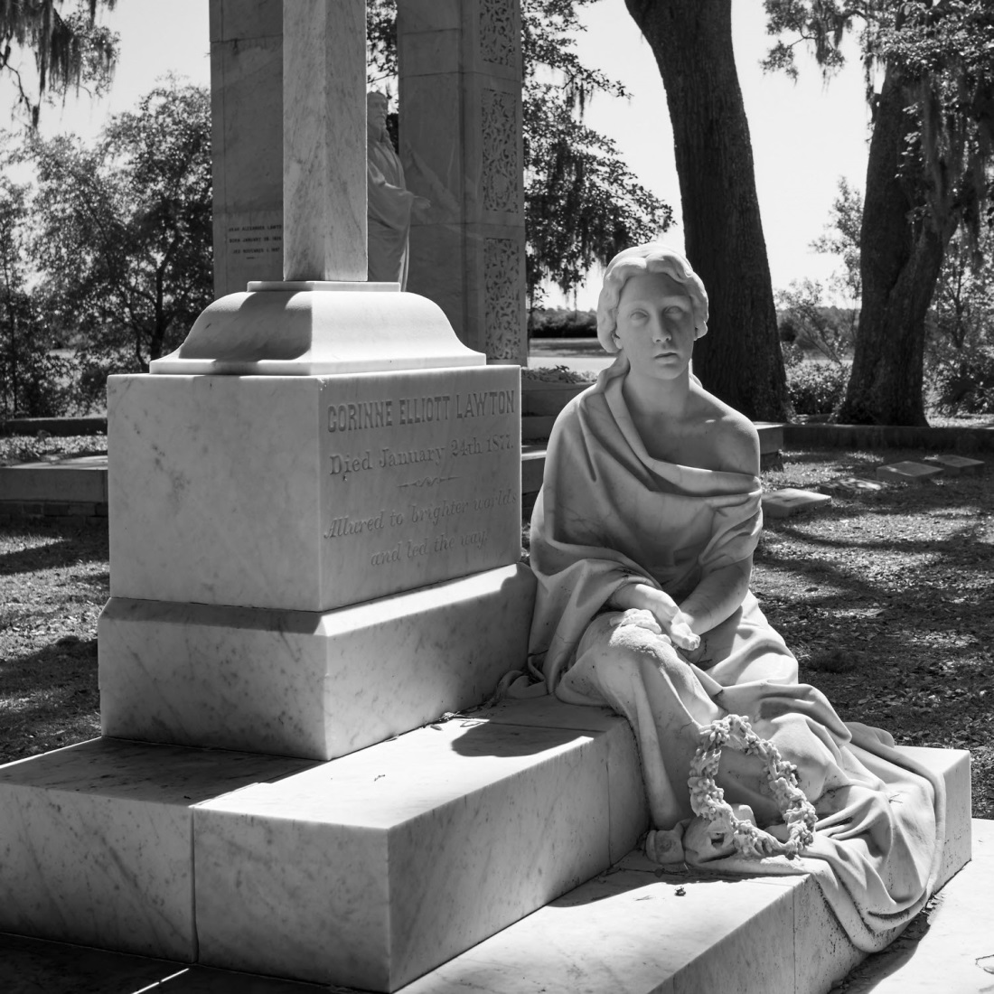
Color removed and cropped

Slide 49
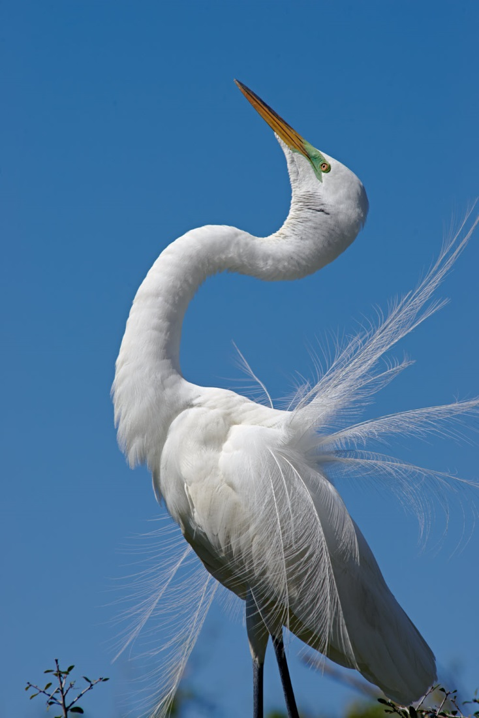
Alligator Farm Saint Augustine – nothing wrong with the color version
Notes:
2017 Nikon D610

Slide 50
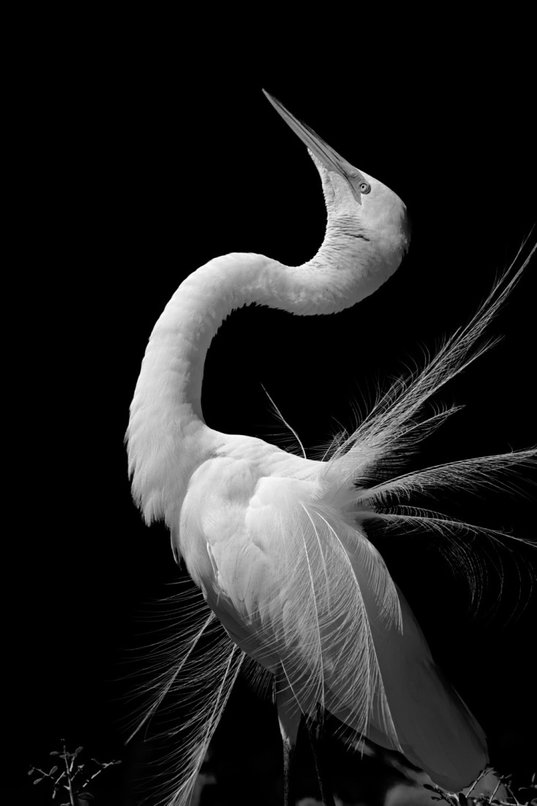
Blue and cyan removed to darken the sky – not better, just different

