Slide 1
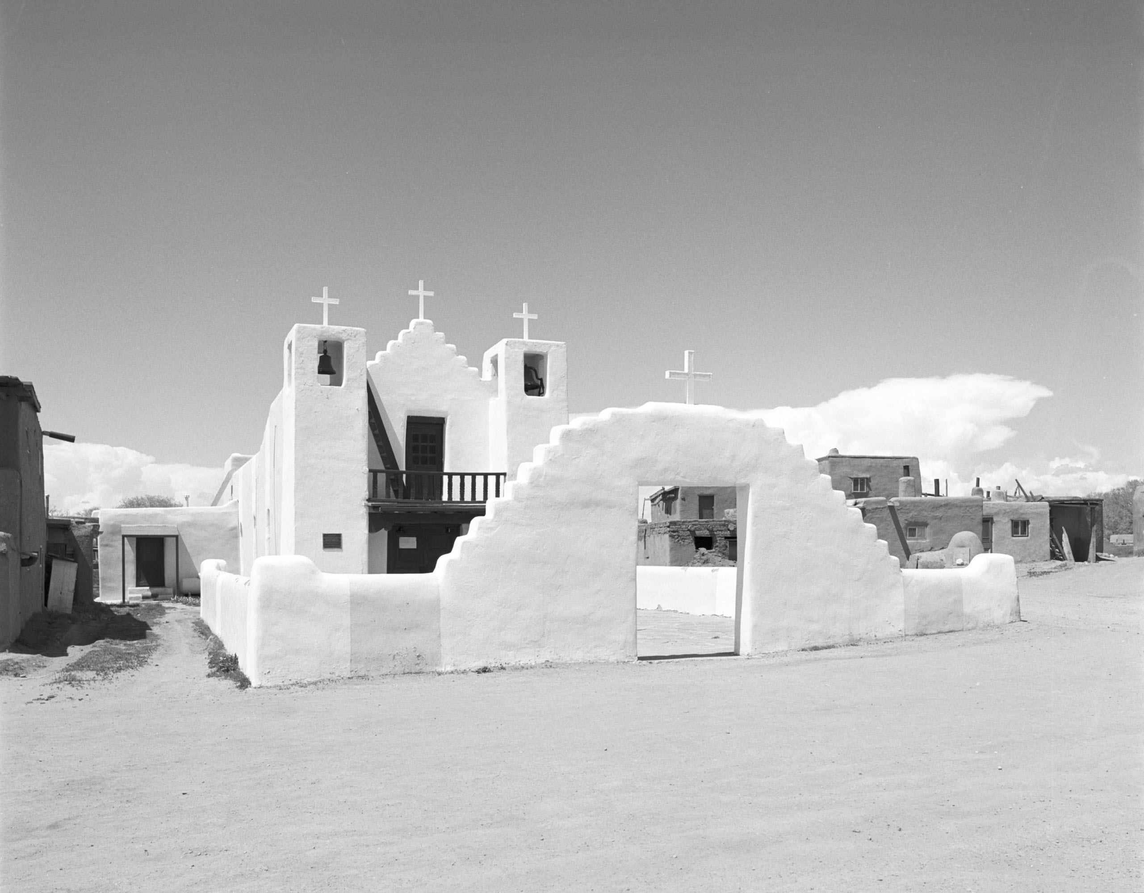
Taos, NM 1987
Notes:
1987 Hasselblad Tmax 400

Slide 2
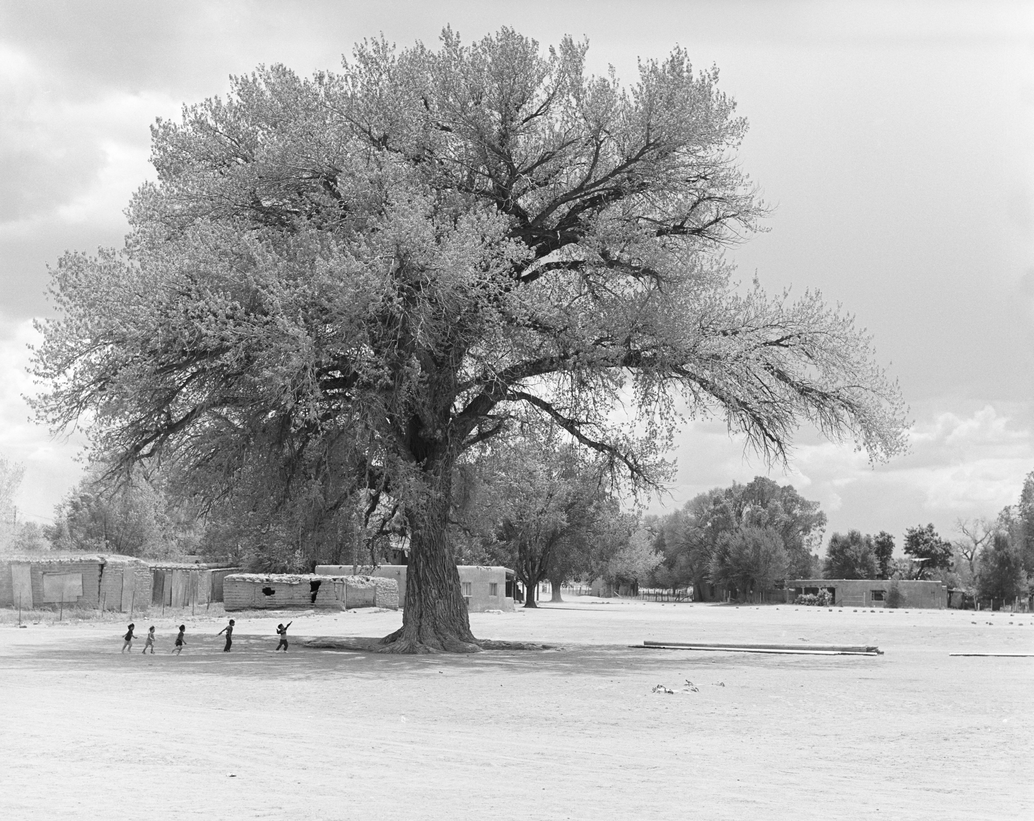
San Ildefonso Pueblo 1987
Notes:
1987 Hasselblad Tmax 400

Slide 3
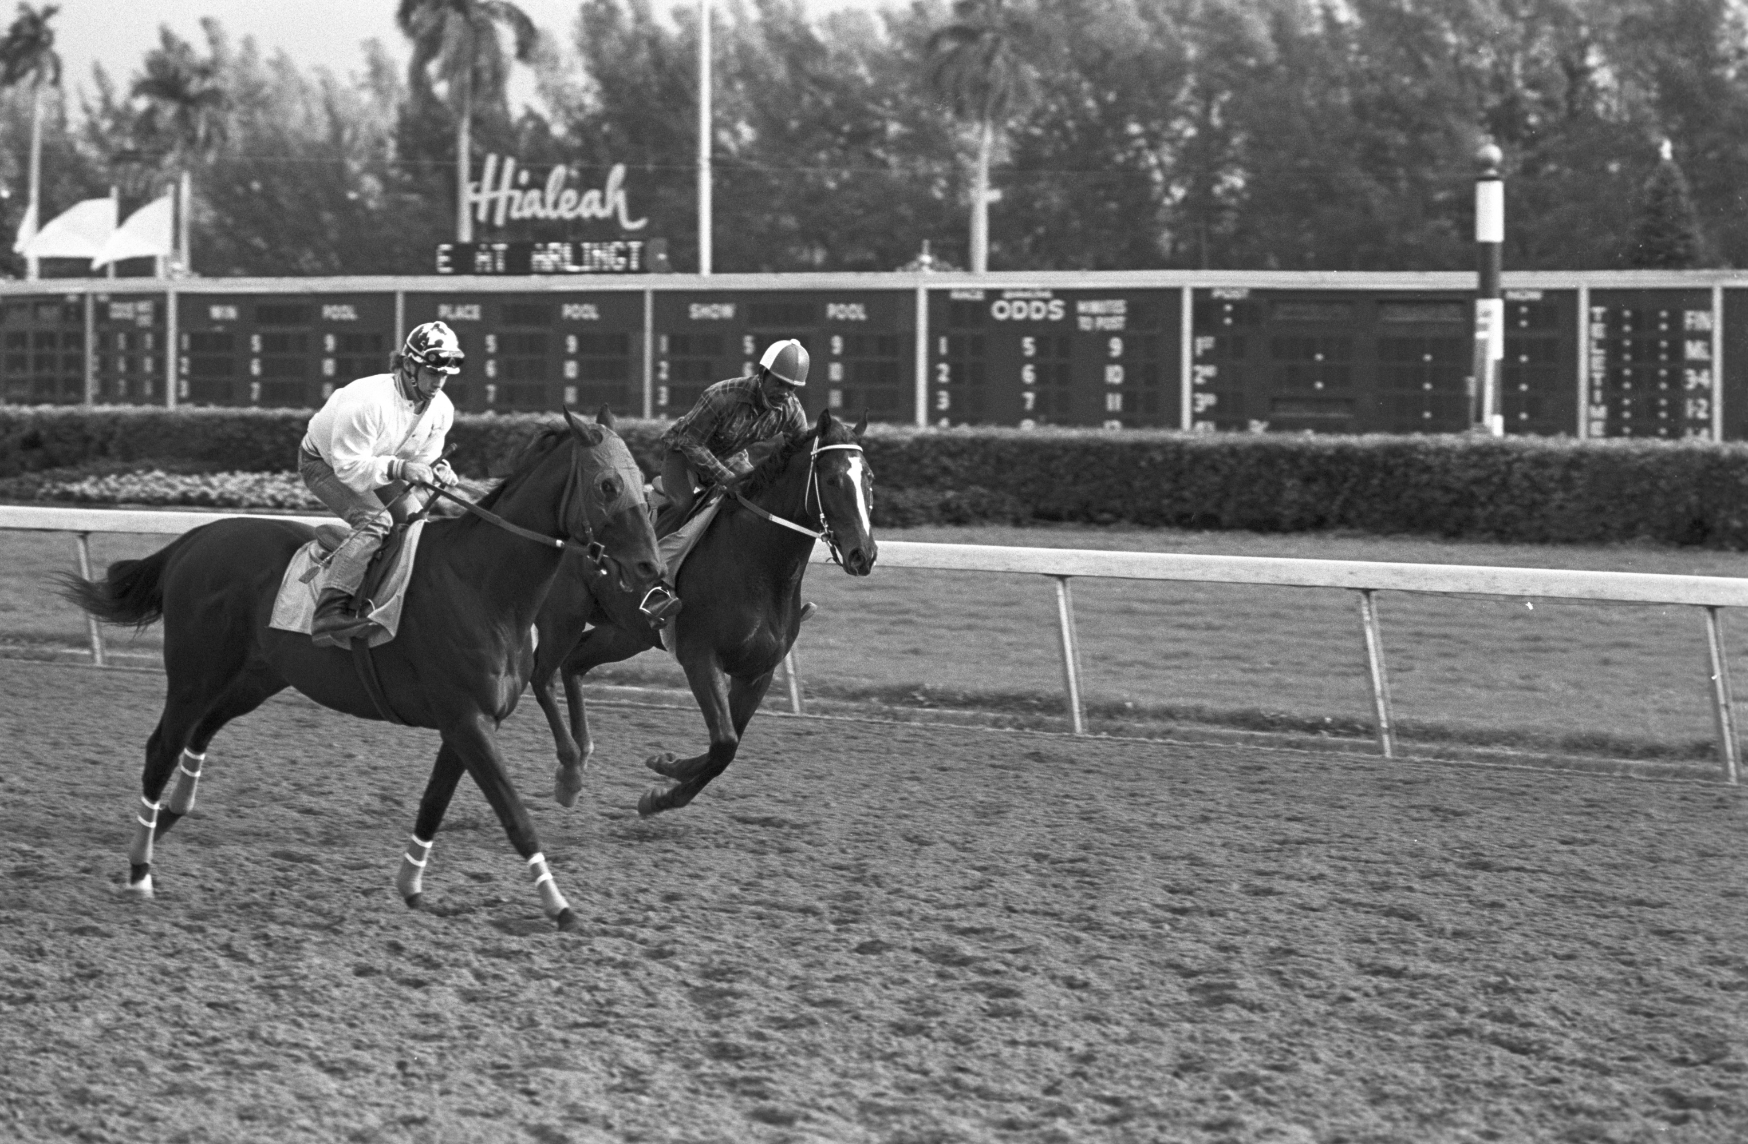
Notes:
1987 Tmax 400

Slide 4
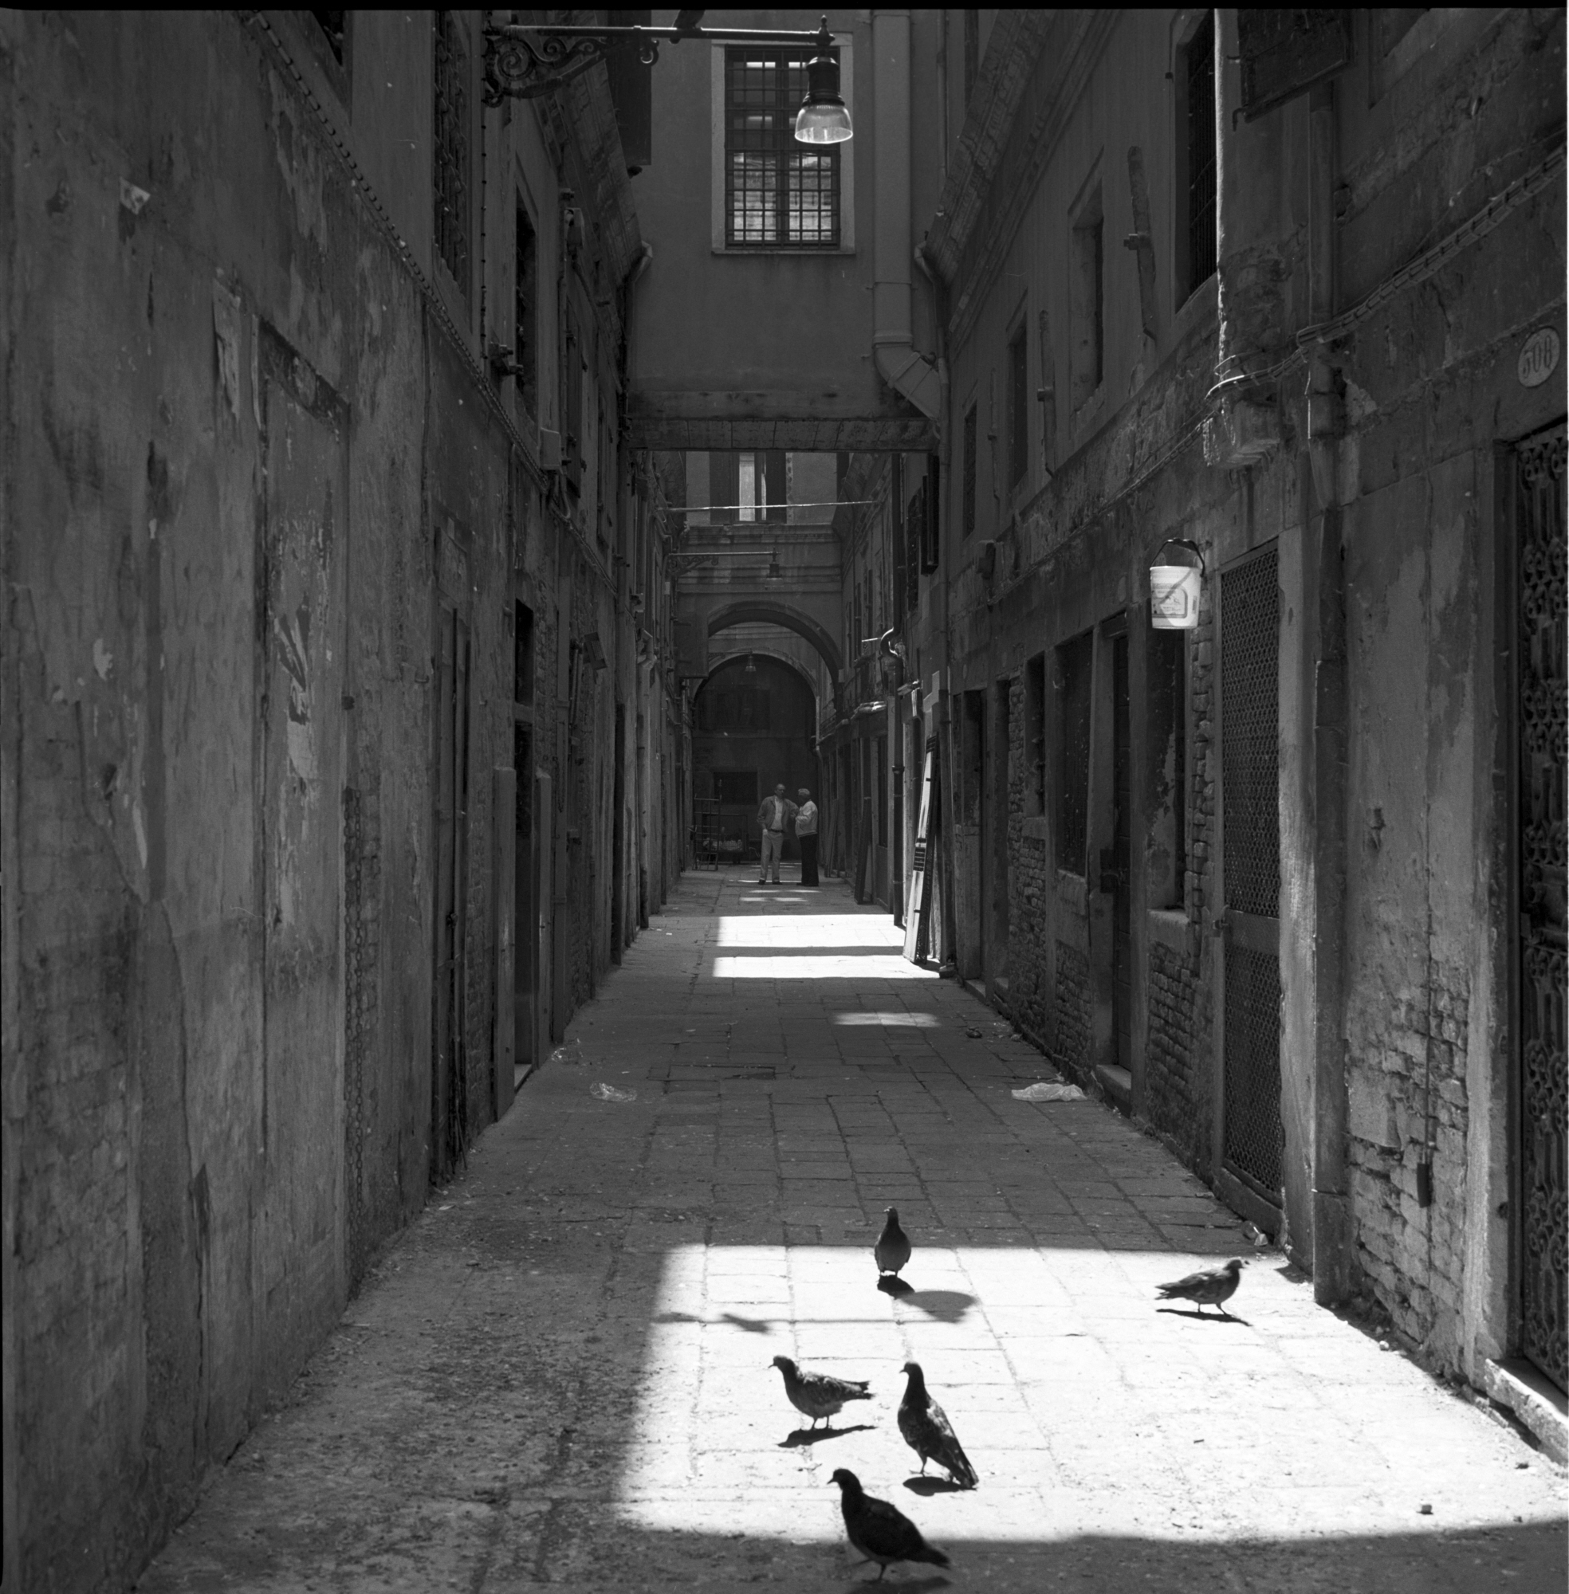
Venice 1988
Notes:
1988 Hasselblad Tmax 400

Slide 5
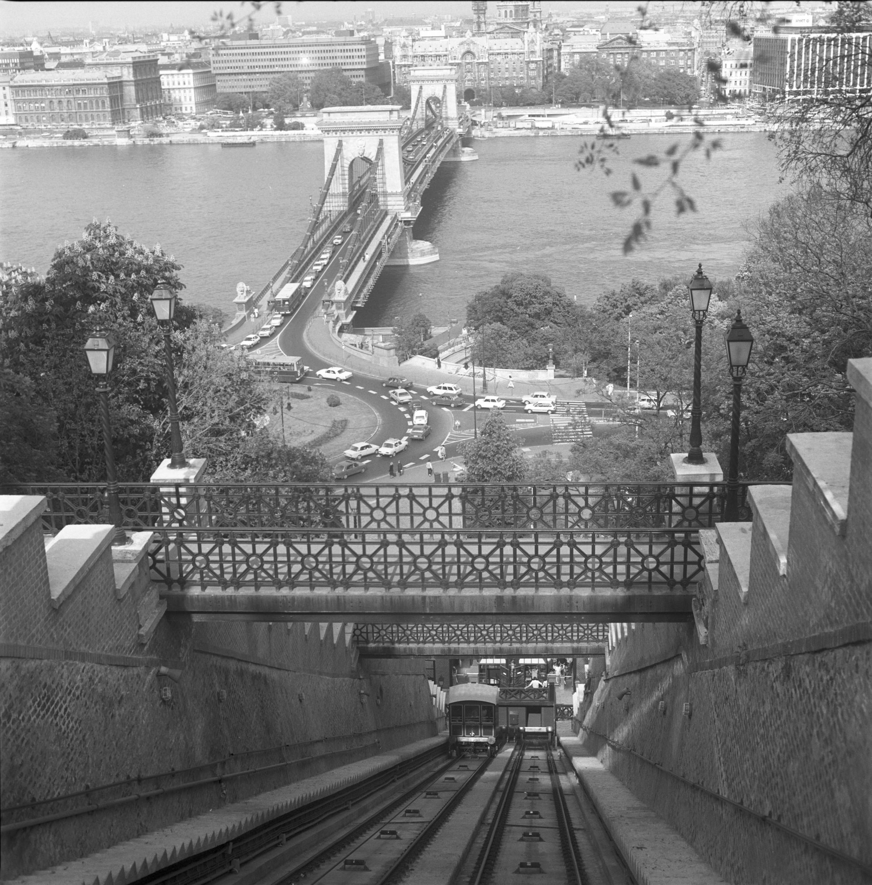
Budapest 1988
Notes:
1988 Hasselblad Tmax 400

Slide 6
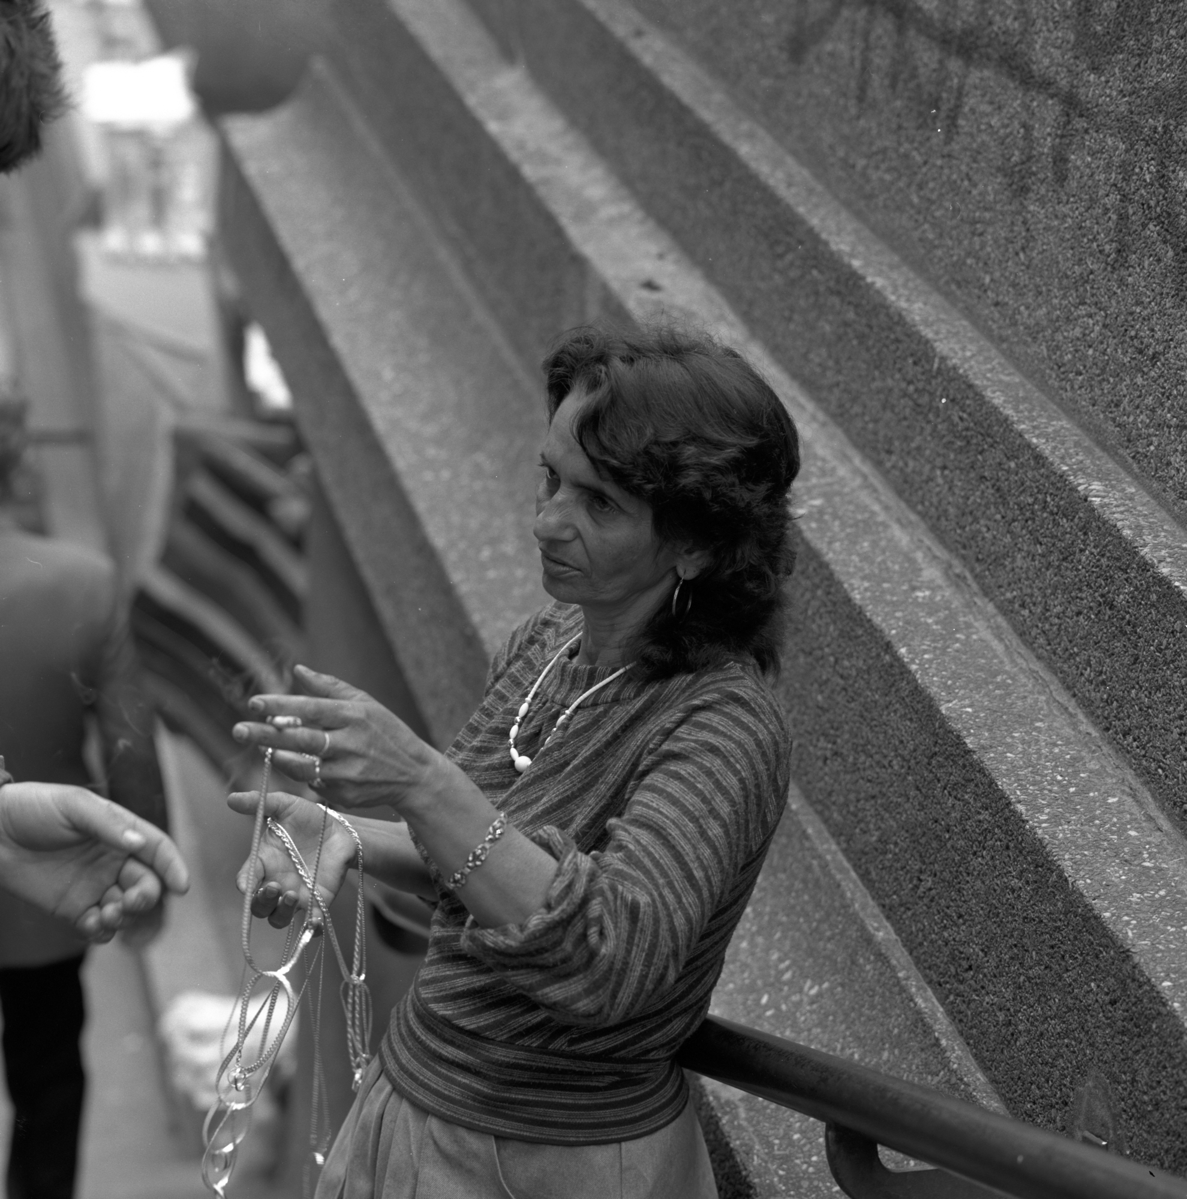
Zagreb 1988
Notes:
1988 Hasselblad Tmax 400

Slide 7

Notes:
1988 Zone VI Tmax 100

Slide 8
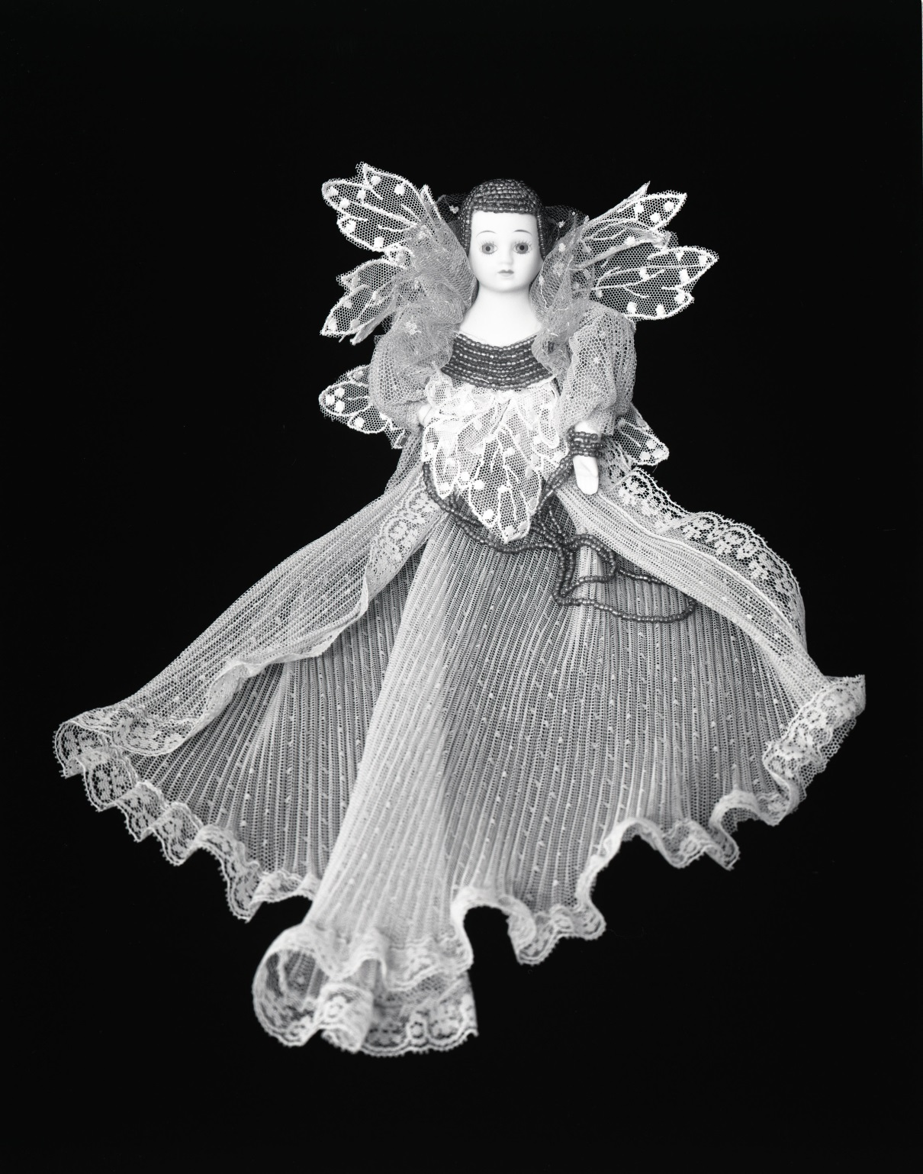
Notes:
1988 Zone VI Tmax 100

Slide 9
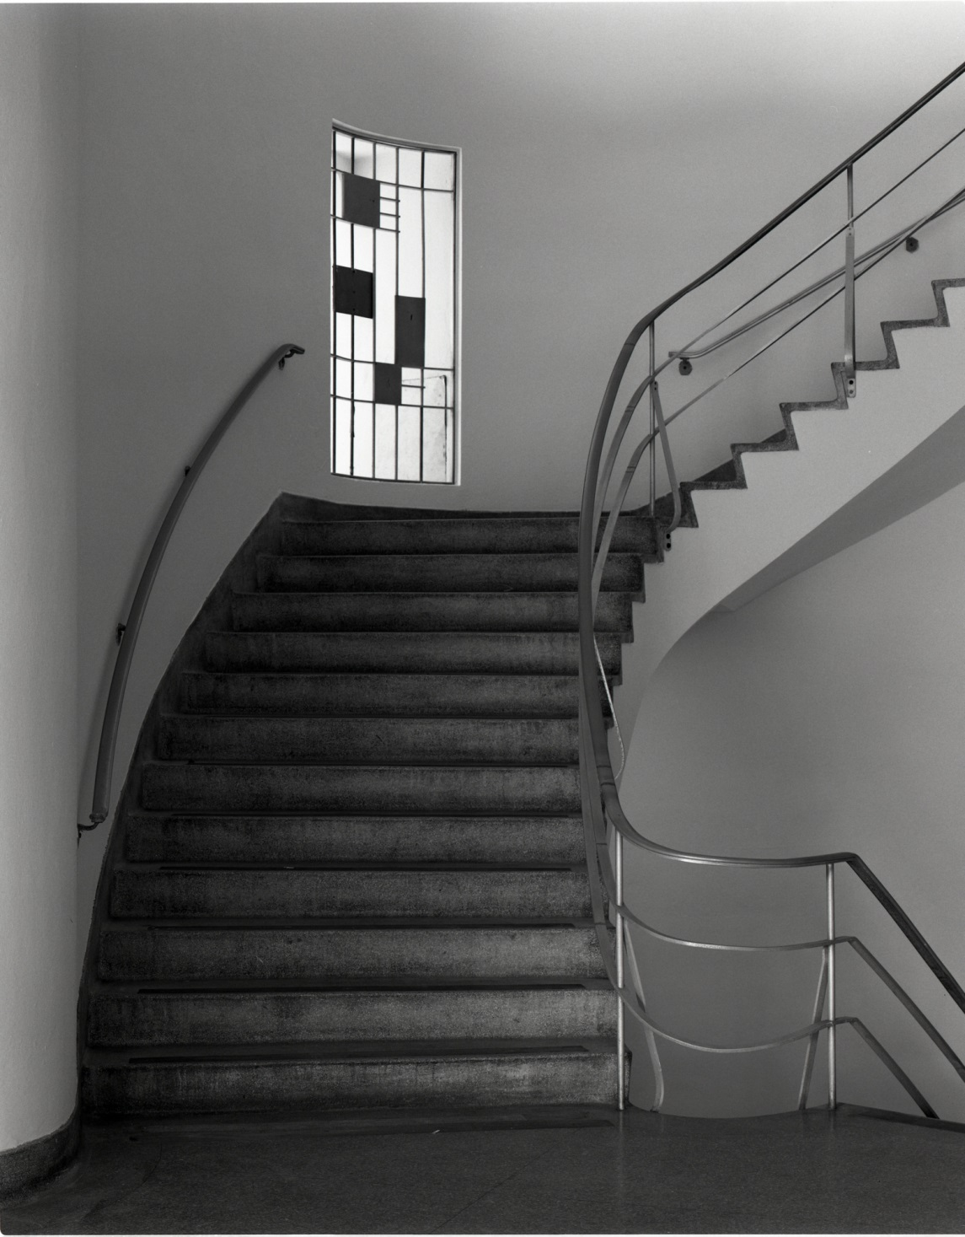
University of Miami 1988
Notes:
1988 Zone VI Tmax 400

Slide 10
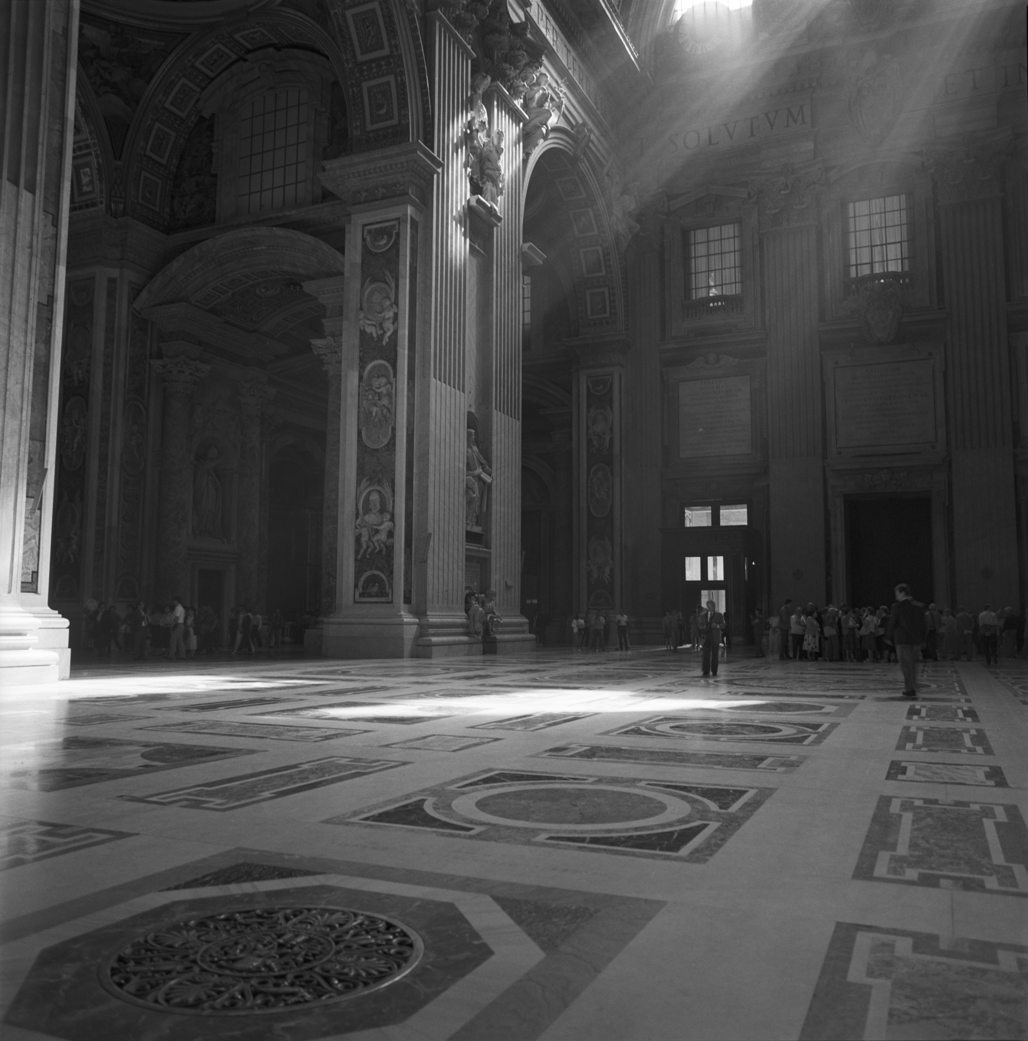
Saint Peters 1990
Notes:
1990 Hasselblad Tmax 400

Slide 11
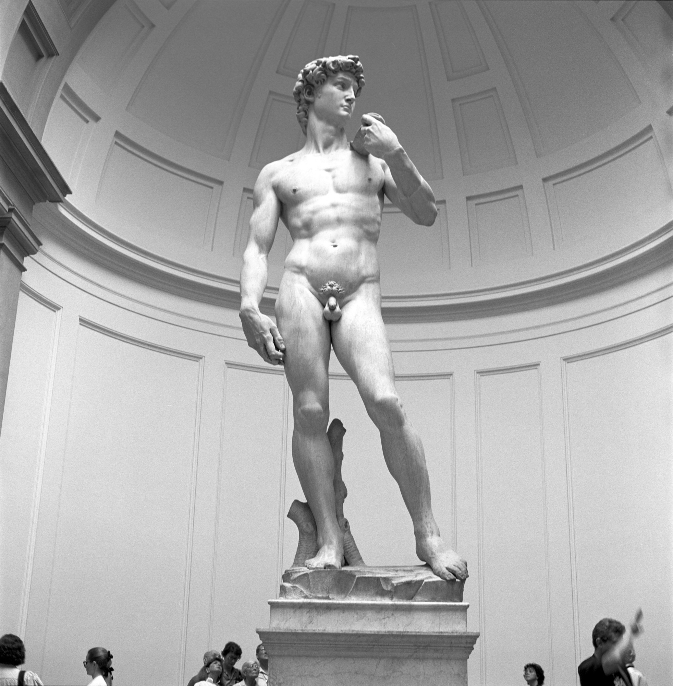
Florence 1990
Notes:
1990 Hasselblad Tmax 400

Slide 12
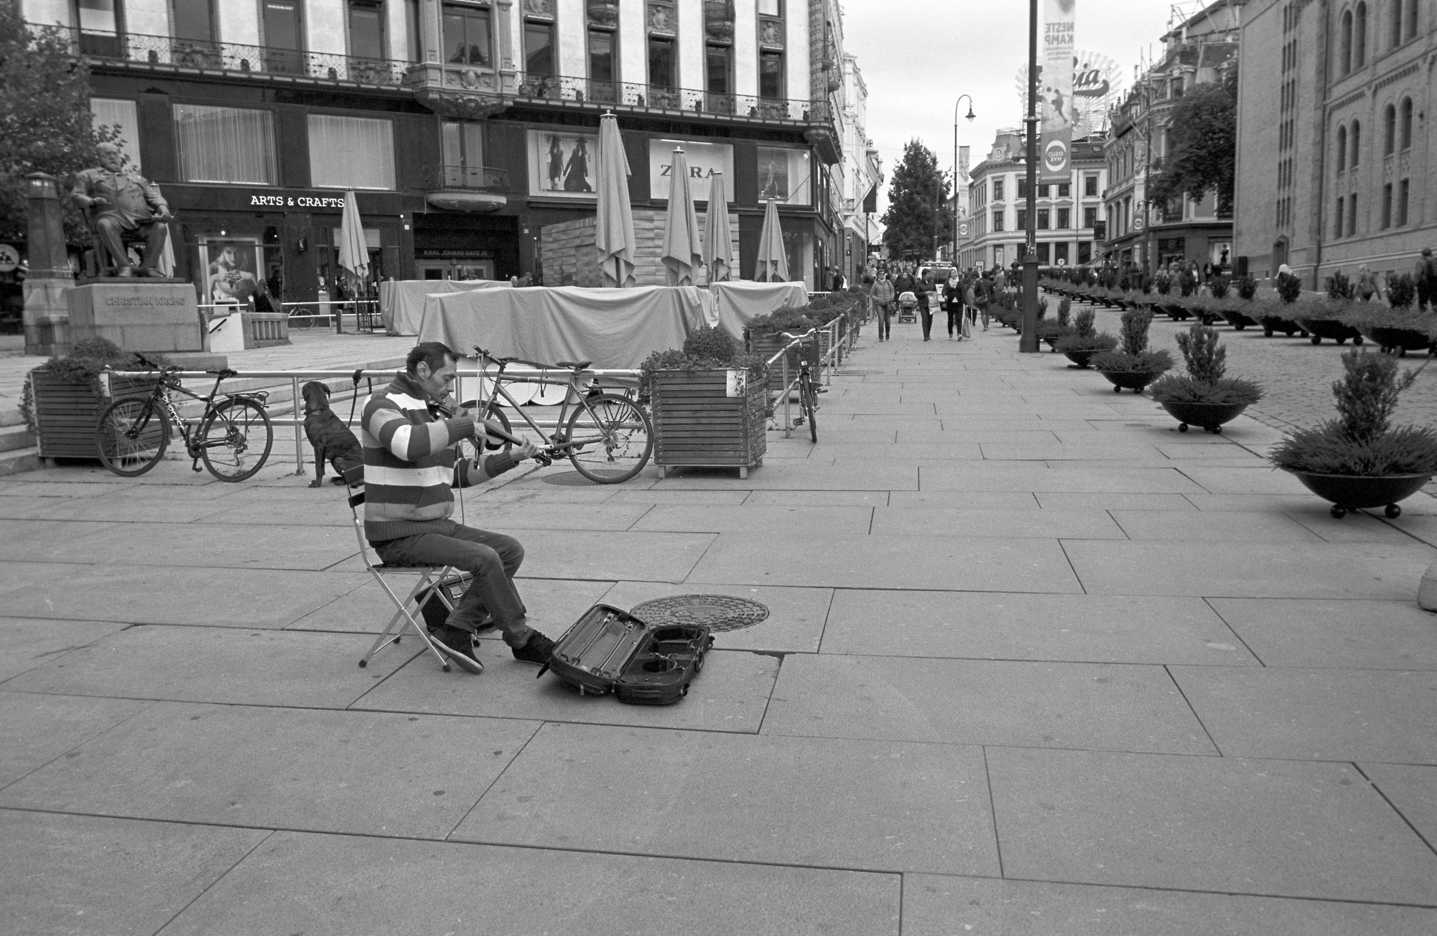
Oslo 2013
Notes:
2013 Tmax 400

Slide 13
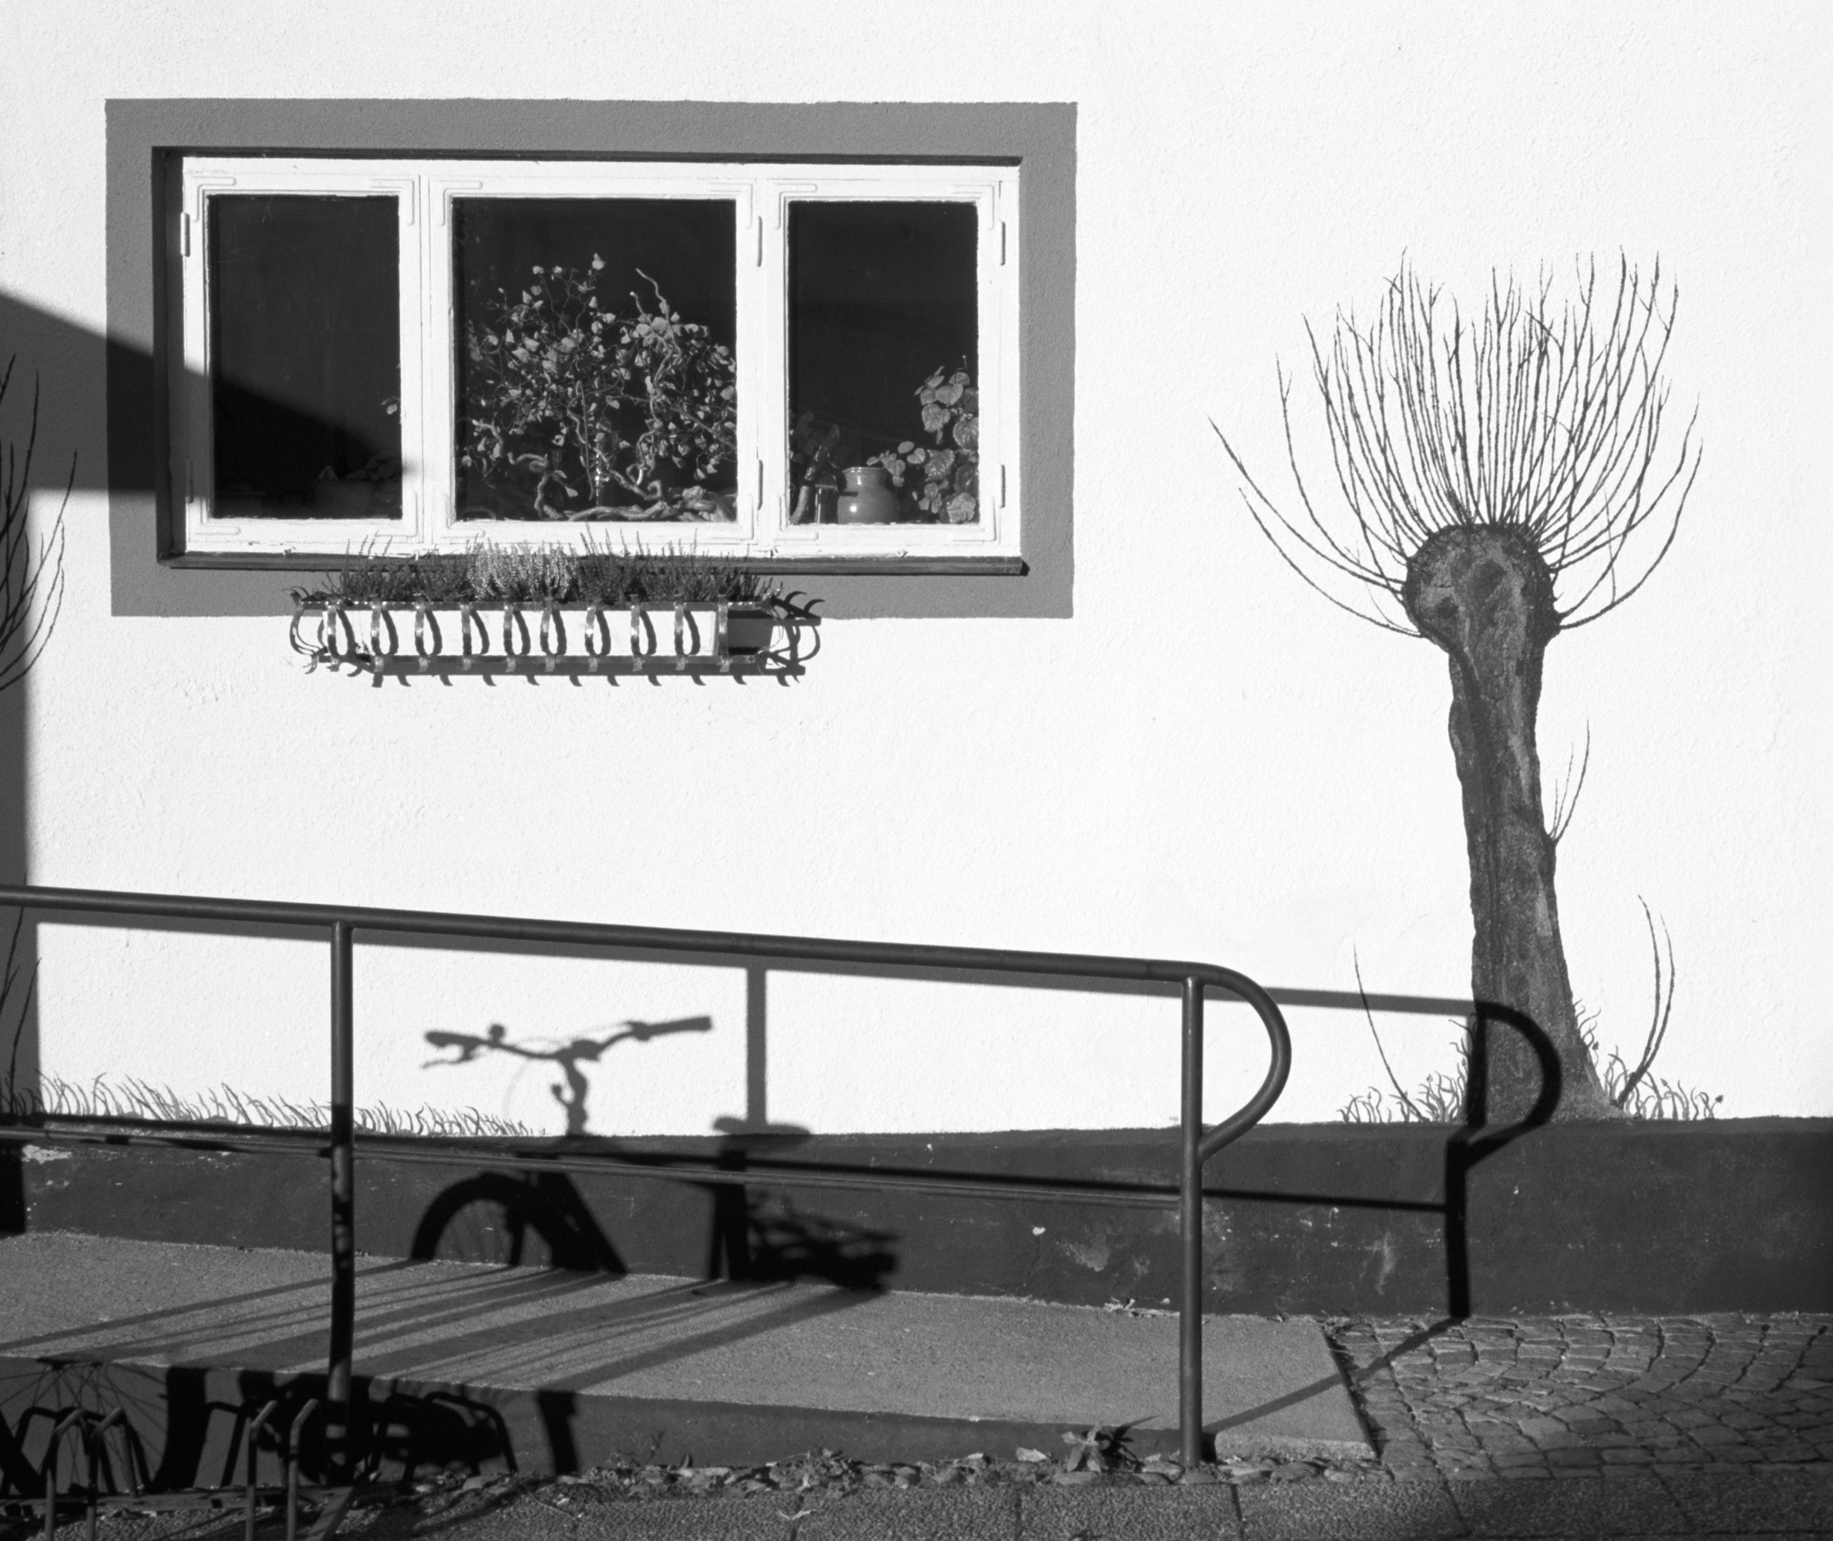
Ystad, Sweden 2013
Notes:
2013 Tmax 100

Slide 14
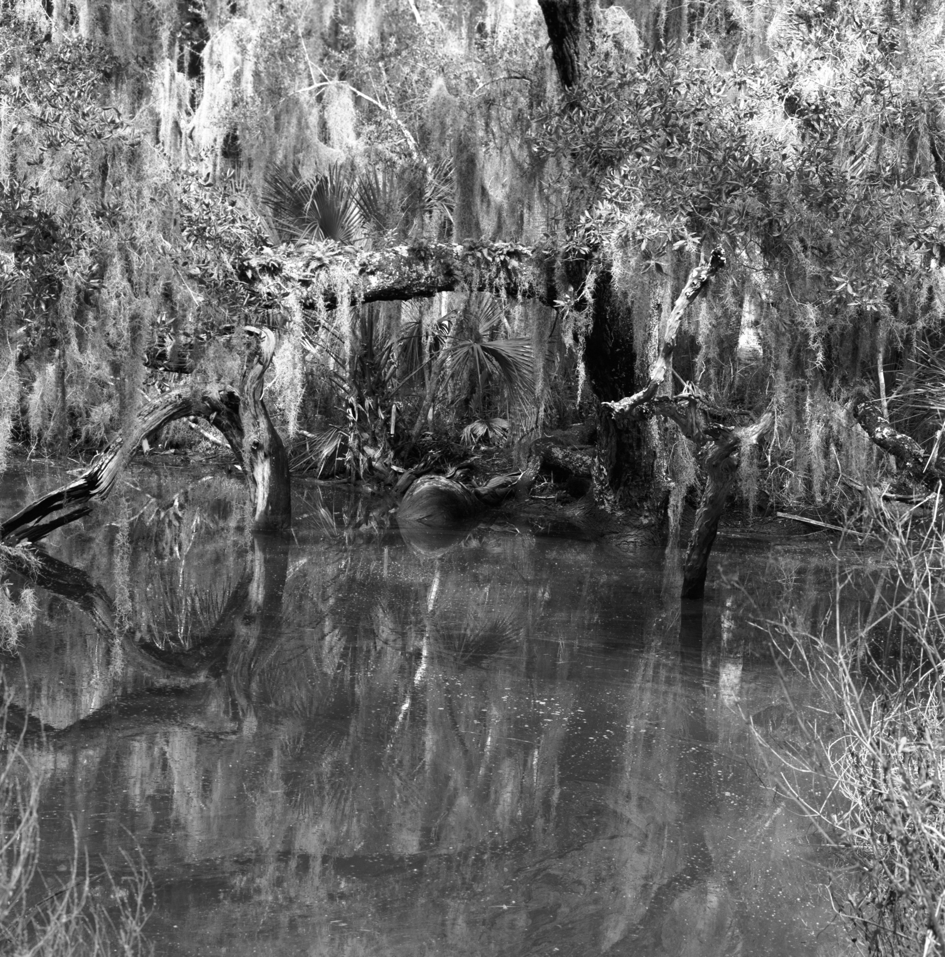
Fort George Island 2014
Notes:
2014 Hasselblad Tmax 400

Slide 15
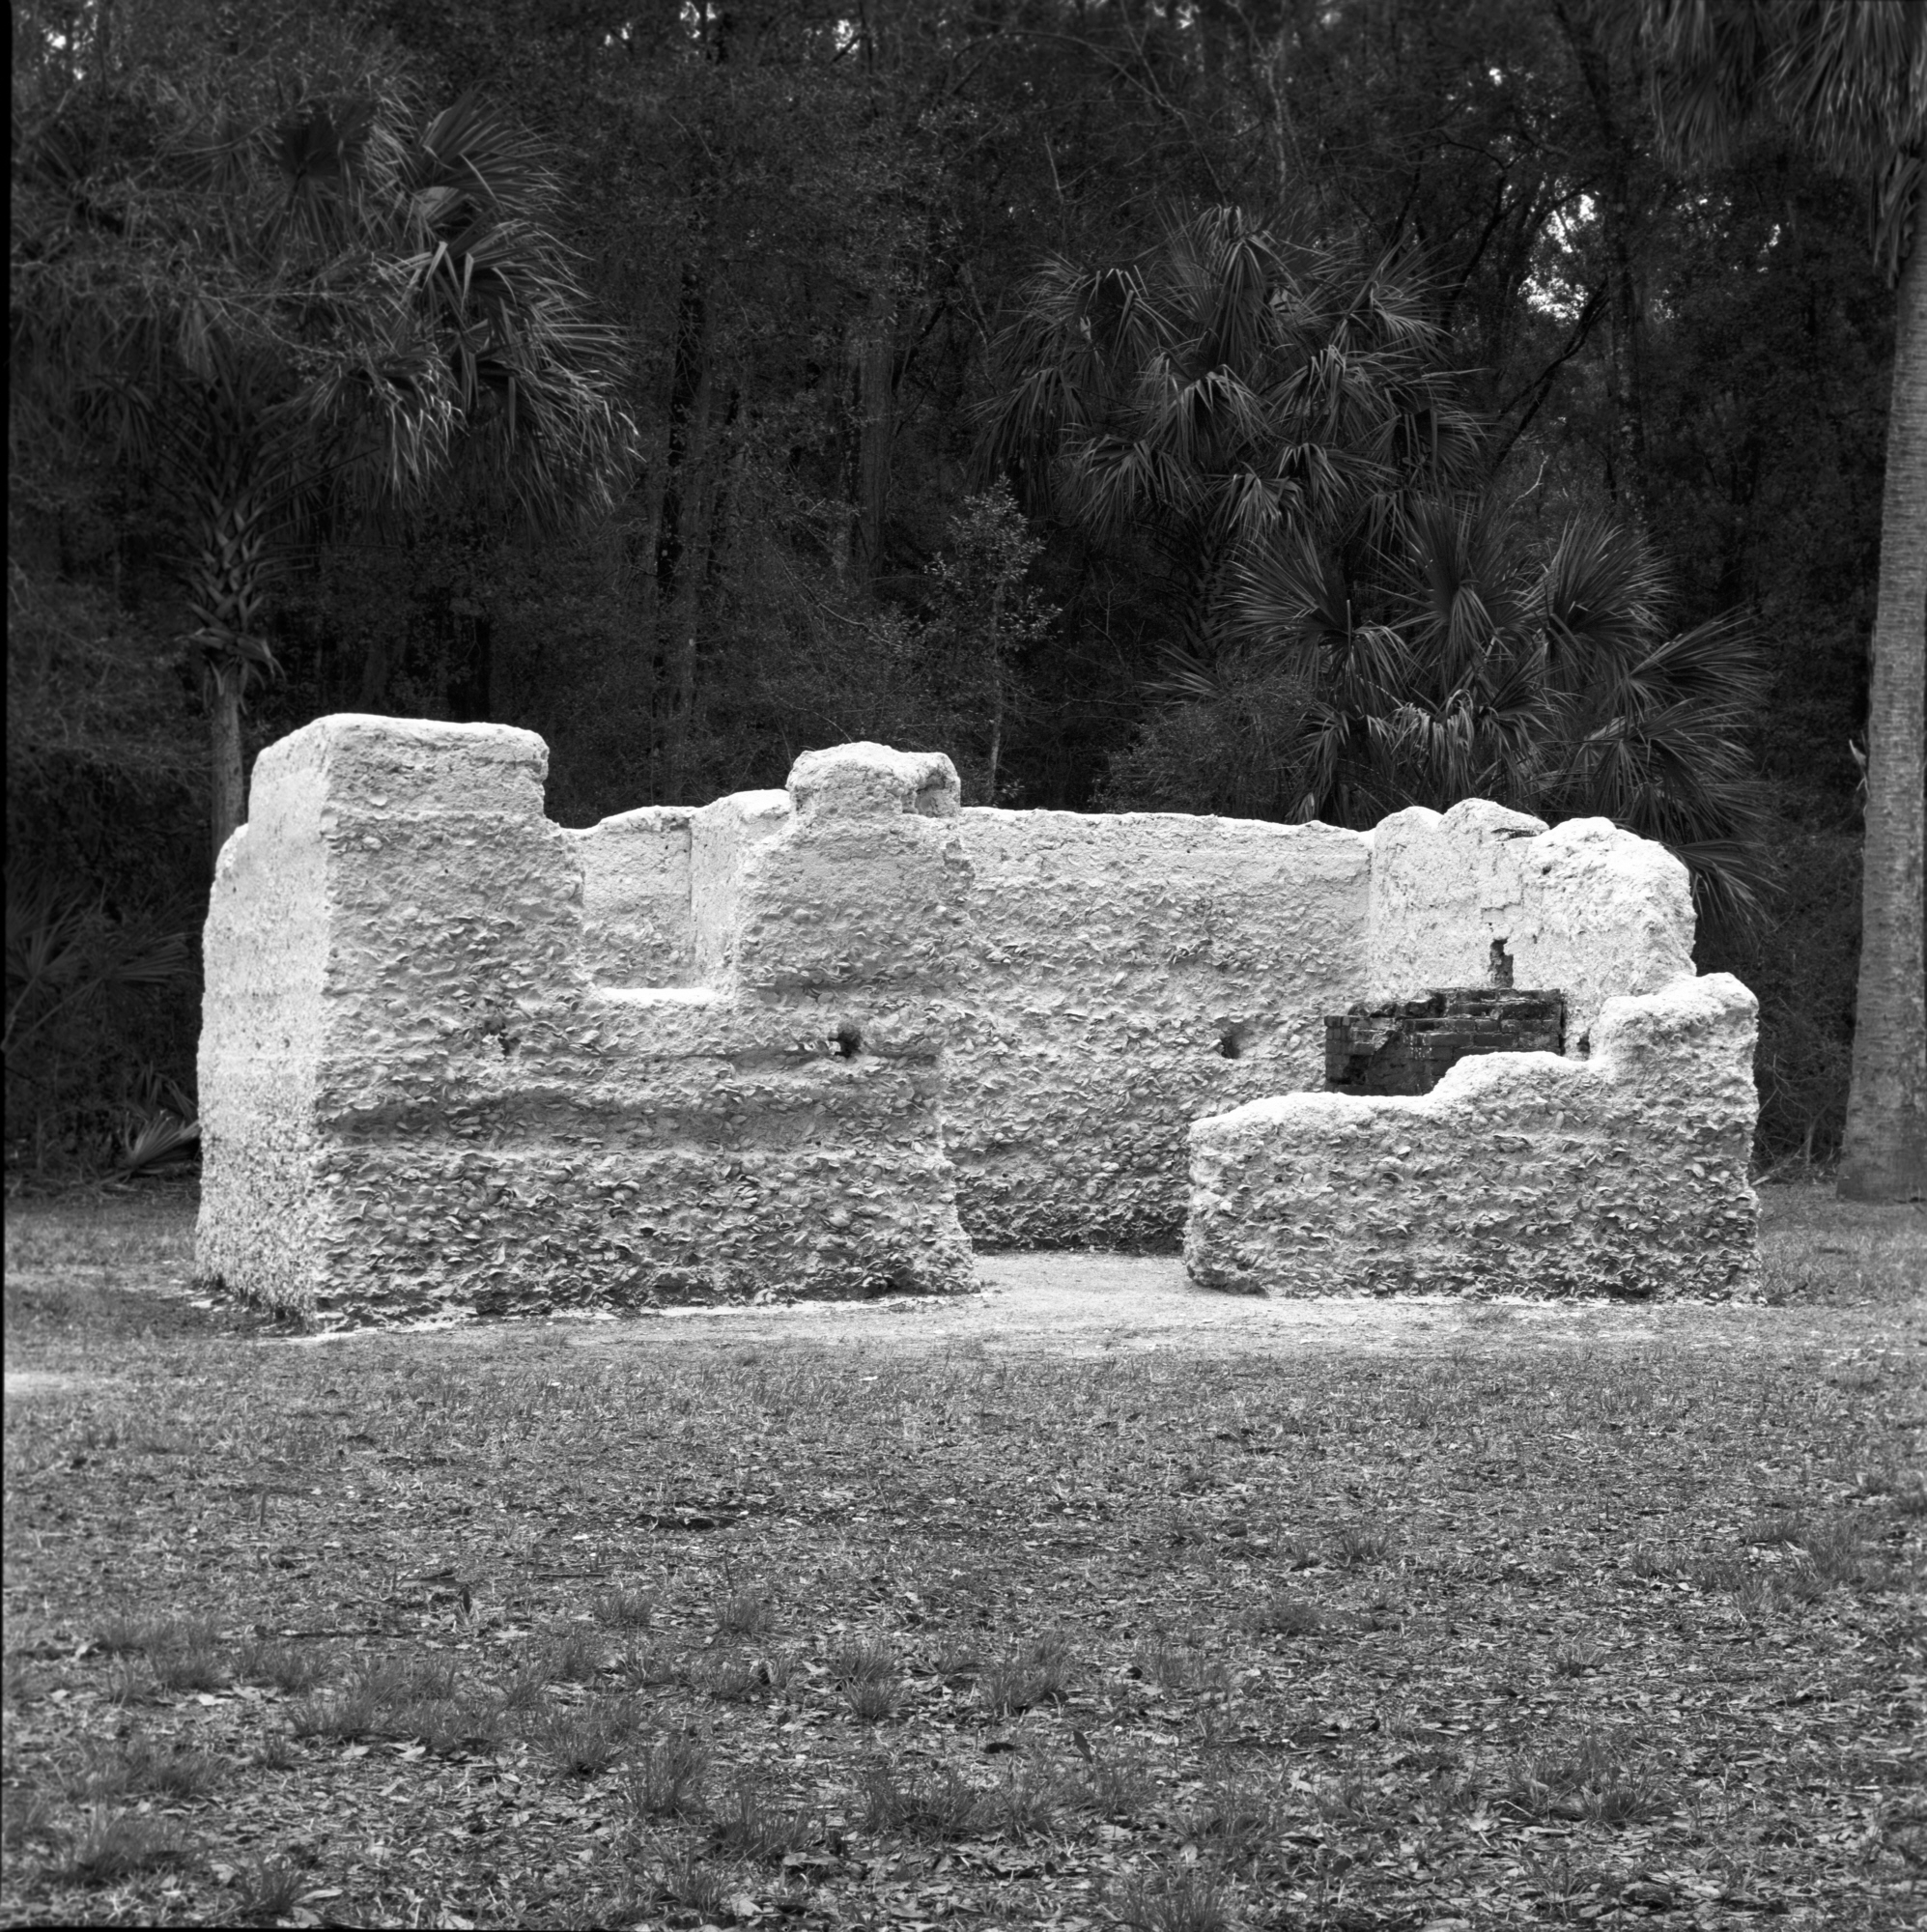
Kingsley Plantation 2014
Notes:
2014 Hasselblad FP4

Slide 16
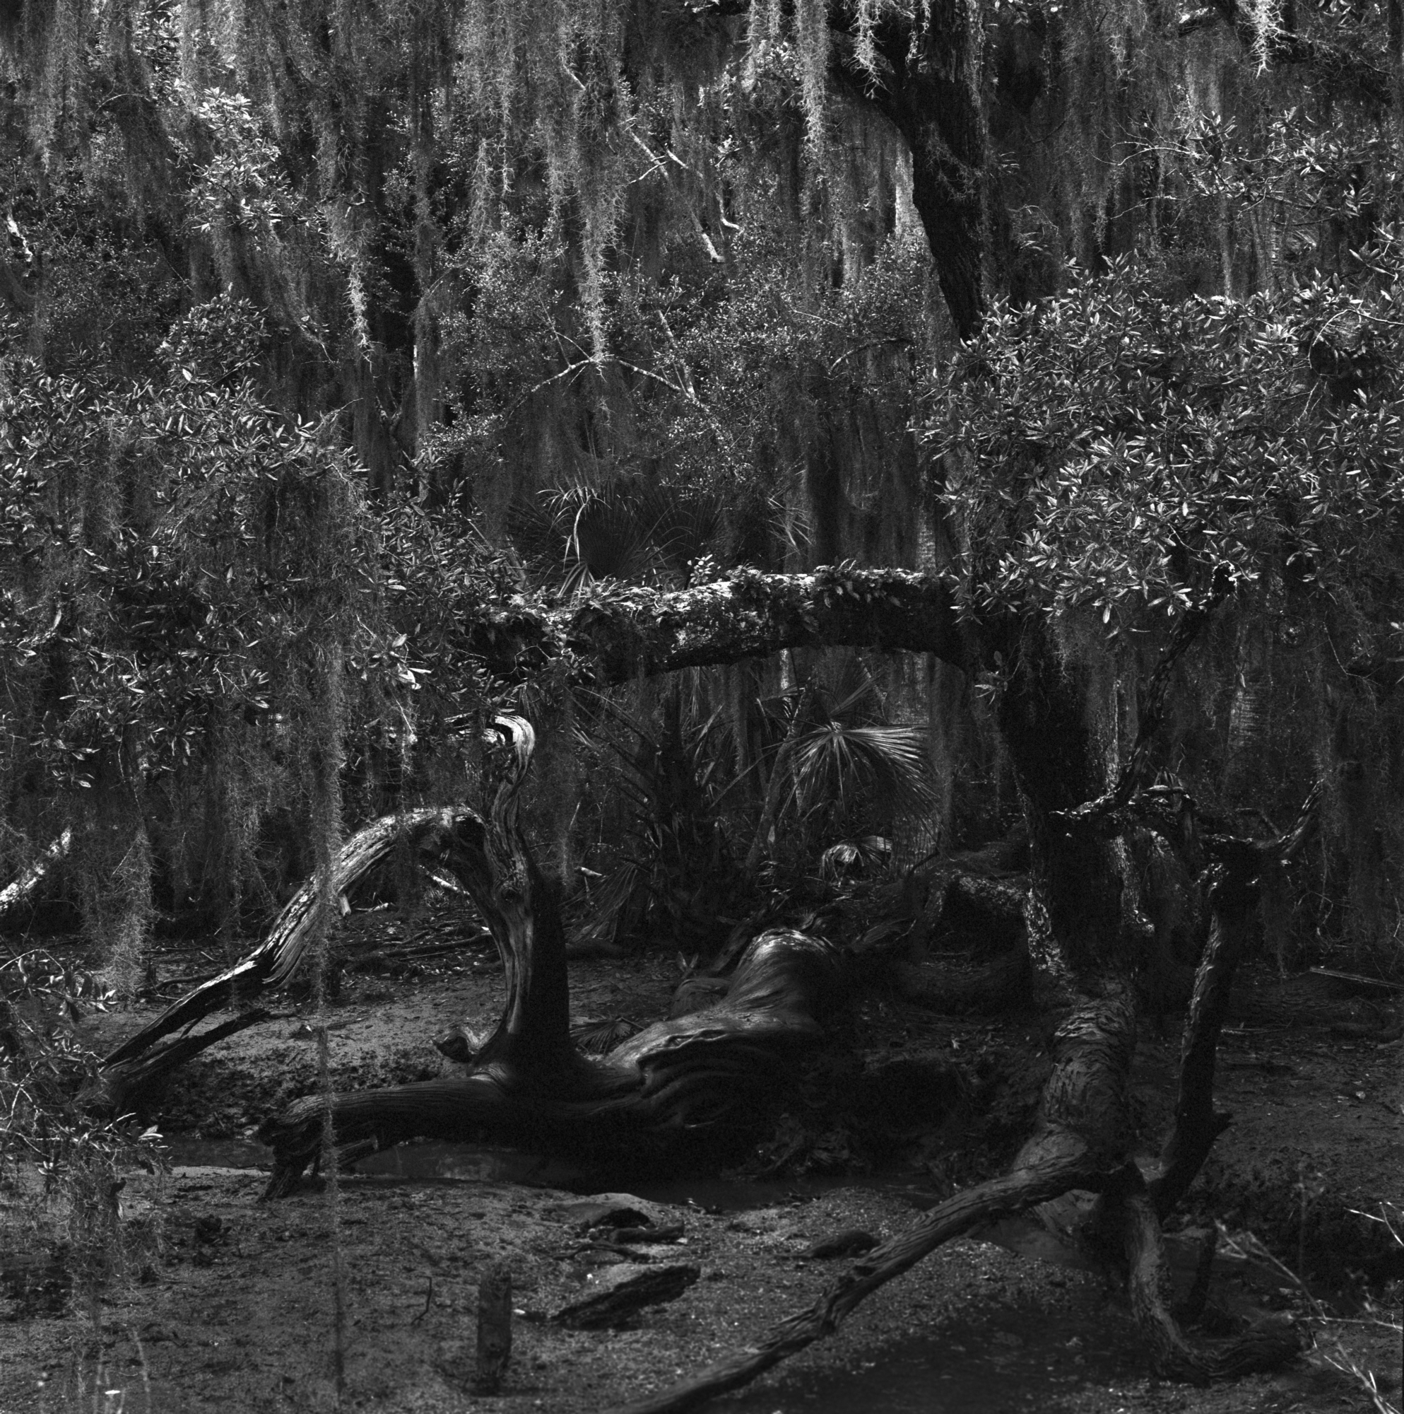
Fort George Island 2014
Notes:
2014 Hasselblad Tmax 400

Slide 17
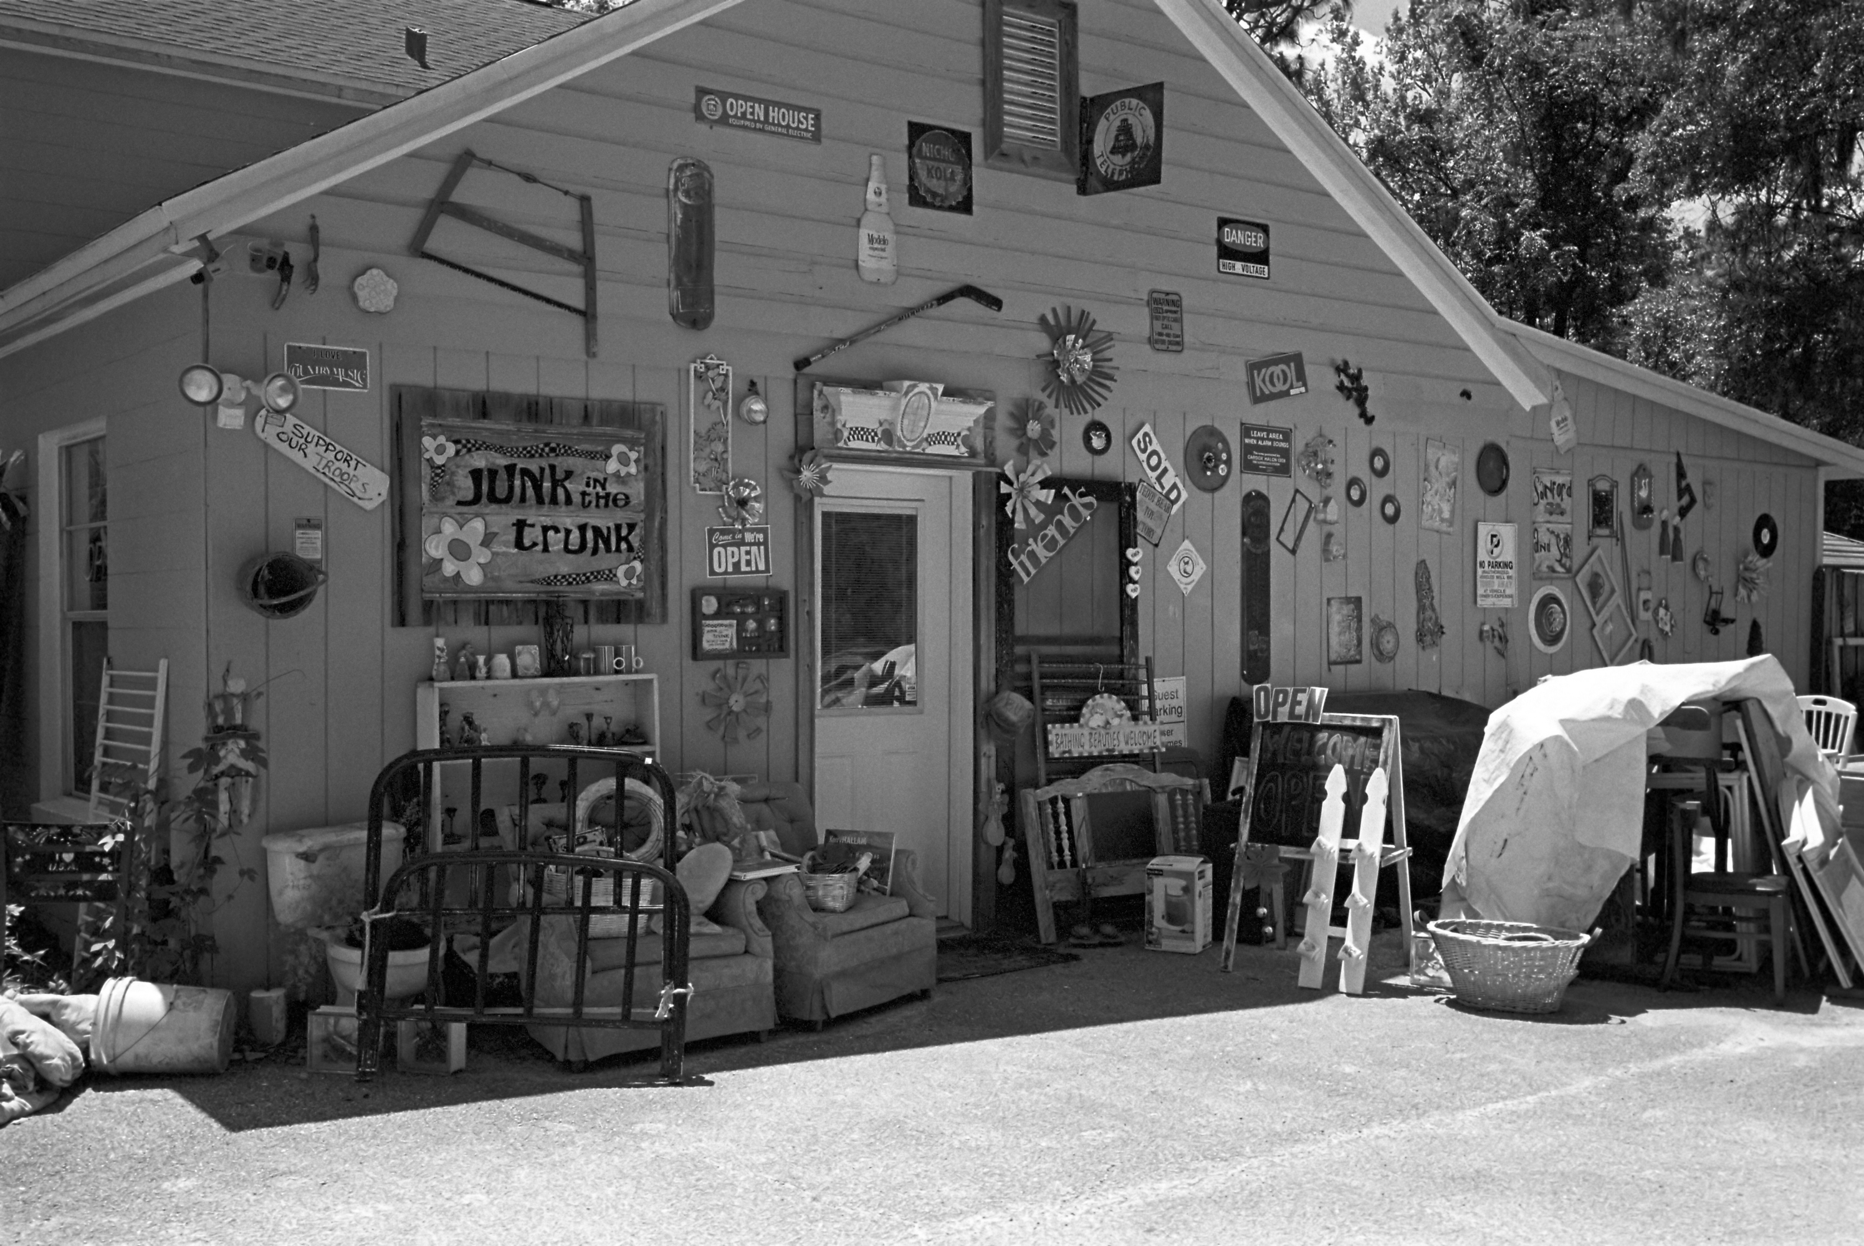
Route 17 South of Yulee 2014
Notes:
2014 Tri X

Slide 18
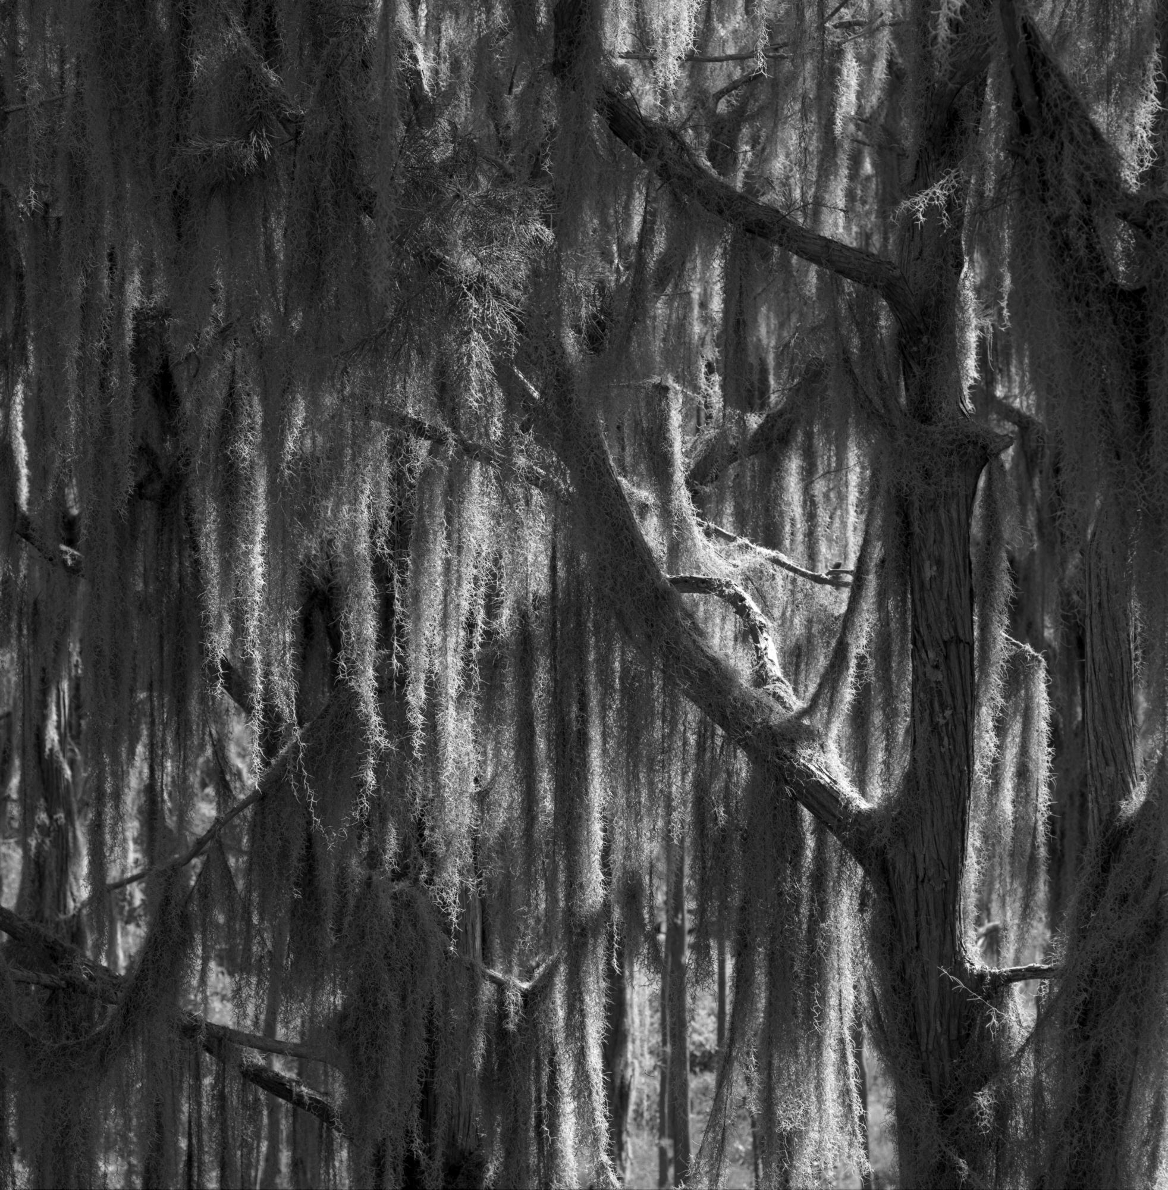
Okefenokee Park 2014
Notes:
2014 Hasselblad Tmax 100

Slide 19
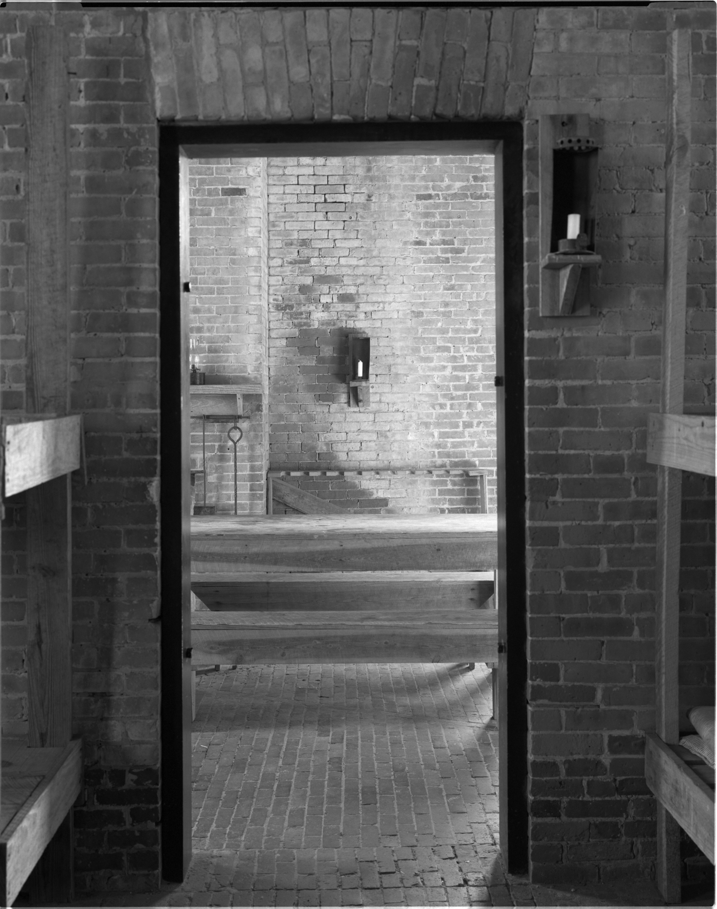
Fort Clinch 2014
Notes:
2014 Zone VI Tri X

Slide 20
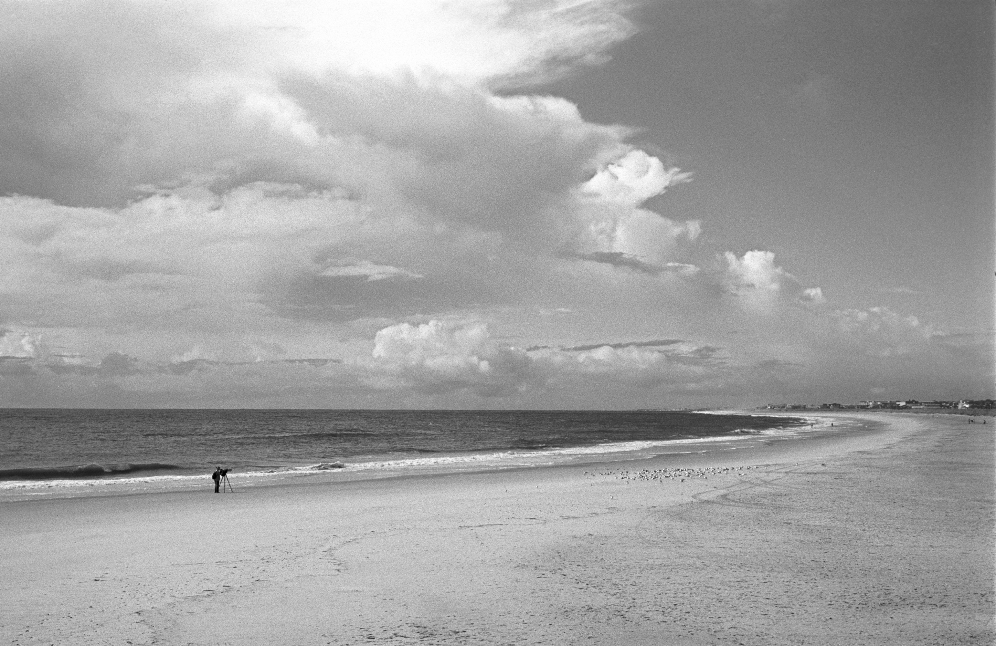
Fort Clinch State Park 2014
Notes:
2015 Delta 100

Slide 21
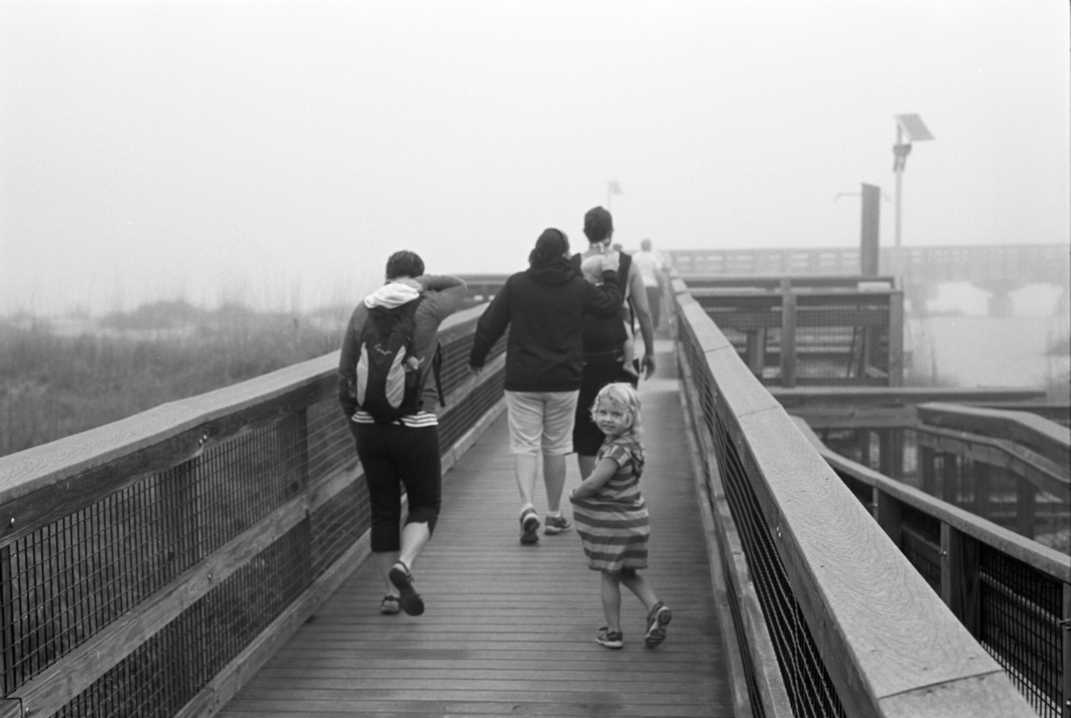
Fort Clinch State Park 2015
Notes:
2015 Ilford Pan F

Slide 22
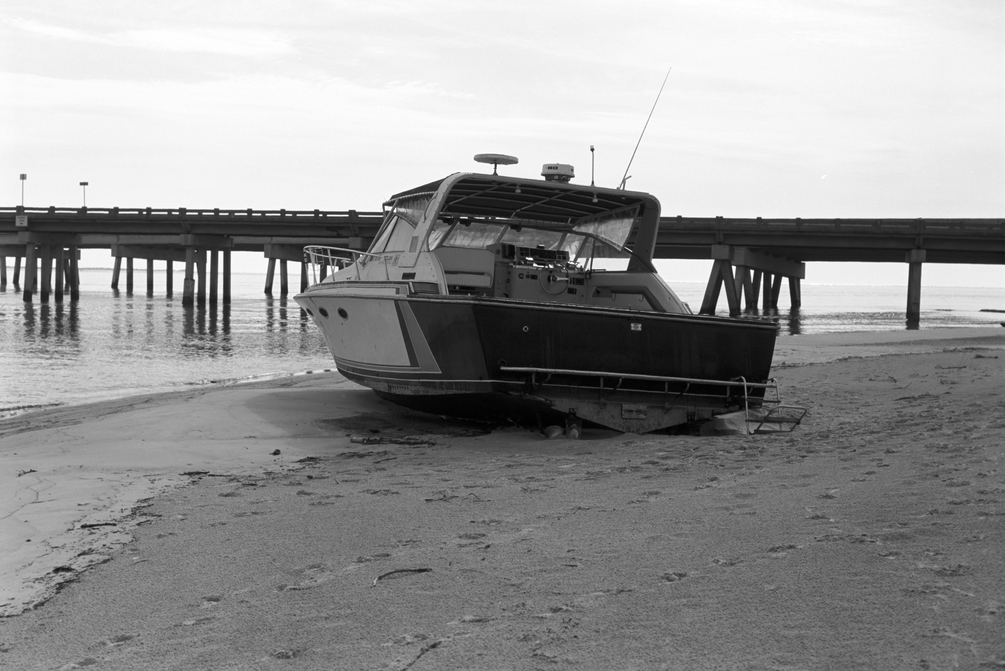
Big Talbot State Park 2015
Notes:
2015 Delta 100

Slide 23
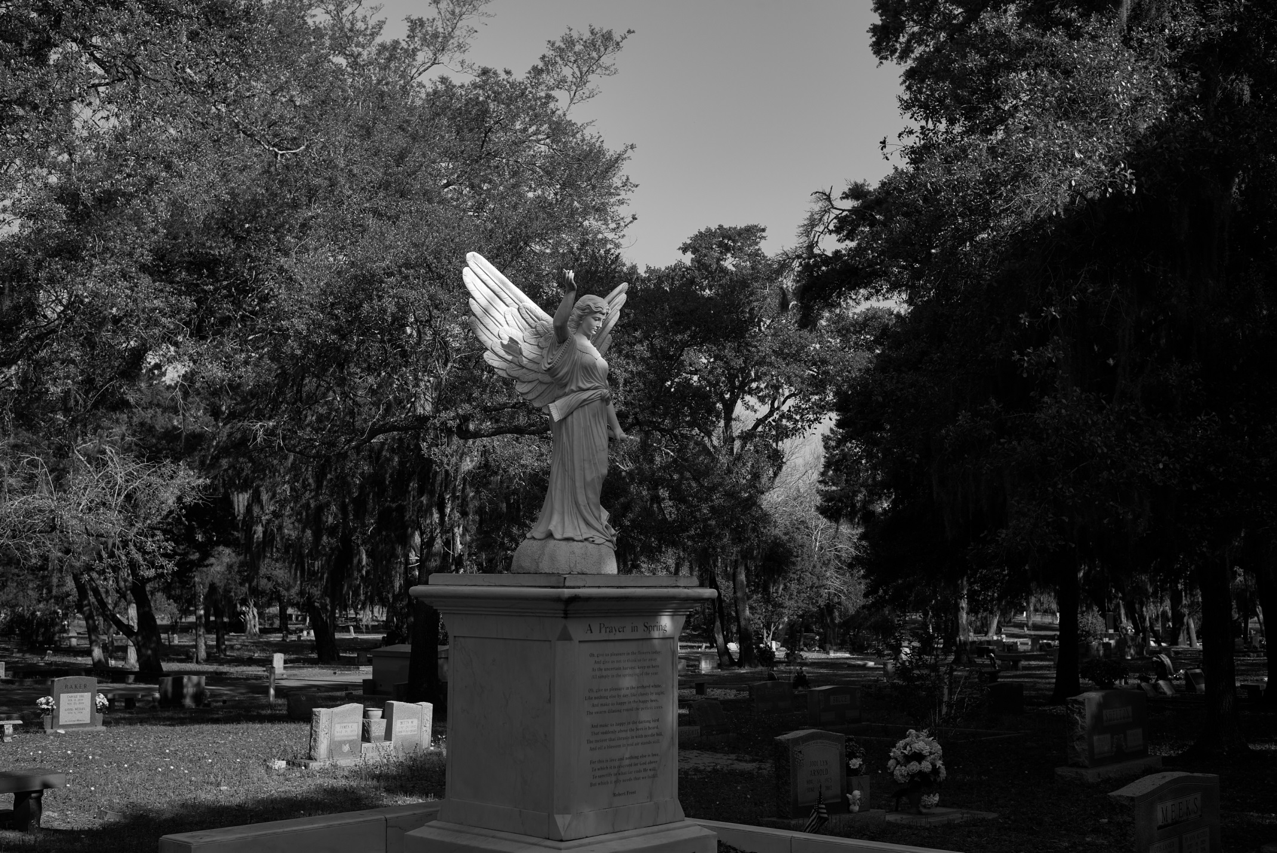
Bosque Bello 2021 (Digital monochrome)
Notes:
A7 II (m)

Slide 24
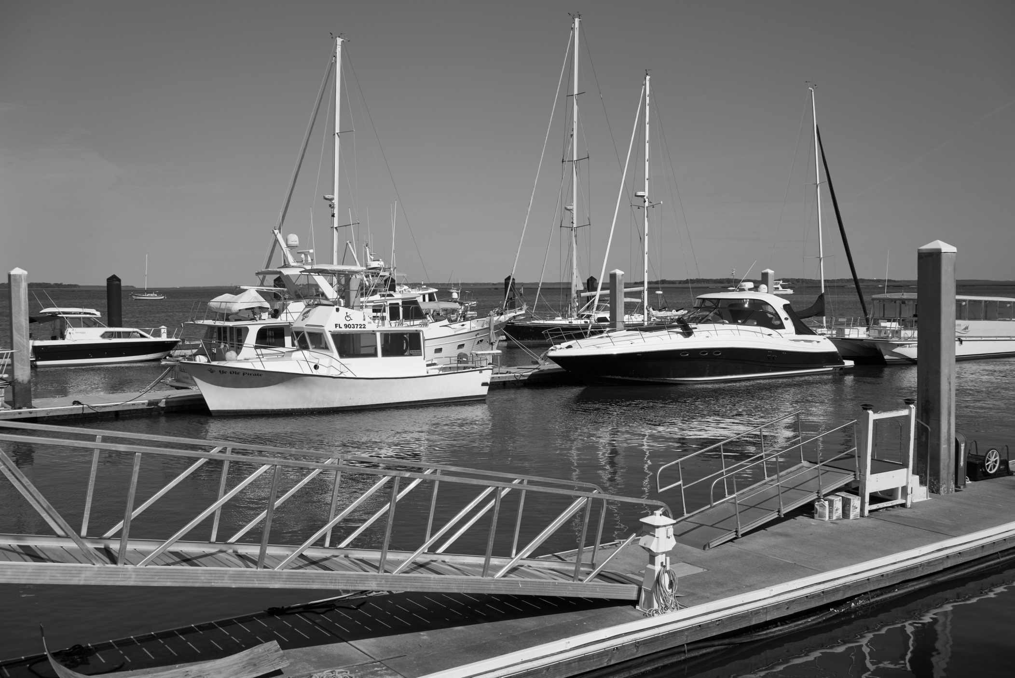
Marina 2021 (Digital monochrome)
Notes:
A7 II (m)

Slide 25
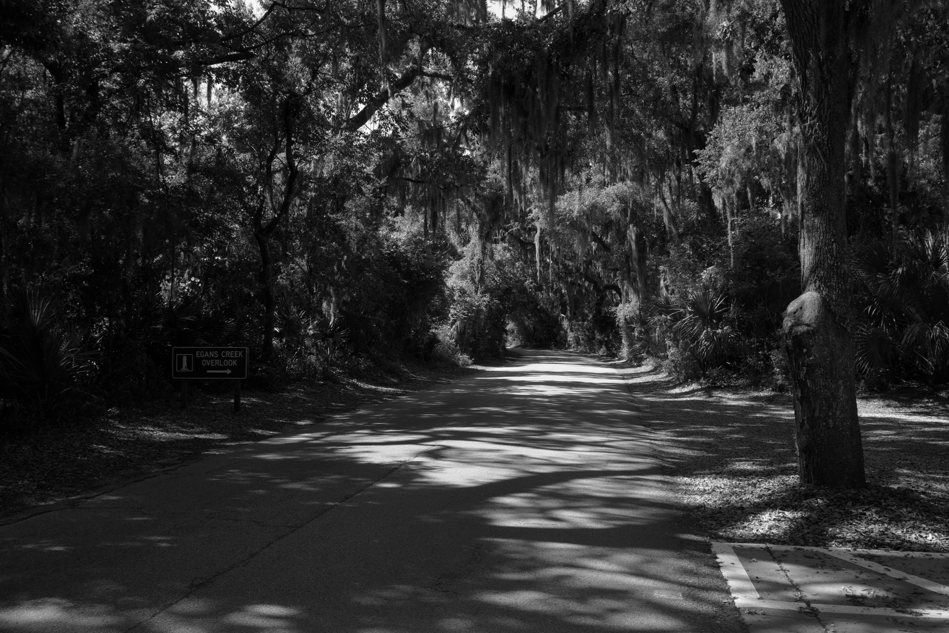
Creek Overlook 2021 Egans (Digital monochrome)
Notes:
A7 II (m)

